Slide 1
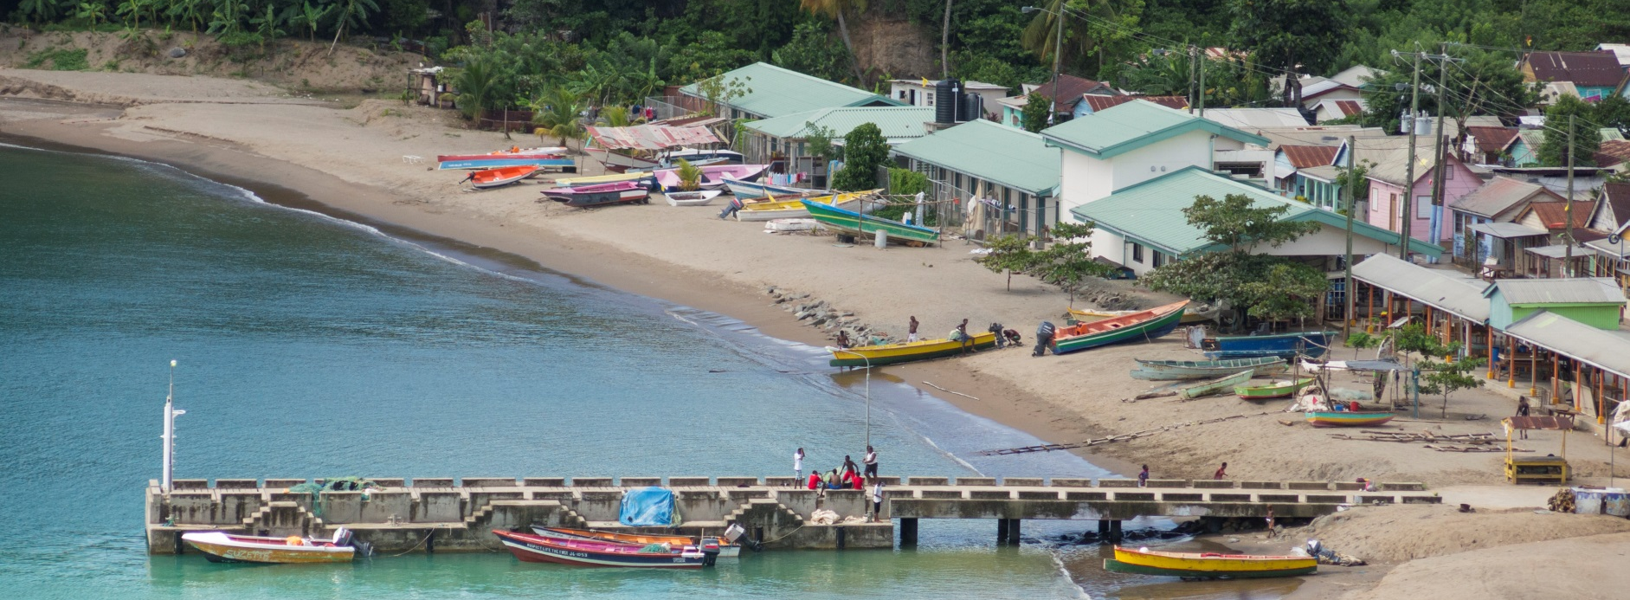
“Fishery-Related Ecological and Socio-Economic Impact Assessments and Monitoring System” Project
Regional Planning Workshop
Kingstown, April 25 & 26, 2018

Slide 2
Workshop objectives
Shared understanding of pathways of climate change impact on fisheries
Clarity on purpose and functions of a “climate-smart fisheries” monitoring system and database
Input on communications goals, activities and messages
Decision on pilot study sites
Decision on Project Working Group
Major output: Report of the Regional Planning Workshop - Scope
Notes:
• Develop a shared understanding of the pathways of climate change impact on ecological and socio-economic components of three fisheries systems (reef, mangrove / seagrass and pelagic ecosystems)
• Clarify the purpose and functions of a climate-smart fisheries monitoring system and related fisheries and environment database
• Discuss options and select pilot study sites for local project activities and eventual implementation of the monitoring system that could best serve the intended functions
• Strengthen communication goals around knowledge, awareness and practice on climate adaptation and disaster risk reduction responses within the Caribbean fisheries sector
• Establish a CRFM PPCR Project Working Group

Slide 3
Agenda

Slide 4
Ground rules
One voice at a time
Share opportunities for air time equally
Don’t let perfection get in the way of progress
You get out what you put in – your perception, knowledge & respect for each other

