Slide 1
Mapping the pathways of climate change and fisheries-sector related socio-economic impacts
Regional Planning Workshop
Kingstown, April 25 & 26, 2018

Slide 2
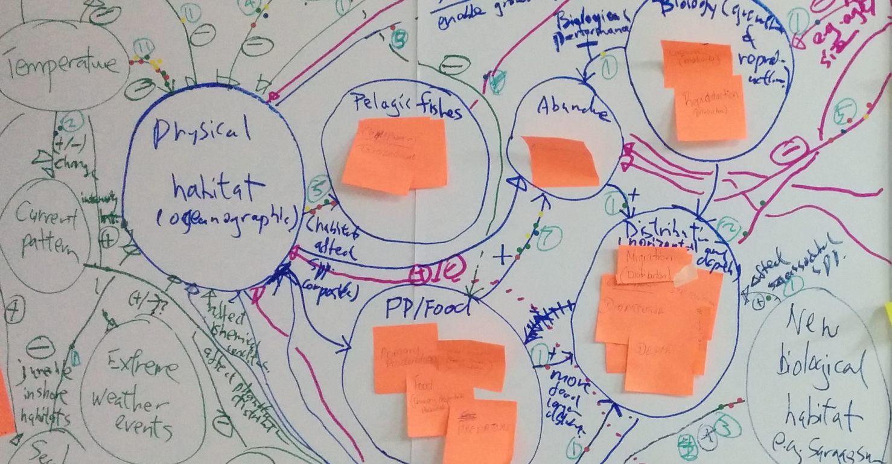
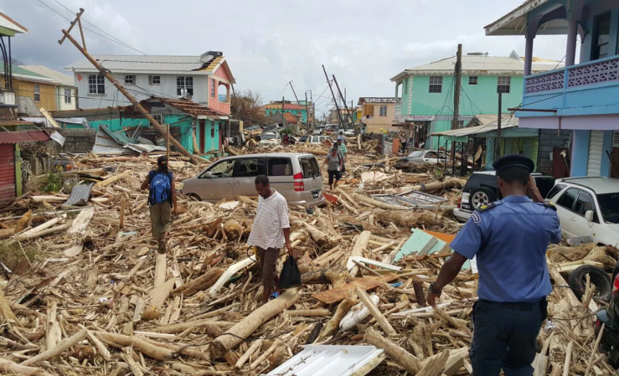
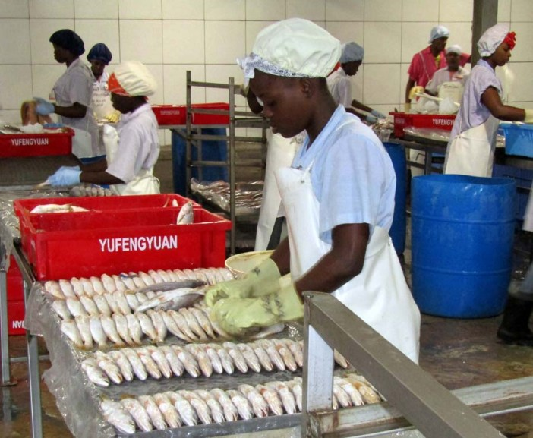
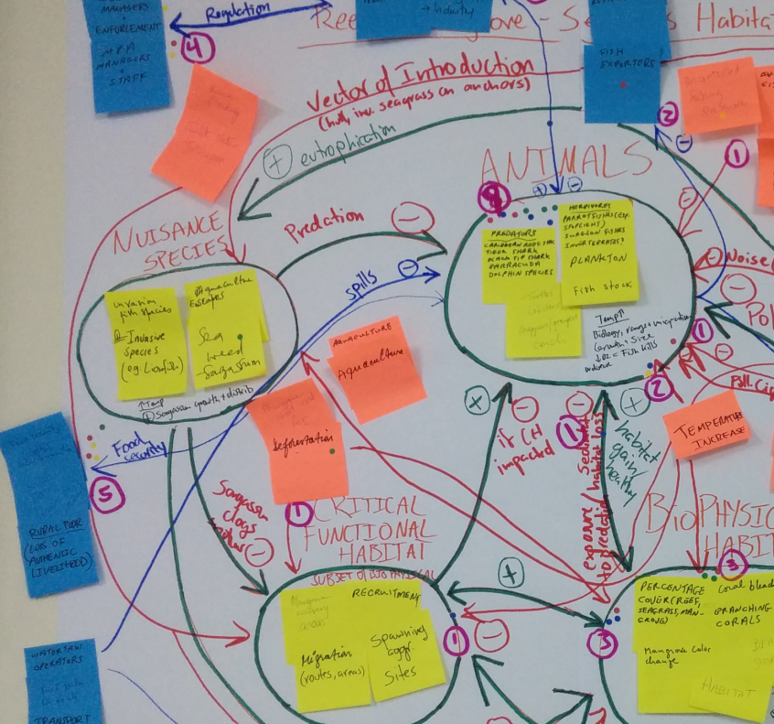
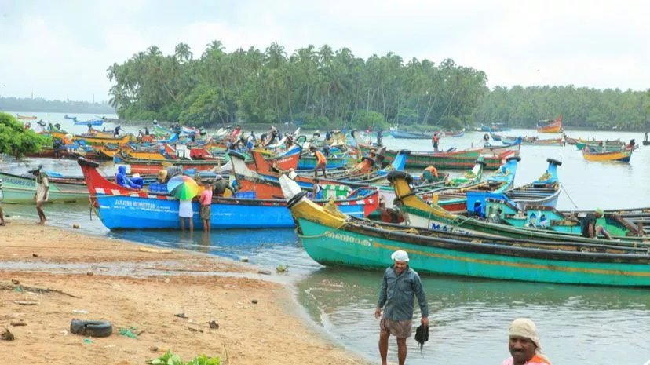
Notes:
Possible impacts of long term climate change trends and short term extreme weather events on Caribbean fisheries include damage to fishing and aquaculture community infrastructure, including roads, harbours, farms and houses caused by sea level rise and stronger storms, as well as unsafe fishing conditions and loss of life at sea as a result of strong storms and hurricanes, according to a 2015 study published by the Food and Agricultural Organisation (FAO).

Slide 3
Probability of impact | Impact
Already happened / happening | Rising mean sea levels at rates similar to the global average, with regional differences in inter-annual variability Shifts in patterns of Atlantic tropical storms, with conflicting evidence of an increase in hurricane intensity or frequency Warming of Caribbean sea-surface temperatures (SSTs) by approximately 1.5°C over the last century Mass coral bleaching events linked to extremely high SSTs increasingly documented Sargassum blooms linked to increased SSTs and other non-climate stressors becoming more common in the past decade Increasing acidity in the Caribbean basin, with seasonal and spatial variations
Expected | Rise in average sea levels in the Caribbean and Atlantic greater than the global average Rise in SSTs, with spatial variation Continued ocean acidification Enhanced hurricane and storm intensity Increased shoreline erosion Widespread changes in the location, numbers and quality of plants and animals (e.g.,): Permanent and seasonal movement of marine fishery resources Changes in species’ community structure Reduced productivity of most marine organisms and ecosystems Reduced fish size Reduced coral reef health and effectiveness in attenuating wave action Collapse of the Mesoamerican barrier reef system by mid-century Increased incidence of marine diseases Shoreward retreat of mangroves, where topography and development allow Drowning of seagrass beds Increased production of the neurotoxin ciguatoxin
Examples of physical and ecological impacts of a changing climate in the Caribbean marine environment (Source: Monnereau and Oxenford, 2017)

Slide 4
Climate change & socio-economic impact pathways in fisheries
Dr Richard Boyd
Economist with 20 years of experience working on climate change & economics issues in Canada, Europe, Asia and Africa, for municipal, state and national governments, banks, insurers, development agencies, and the private sector.
Specializes in economic analysis and implementation of cost-effective adaptation actions.

Slide 5
Climate change & socio-economic impact pathways in fisheries
Specify and understand the goal
Identify bounds of the systems of interest [20 mins]
Links in the fish chain
Identify key components and interactions [30 mins]
Supporting assets and human resources
Describe relationships of stressors with key components [45 mins]
Climate stressors (4) → physical impact → economic and social consequences
Non-climate stressors
Identify priority pathways of impact and indicators [25 mins]
Report to plenary, identify important country-specific differences [30 mins]

Slide 6
1. Specifying and understanding the goal
Identify the likely social and economic impacts of climate change on the fisheries sector:
Reef-seagrass-mangrove fisheries
Pelagic fisheries

Slide 7
2. Identify bounds of the systems of interest
Links in the fish and marine resource chain
Activities and actors

Slide 8
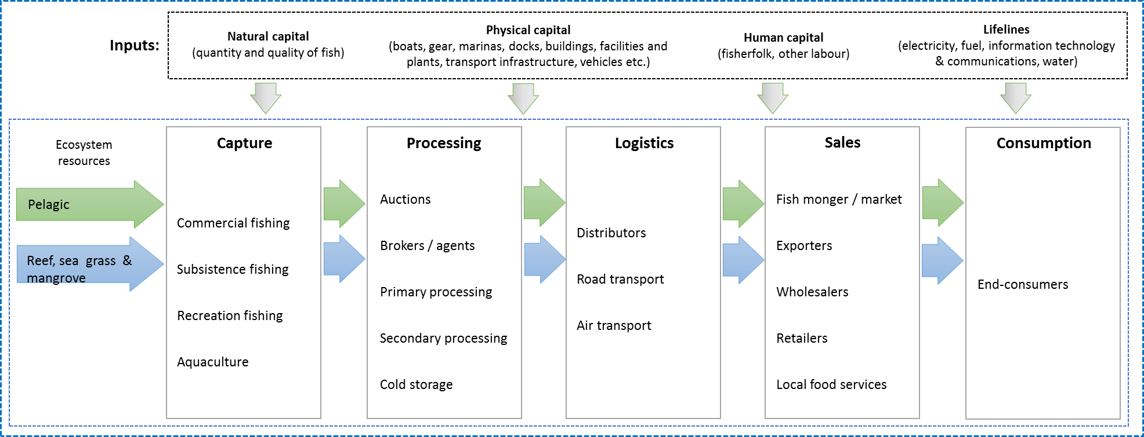
3. Identify key components and interactions

Slide 9
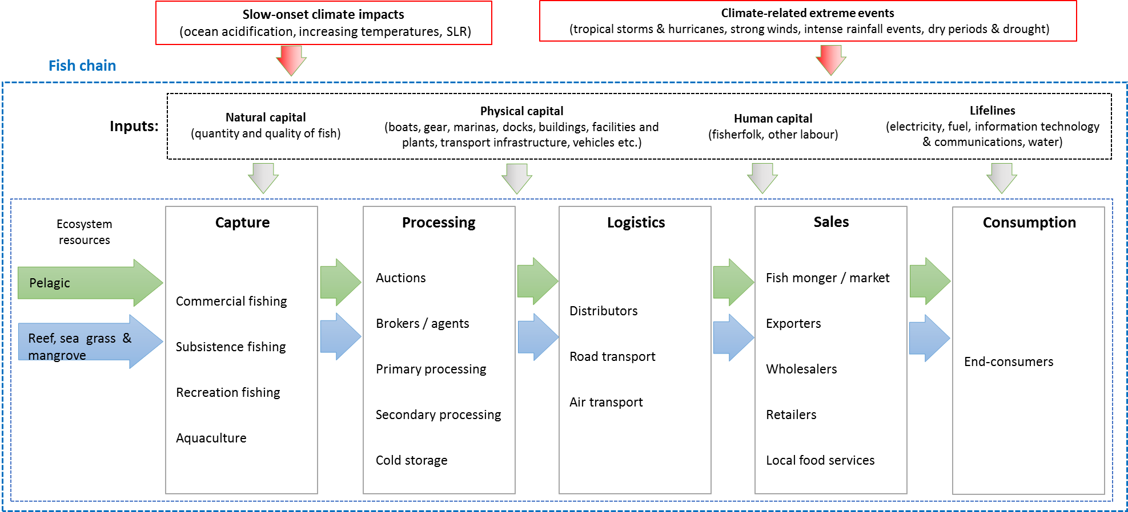
4. Describe relationships of stressors with key components
Physical & environmental changes (due to CC/CV)
Economic and social consequences of these changes (+/- or neutral)

Slide 10
Climate influences
What are key climate change variables that will affect the system?
4 in total
Slow onset and climate-related extremes
What components of the system will be affected?
What are the economic and social consequences of these effects?
What is the direction of these effects (positive or negative)?
What other stressors affect the system?

Slide 11
5. Identify priority pathways of impact and indicators
Of the impact pathways identified, which is likely to have the greatest magnitude of impact? [sticky dot exercise]
What would be a way of trying to measure that impact?

Slide 12
6. Report to plenary
Volunteers from each group explain resulting conceptual model

