Slide 1
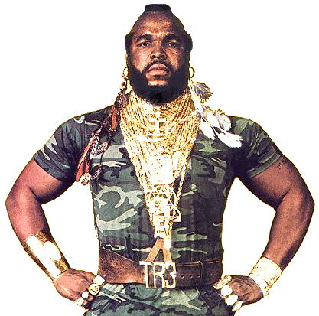
Value chains:
A primer
Ahmed Khan, PhD
Khan & Associates Sustainability Consulting Inc.
Jacksonville, FL, USA| Ottawa, ON, Canada

Slide 2
WP1: Value Chains and Socio-Economic Impact Assessments

Slide 3
WP1: Value Chains and Socio-Economic Impact Assessments
Fish
Species
Commodity
Food
Sustainability
Trade & livelihoods
Nutritional well-being

Slide 4
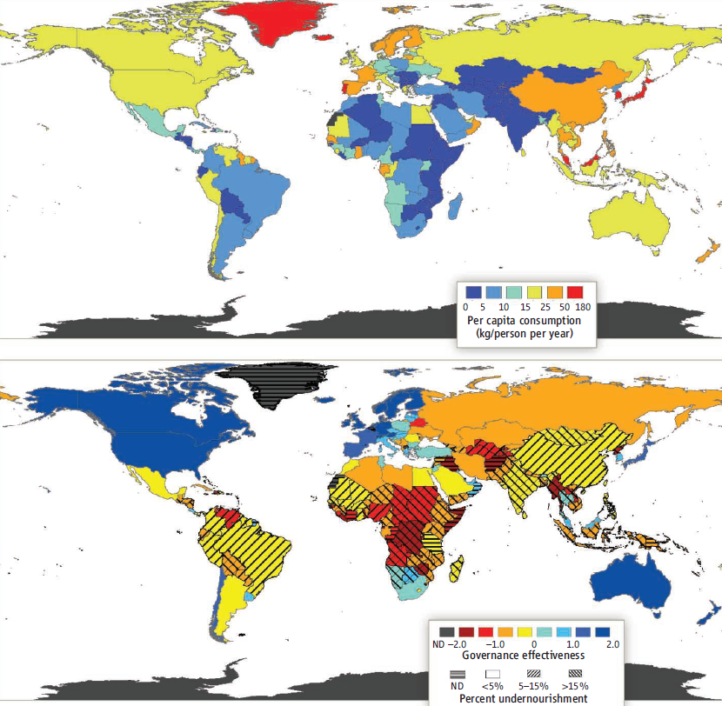
Seafood contribution to global trade and nutrition
Smith et al., 2010: Science

Slide 5
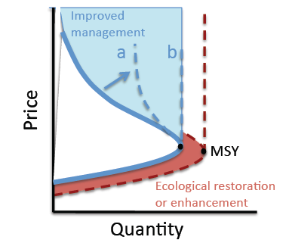
Seafood contribution to global trade and nutrition
Smith et al., 2010: Science

Slide 6
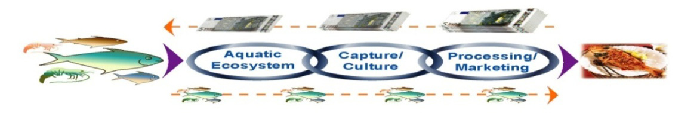
Fish chain: A systems approach to fisheries
Bavinck et al. 2008: An interactive governance to fisheries

Slide 7
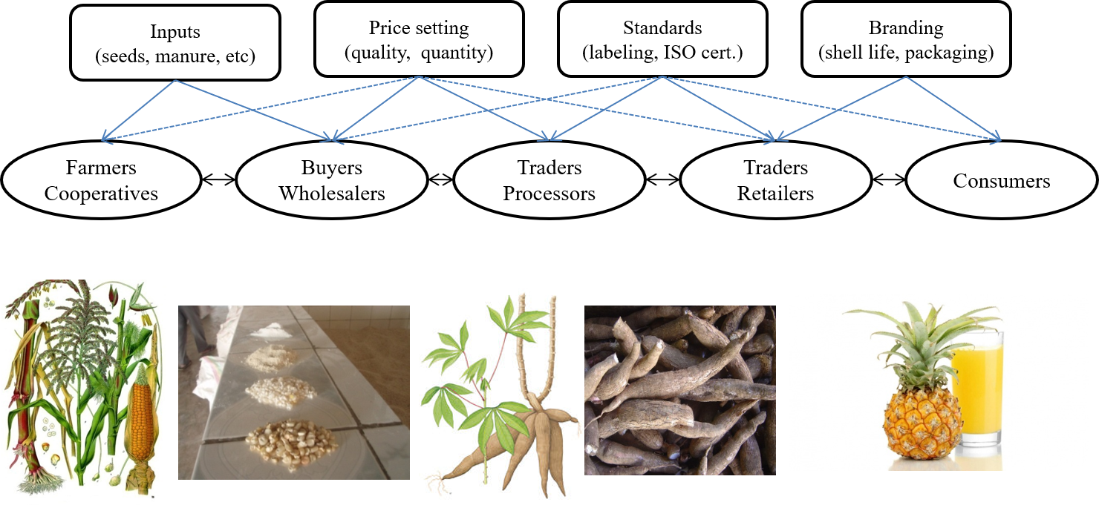
Khan et al: In press Regional Environmental Change

Slide 8
Resource management &
conservation policy instruments
Fishing regulatory
instruments
Market-based instruments &
consumer awareness measures
Policy instruments
Inter-linkages
Inter-linkages
Pre-harvest
(marine ecosystems)
Harvest
(fishing activities)
Post-harvest
(process & marketing)
Production stages
Social interactions
Social interactions
Bureaucrats Managers Fishers Enforcers Processors Plant workers Retailers Consumers
Conservation groups trade unions Coastal communities Financial institutions Media Citizens
Key
stakeholders
Khan and Chuenpagdee 2013 : Ambio Journal of Human Environment

Slide 9
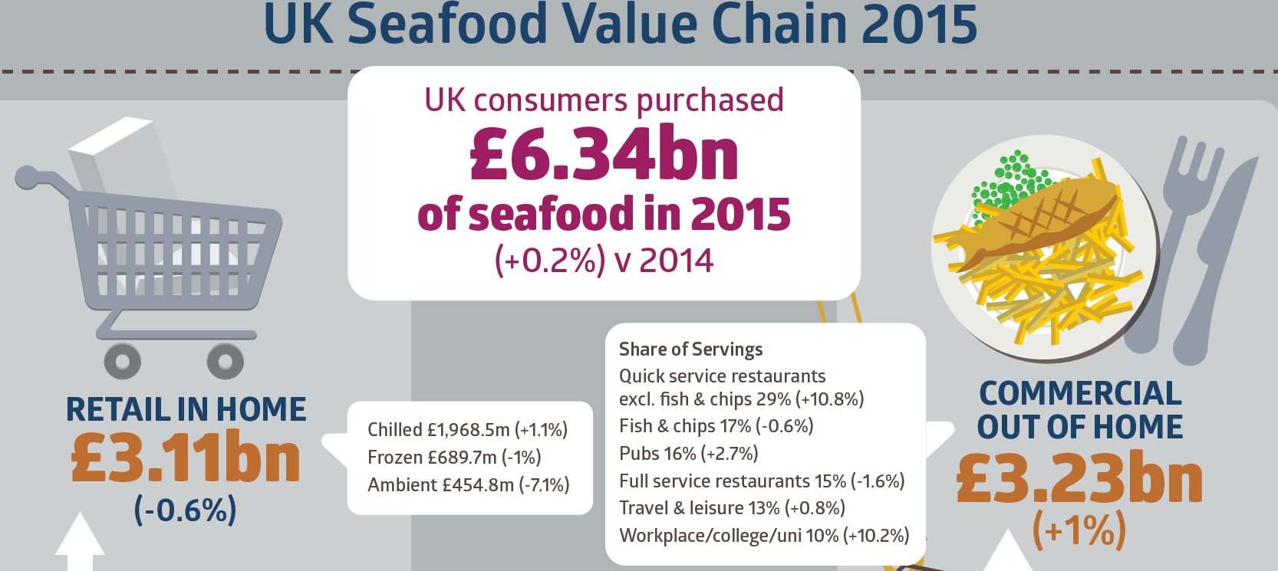
Source: Seafish TNC Khan, 2010: Sustainability Purcell et al. 2018: Marine Policy

Slide 10
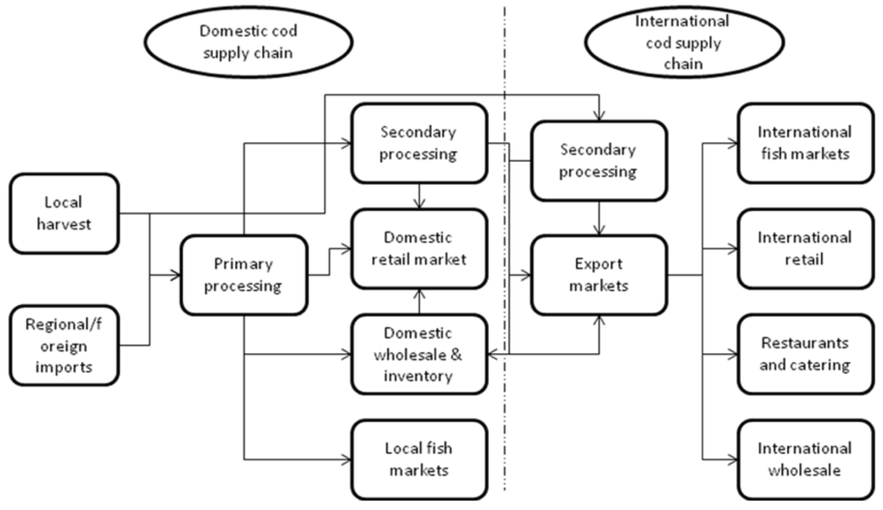
Source: Seafish TNC Khan, 2010: Sustainability Purcell et al. 2018: Marine Policy

Slide 11
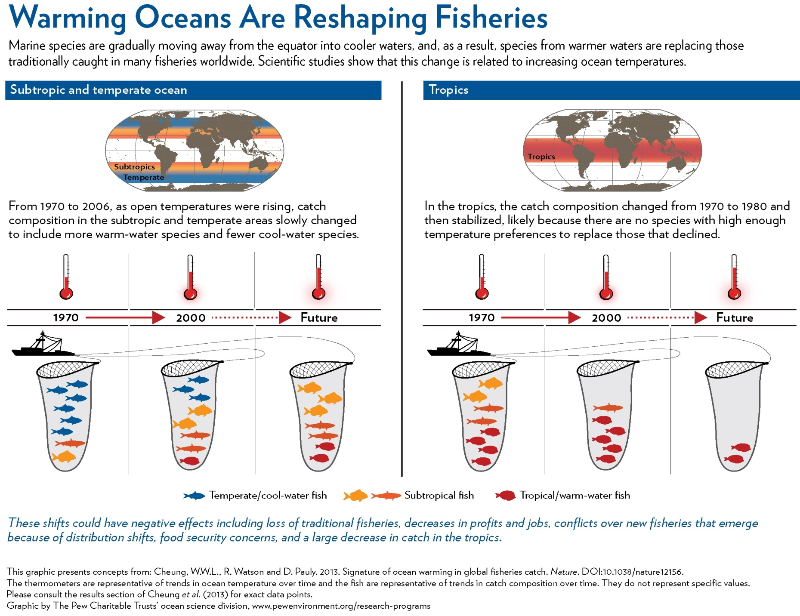

Slide 12
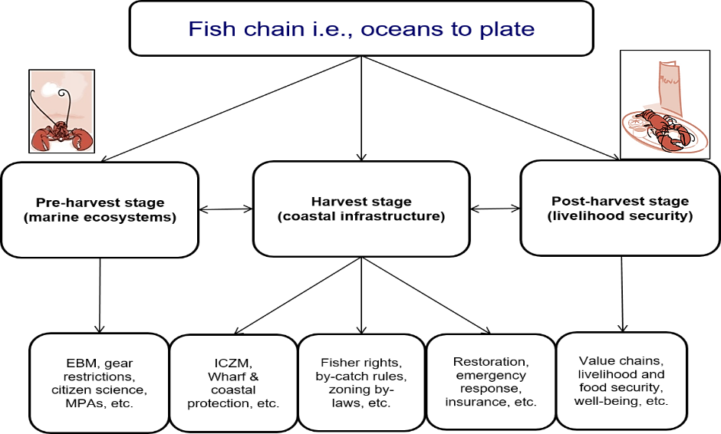
Khan et al. 2016: Climate Policy

Slide 13
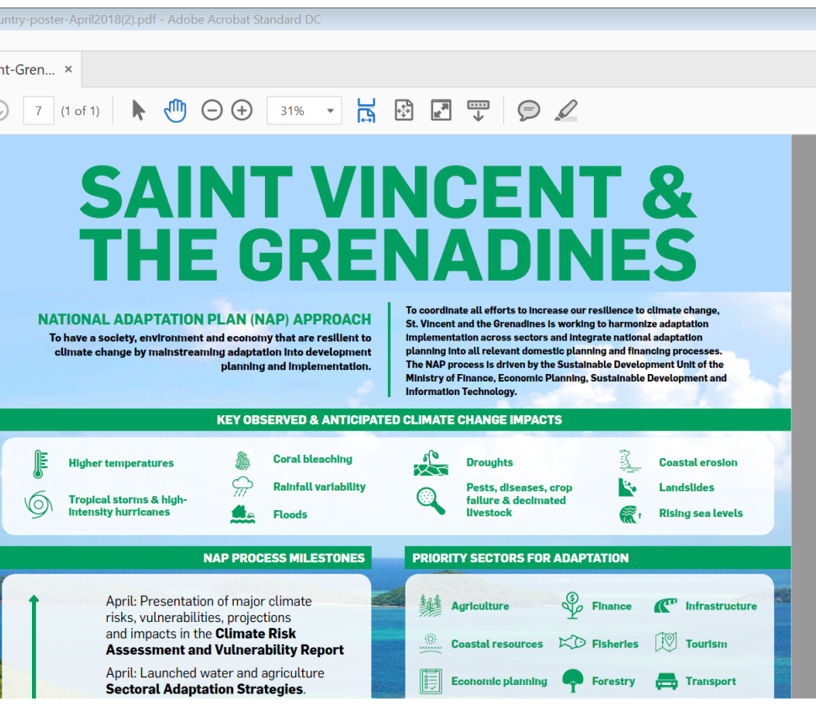
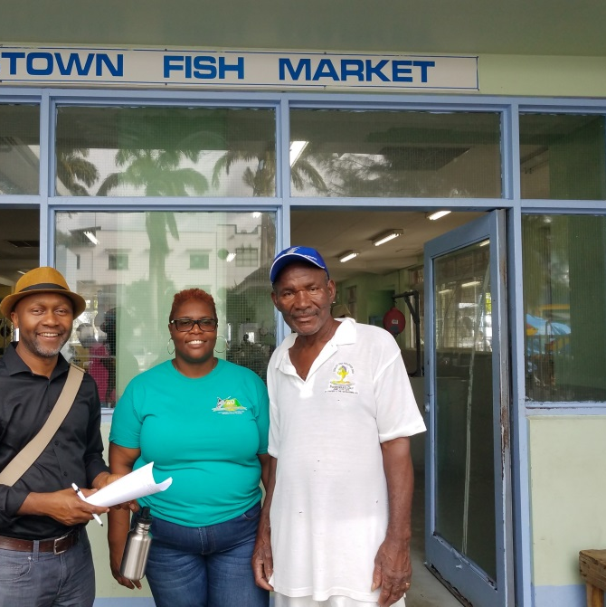
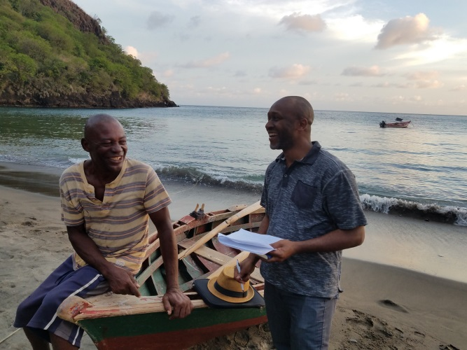
WP1: Field instruments
Managers and public administrators
  Organizational and institutional vision on synergies
  Cross linkages on adaptation and fisheries co-benefits and spatial planning
  Policy networks
Resource users and fishing livelihoods
  Resource use and fishing activities
  Livelihood vulnerability to climate stressors
  Cost and earnings of fishing performance under various scenarios
Post-harvest opportunities
  Product differentiation (fresh, filleted, frozen, canned, smoked, etc.)
  Value addition and up-scaling initiatives (eco- branding, traceability)
  Exploring market and consumer preferences
Climate risks and policy responses
  Enablers and barriers
  Coping mechanisms and adaptive responses
  Policy instruments and governance options
  Contributions to NAPS and SDGs (e.g. 14)

Slide 14
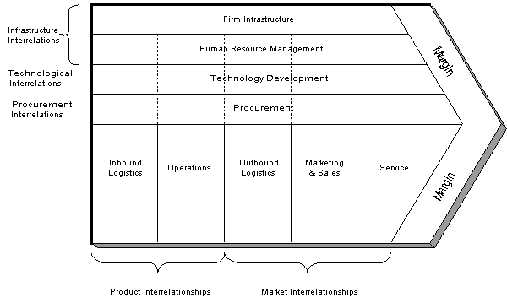
Porter 1985: Competitive Advantage

Slide 15
Slow-onset climate impacts
(ocean acidification, increasing temperatures, SLR)
Climate-related extreme events
(tropical storms & hurricanes, strong winds, intense rainfall events, dry periods & drought)
Fish chain
Natural capital
(quantity and quality of fish)
Physical capital
(boats, gear, marinas, docks, buildings, facilities and plants, transport infrastructure, vehicles etc.)
Human capital
(fisherfolk, other labour)
Lifelines
(electricity, fuel, information technology & communications, water)
Inputs:
Ecosystem resources
Capture
Processing
Logistics
Sales
Consumption
Oceanic pelagic
Auctions
Brokers / agents
Primary processing
Secondary processing
Cold storage
Fish monger / market
Exporters
Wholesalers
Retailers
Local food services
Commercial fishing
Subsistence fishing
Recreation fishing
Aquaculture
Distributors
Road transport
Air transport
Reef & shallow shelf
End-consumers
Deep slope
Shrimp & groundfish
Tangible (market values) impacts and consequences
Intangible (non-market values) impacts and consequences
Notes:
Each stage in supply chain or activities in a stage will not be relevant to all fish groups or locations. Each stage will have its own mix of inputs. Each input will have an inherent vulnerability (propensity for harm) to specific climate stimuli.

Slide 16
Climate stressor?
Bio-physical Impacts?
What direct bio-physical impacts result from the climate stressor (storm can result in flooding, strong winds)?
Direct impacts on fishery sector?
What are the resultant direct physical impacts on applicable inputs to the fishery supply chain?
Consequences for the fishery sectors?
E.g., a storm, hurricane, intense rainfall event, SLR, etc.
What are the resultant financial, safety & social consequences?
Flow-on effects?
Formulation of impact-pathways with stakeholders.
Priority impact-pathways established and rated / scored
Priority impact-pathways quantified
Effects defined and estimated for priority impact-pathways.

Slide 17
SEI Pathways for a tropical storm
Frequency of extreme events
Flooding
Winds
Rough seas
Temporary interruption to fishing
Damage electricity T&D network
Power outage
Interruption of processing
Interruption of cold storage
Loss of net income
Etc.
Damage to fishing vessels
Increased maintenance costs
Loss of net income for fishers
Vessels continuing to fish
Longer travel times
Safety risk for fishers
Increased (fuel, labour) operating costs
Mental health
(stress, anxiety)
Injuries and potential fatalities
Destruction and loss of traps
Loss of net income / increased costs
Damage to docks, marinas, etc.
Etc.
Disruption to transport routes
Disruption of access to downstream supply chain
Etc.
Foregone income

Slide 18
 | Metrics and indicators
Pre-harvest stage (Marine ecosystems) | Maximum catch potential
 | Habitat suitability indices
 | Ocean acidity or PH
 | Stock migration range
 | Fish stock index
 | Marine Trophic index
 | Area of MPA
 | Patchiness
 | SST, etc.
Harvest (fishing activities) | Fishing effort (days at sea, fuel use, etc.)
 | Fleet types and characteristics
 | TACs
 | Landings
 | Seafood consumption
 | Net production
 | Export and import
 | Fishing as % household income
 | Loss and damage, etc.
Post -harvest (processing and marketing) | Landed value
 | Ex vessel price
 | Viability (economic/profitability/ect.)
 | Operational cost
 | ROI
 | % value addition
 | Market destinations, etc.

Slide 19
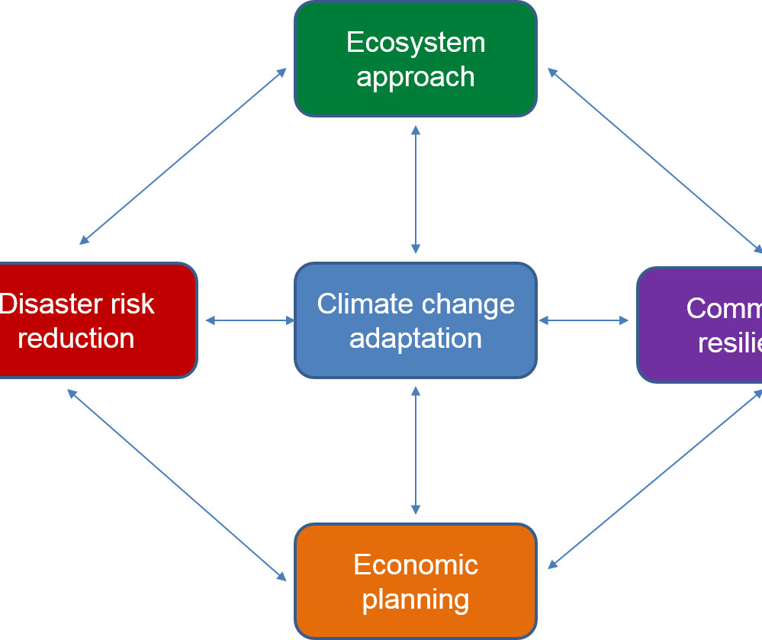
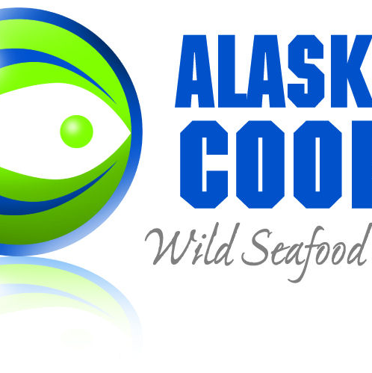
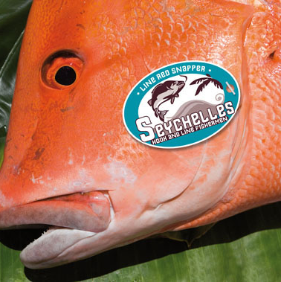

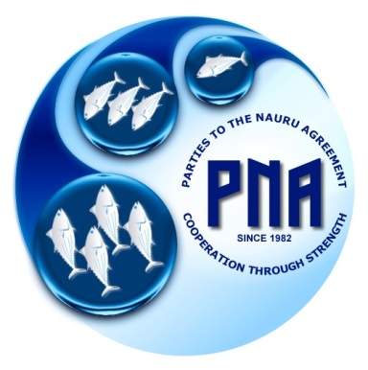
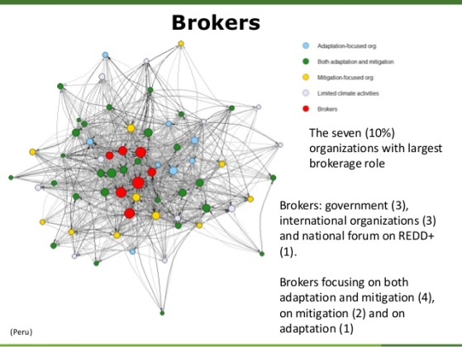
So what? Entry points, BMPs, and innovative interventions
Regional stocks agreements (e.g. PNA, IPHC)
Synergies and complementarities – NAPs + ICZM
  Hard and soft coastal interventions
PPP for insurance and loss and damage
Fiscal incentives and inclusive policy instruments
Fisher cooperatives as catalyst for change for stewardship & eco-branding
Policy networks & co-benefits
NGOs as policy brokers

Slide 20
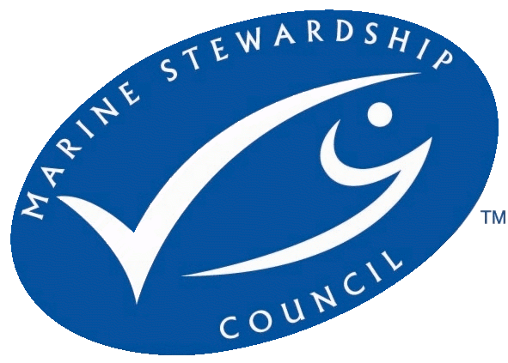
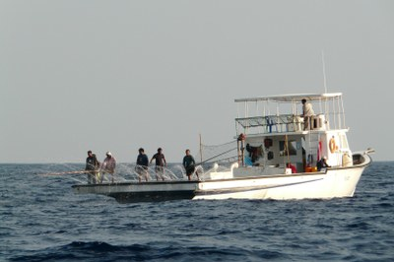
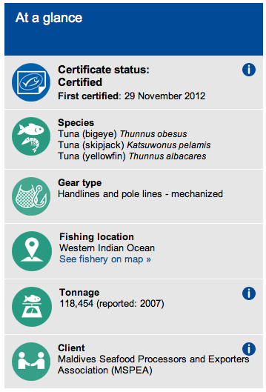
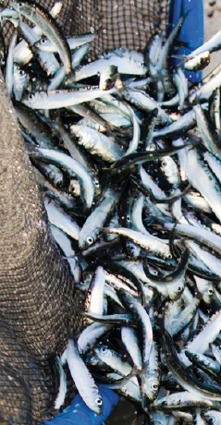

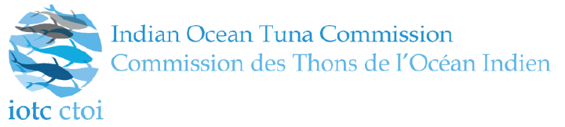
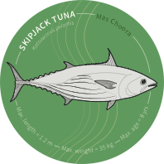
MSC Certified Maldives Pole & Line Tuna – an example

Slide 21
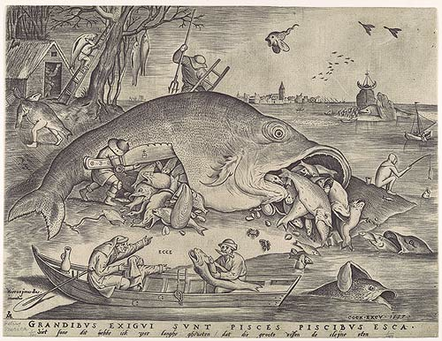
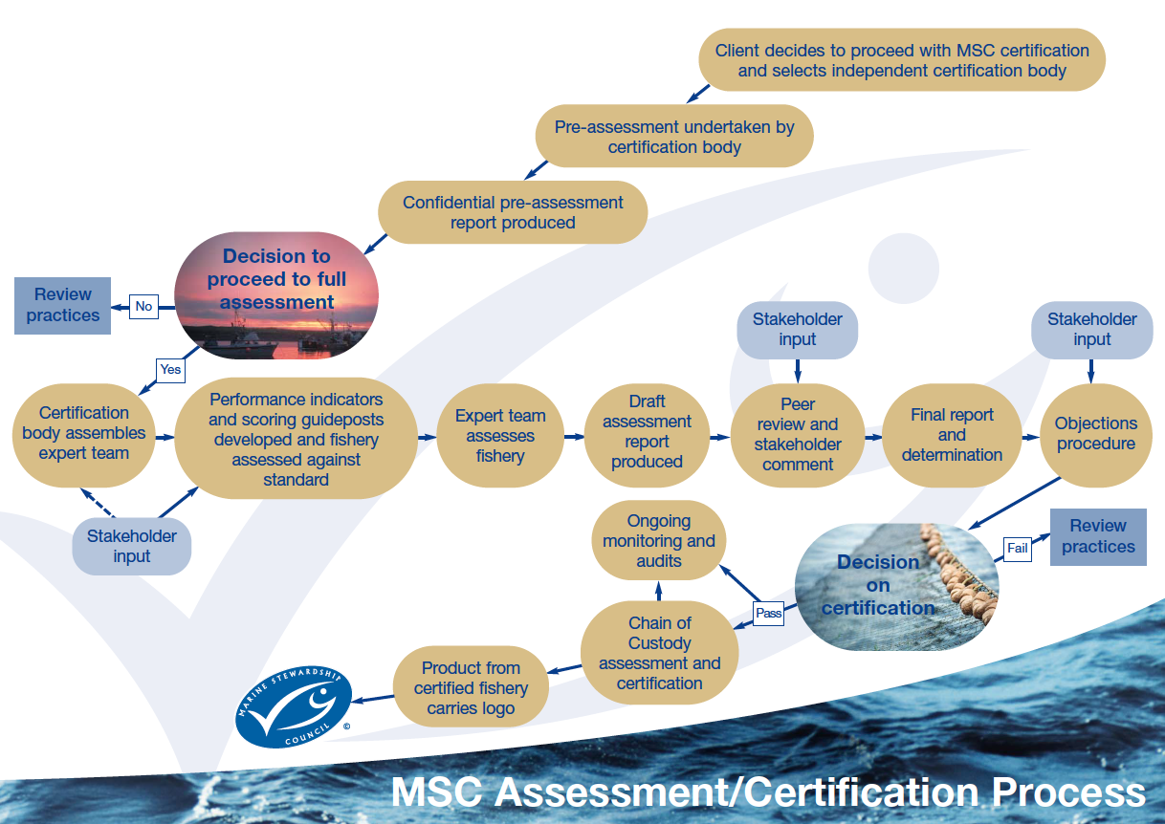
Target Species
Ecosystem
Management
Pieter Bruegel the Elder’s "Big Fish Eat Little Fish”, 1557.

