Slide 1
Module 3: Ecological and Economic Impacts of Climate Change on Caribbean Fisheries
PRESENTERS
Location, Date
Produced by ESSA Technologies Ltd. for the Investment Plan for the Caribbean Regional Track of the Pilot Programme for Climate Resilience

Slide 2
Objectives
Highlight key findings from assessment of climate change effects on Caribbean marine ecosystems and fisheries
Highlight key findings from assessment of economic consequences of fisheries climate change impacts
Notes:
This presentation summarizes key results of quantitative climate change impact assessment undertaken as part of the project.

Slide 3
Climate Change Effects On Caribbean Marine Ecosystems and Fisheries
W. Cheung, G. Reygondeau and C. Wabnitz
Changing Ocean Research Unit, Institute for the Oceans and Fisheries, The University of British Columbia, Canada
Notes:
====
Notes:
[Prior to sharing results of the ecological modelling work we recommend reading and becoming familiar with the contents of paper A: Climate Change Effects on Caribbean Marine Ecosystems and Fisheries – Regional Projections, as well as paper B: Climate Change Effects on Caribbean Marine Ecosystems and Fisheries – National Projections for Six Case Study Countries – Jamaica, Haiti, Dominica, St. Lucia, St. Vincent and the Grenadines and Grenada.]
[The slide acknowledges the Changing Oceans Research Unit at the University of British Columbia.]
[The next 24 slides present highlights from the ecological assessment work. It draws on some of the research, there is the potential to extract much more, depending on your objectives and target audience.]

Slide 4
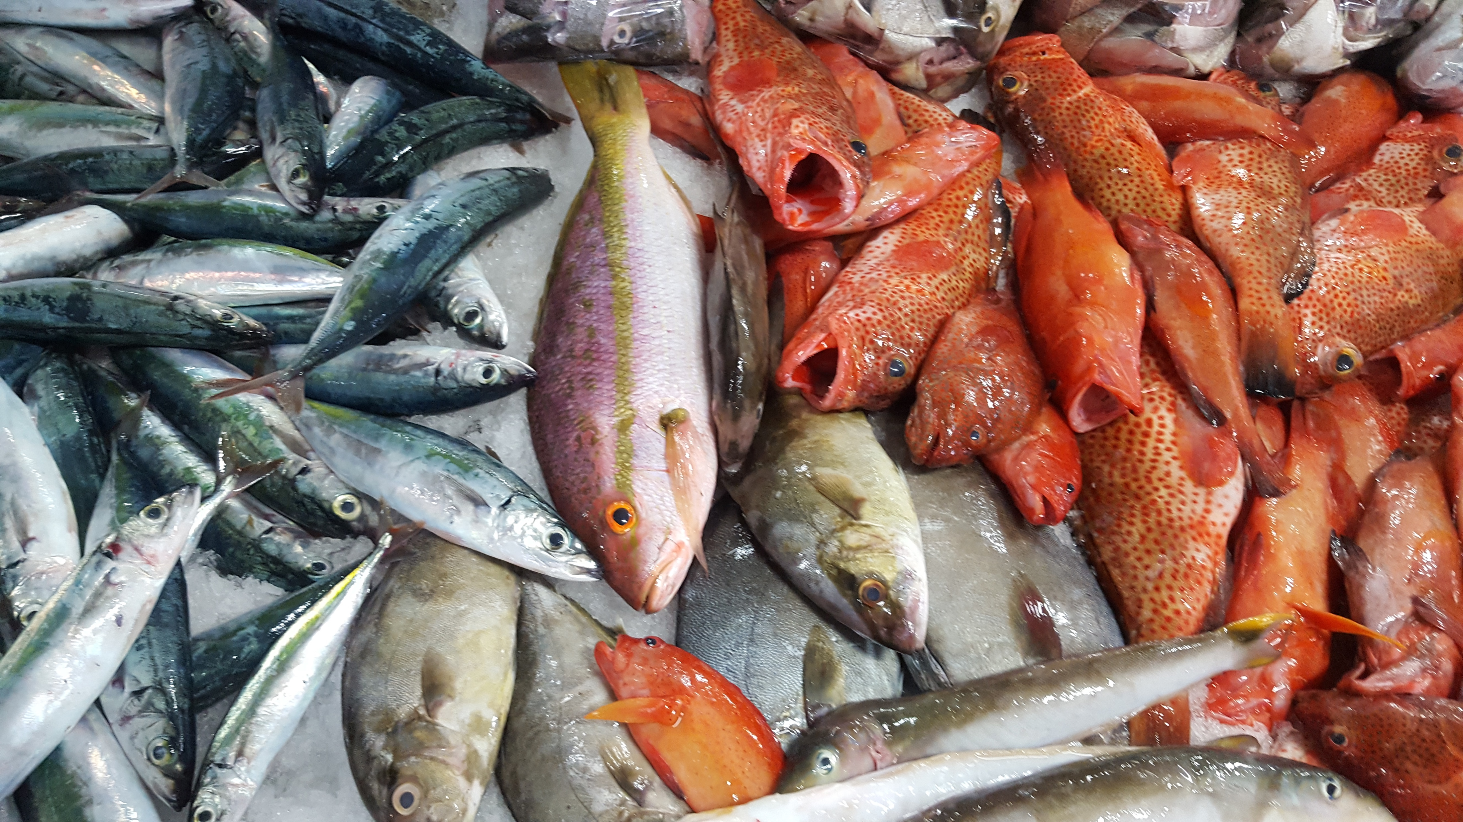
Objective
To assess the ecological impacts of climate change and variability on Caribbean fisheries
Notes:
Climate change affects marine species and fisheries in a number of ways. Changes in temperature and other ocean conditions affect the biology of species, affect population-level dynamics such as growth, abundance and distribution. This then affects species’ assemblage and community structure. In turn, this affects fisheries through changes in species composition of catch or maximum catch potential, and the economics of fishing. This study explored the potential effects of the changing climate primarily through exploring the influence of climatic and oceanographic variables on species distributions, richness and potential catch.
====
Notes:
[This was the objective of the ecological assessment work.]

Slide 5
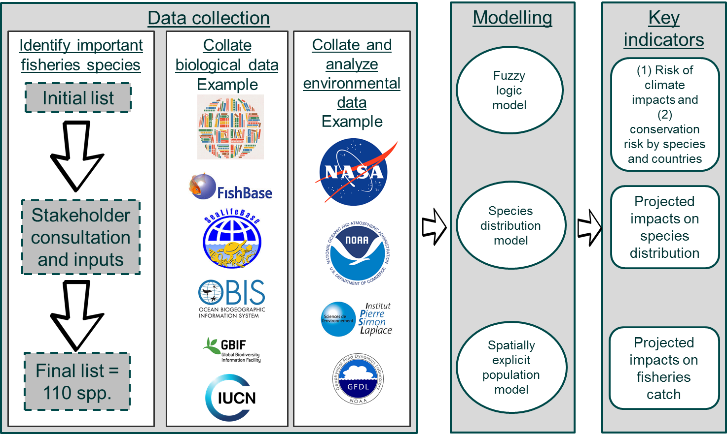
Overall Framework
Notes:
This slide summarizes the overall research framework adopted, which included a data collection phase, modelling and derivation and presentation of key indicators.
To assess climate risks for Caribbean marine fish stocks and fisheries, a first step was to assemble three linked datasets: (1) the list of key species, agreed to together with stakeholders, this assessment should focus on; (2) occurrence data for species identified in (1), as well as life history (e.g., age at maturity) and ecological data (e.g., depth) associated with these species; and (3) variables that globally define the marine environment obtained from a number of separate model outputs.
These data are inputs into three distinct analytical approaches, which we will touch on in the next few slides, to project results to 2050s for the series of indicators shown here on the right. The use of multiple lines of evidence in projecting climate change impacts is a best practice in climate change research, given the uncertainty in understanding and capturing interactions among climatic, environmental and biological factors.
====
Notes:
**Fisheries species: In concert with regional stakeholders, the team identified 110 priority species to model: 2 species of marine mammals (humpback whale and common bottlenose dolphin), 2 species of algae (belonging to the genus Sargassum), 7 species of invertebrates (queen conch, Caribbean spiny lobster and 5 species of sea cucumber), and 99 species of fish
**Occurrence, life history and ecological data came from from published databases including FishBase, SeaLifeBase, the Sea Around Us database, Ocean Biogeographic Information System (OBIS – www.iobis.org), the Intergovernmental Oceanographic Commission of UNESCO (IOC – ioc-unesco.org), the Global Biodiversity Information Facility (GBIF – www.gbif.org), FishBase (www.fishbase.org), and the International Union for the Conservation of Nature (IUCN – http://www.iucnredlist.org/technical-documents/spatial-data).
**Fisheries catch time series used in the analysis consisted of total “reconstructed” fisheries catches, as available from the Sea Around Us database for the region as a whole, and for each of the 6 focal countries.
**Environmental data (ocean, climate) derived from outputs of a subset of three Earth system models (ESM) made available as part of the fifth phase of the Ocean-Atmospheric Coupled Model Intercomparison Project (CMIP5): the Geophysical Fluid Dynamic Laboratory Earth System Model 2G (GFDL ESM 2G), the Institut Pierre-Simon Laplace Climate Model (IPSL-CM5A-MR), and the Max Planck Institute Earth System Model (MPI-ESM-MR).

Slide 6
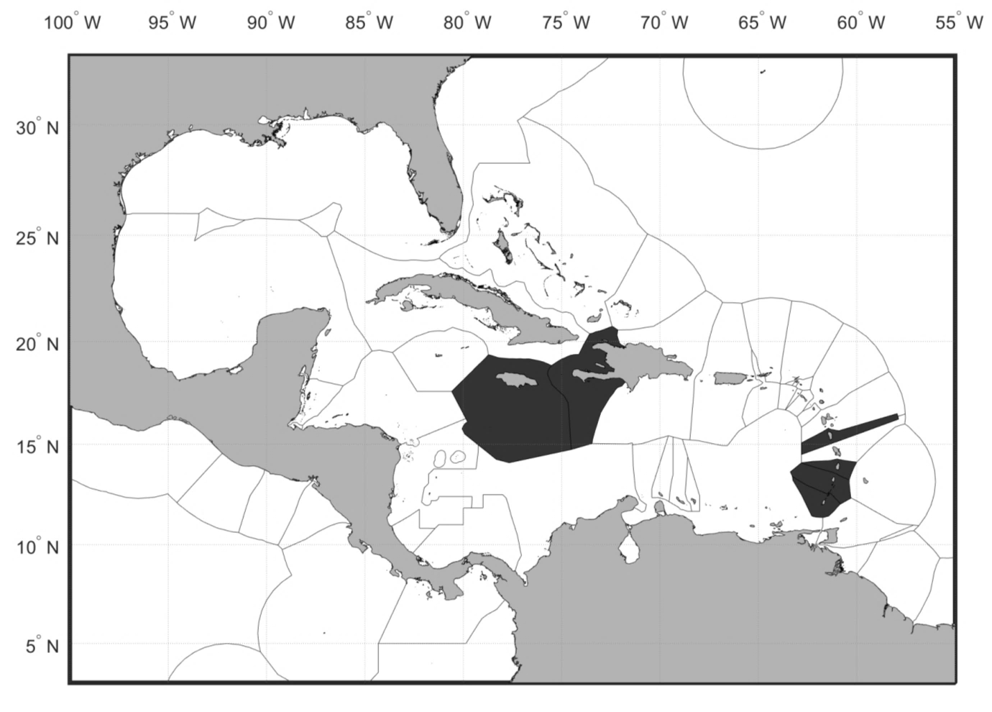
Geographic Scope
Region: Caribbean Sea Large Marine
Ecosystem
Countries: Exclusive economic zones (EEZs)
Jamaica, Haiti, Dominica, Saint Lucia, Saint Vincent and the Grenadines, Grenada
Notes:
Analysis involves spatial modelling, with the geographic scope shown on this slide. The region is defined as the Caribbean Sea Large Marine Ecosystem. In the map on the right, the dark area covers the Exclusive Economic Zones of the six case study countries.
====
Notes:
**The map of the Caribbean LME is from this source: https://clmeplus.org/clme-region/

Slide 7
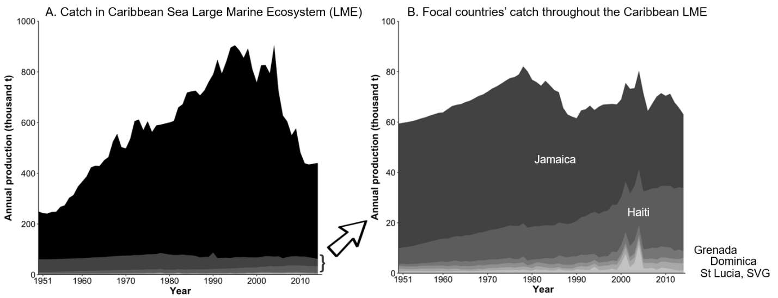
Fisheries Catches
Source: Sea Around Us (www.seaaroundus.org)
Notes:
Fisheries data are inputs into species distribution modelling. We used Sea Around Us data to collate datasets of reconstructed catches for the Caribbean Sea region from 1950 to 2015: figure (A) shows total regional catches and figure (B) shows catches by the six selected focal countries (Dominica, Grenada, Haiti Jamaica, St. Lucia, St. Vincent and the Grenadines) in the Caribbean Large Marine Ecosystem region. Catch from countries other than these six countries in the region is represented by the black area on the figure on the left hand side.

Slide 8
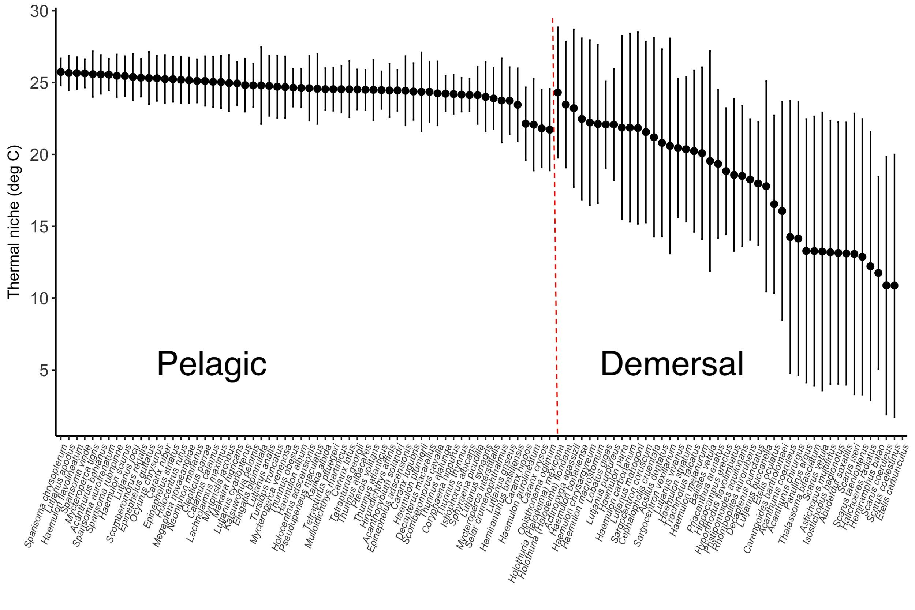
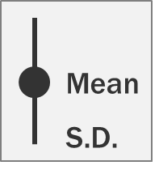
Fisheries Species Modelled
Temperature preference (ºC)
Notes:
In a community of marine fishes and invertebrates, different species have different thermal preferences and tolerances. They can only live in environment where ocean temperature falls within their tolerance limits. When the ocean warms up, temperature may become too warm for some species, leading to their local extinction. At the same time, some species can invade into the area.
The estimated temperature preferences of the 106 selected marine fishes and invertebrates (i.e., excluding marine mammals and two species of algae). These variables were used to determine species’ sensitivity to climate hazards. The black dots represent the preferred temperature while the vertical line represents the 95% confidence intervals of species’ temperature preference profiles.
Overall, the selected 106 marine fishes and invertebrates were found to prefer temperatures ranging from 12˚C to 27˚C.

Slide 9
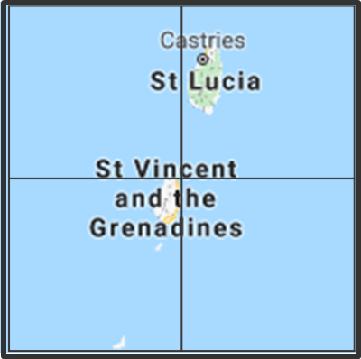
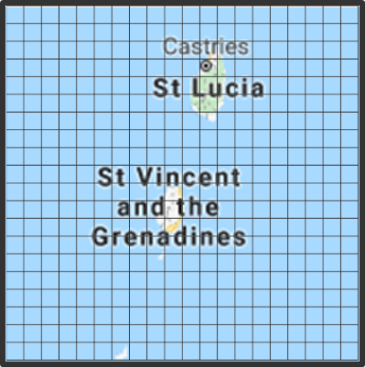
Two Types of Climate-Ocean Projections
Analysis requires Earth system models capable of simulating interactions among the atmosphere, oceans and land surface
Lower resolution
Higher resolution
CMIP5 – 2 models
1º x 1º resolution at best (Global)
Comprehensive physical and biogeochemical fields
Representative Concentration Pathways (RCPs)
Publicly available
GFDL CM2.6
0.1º x 0.1º resolution (Regional)
Temperature, salinity, Net Primary Production, advection
Idealized increase in CO₂
Not available for public release
Notes:
Projected changes in temperature and other ocean conditions derived from three different models, two of lower resolution and one of higher resolution. This slide summarizes key differences between low and high resolution models. The slides that follow include these grid figures to denote whether results use outputs from low or high resolution Earth system models.
Analysis used a single realization (or run) from each model. The Earth system models were nominally run for the period 1850 to 2005 under historical forcing (i.e., radiative forcing estimated to have occurred during that time period), and over the period 2006 to 2100 under two Representative Concentration Pathways (RCP2.6 and RCP8.5), which represent two contrasting alternative scenarios of global mitigation and resulting atmospheric concentrations from 2000 to 2100.
====
Notes:
[Model outputs at 1˚ X 1˚ are interpolated to attain a 0.5˚ X 0.5˚ resolution.]
The following two slides show baseline values of sea surface temperature (surface and bottom), salinity and net primary production mapped onto the Caribbean LME. By contrasting both slides you can see the difference employing a higher resolution model can make. Unfortunately, the model outputs (fields) needed for understanding biological and ecological shifts exceeded those available from the high resolution model (GFDL CM2.6).

Slide 10
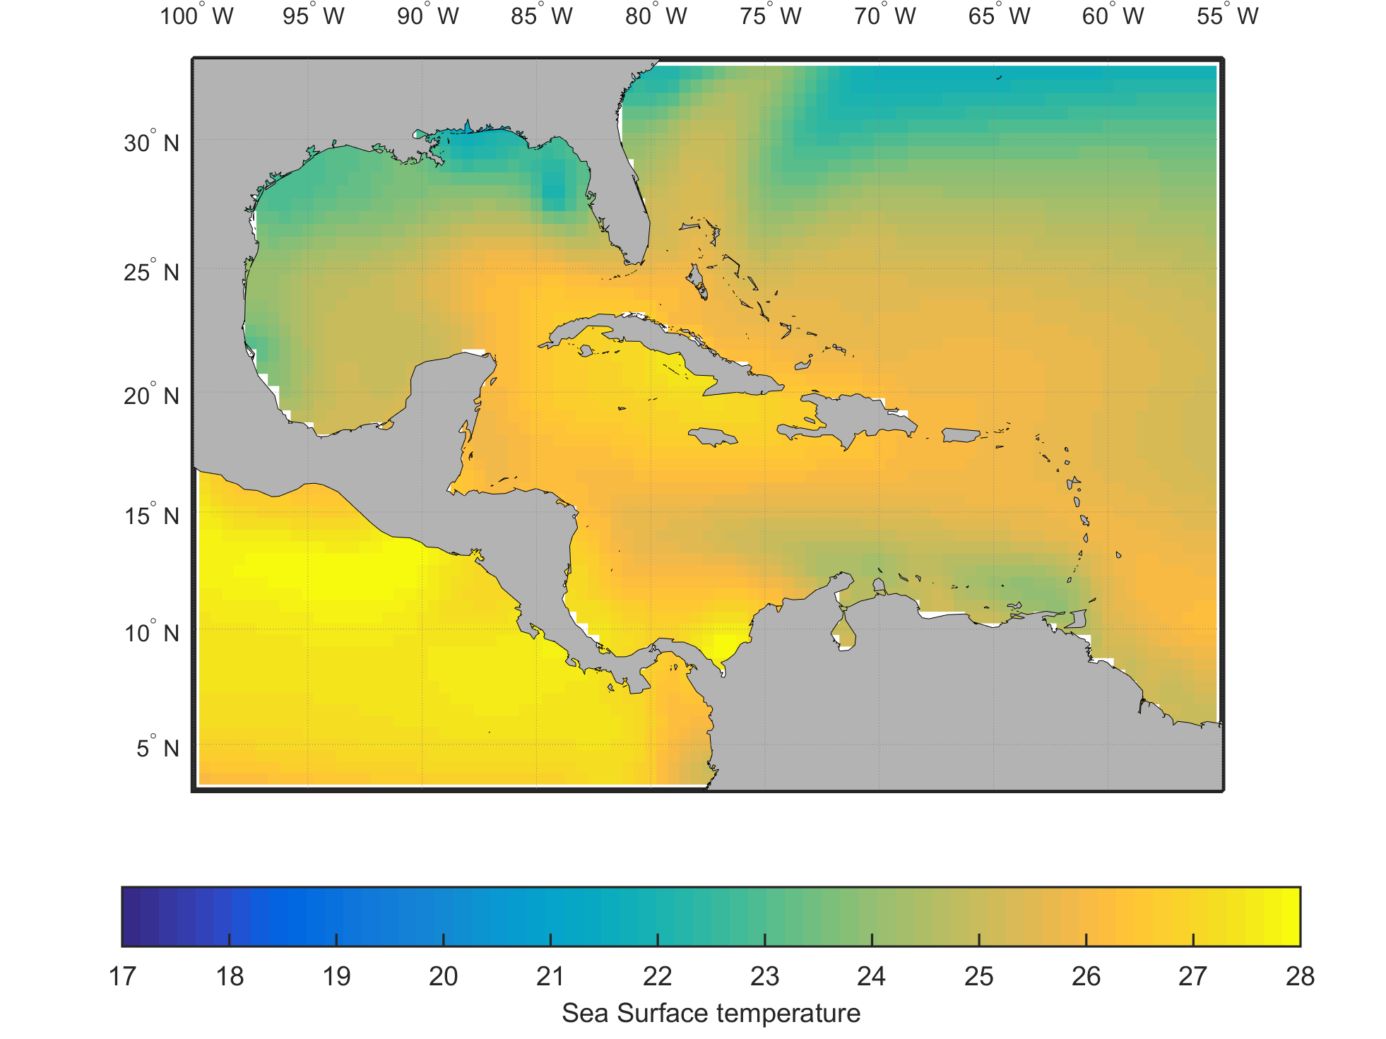
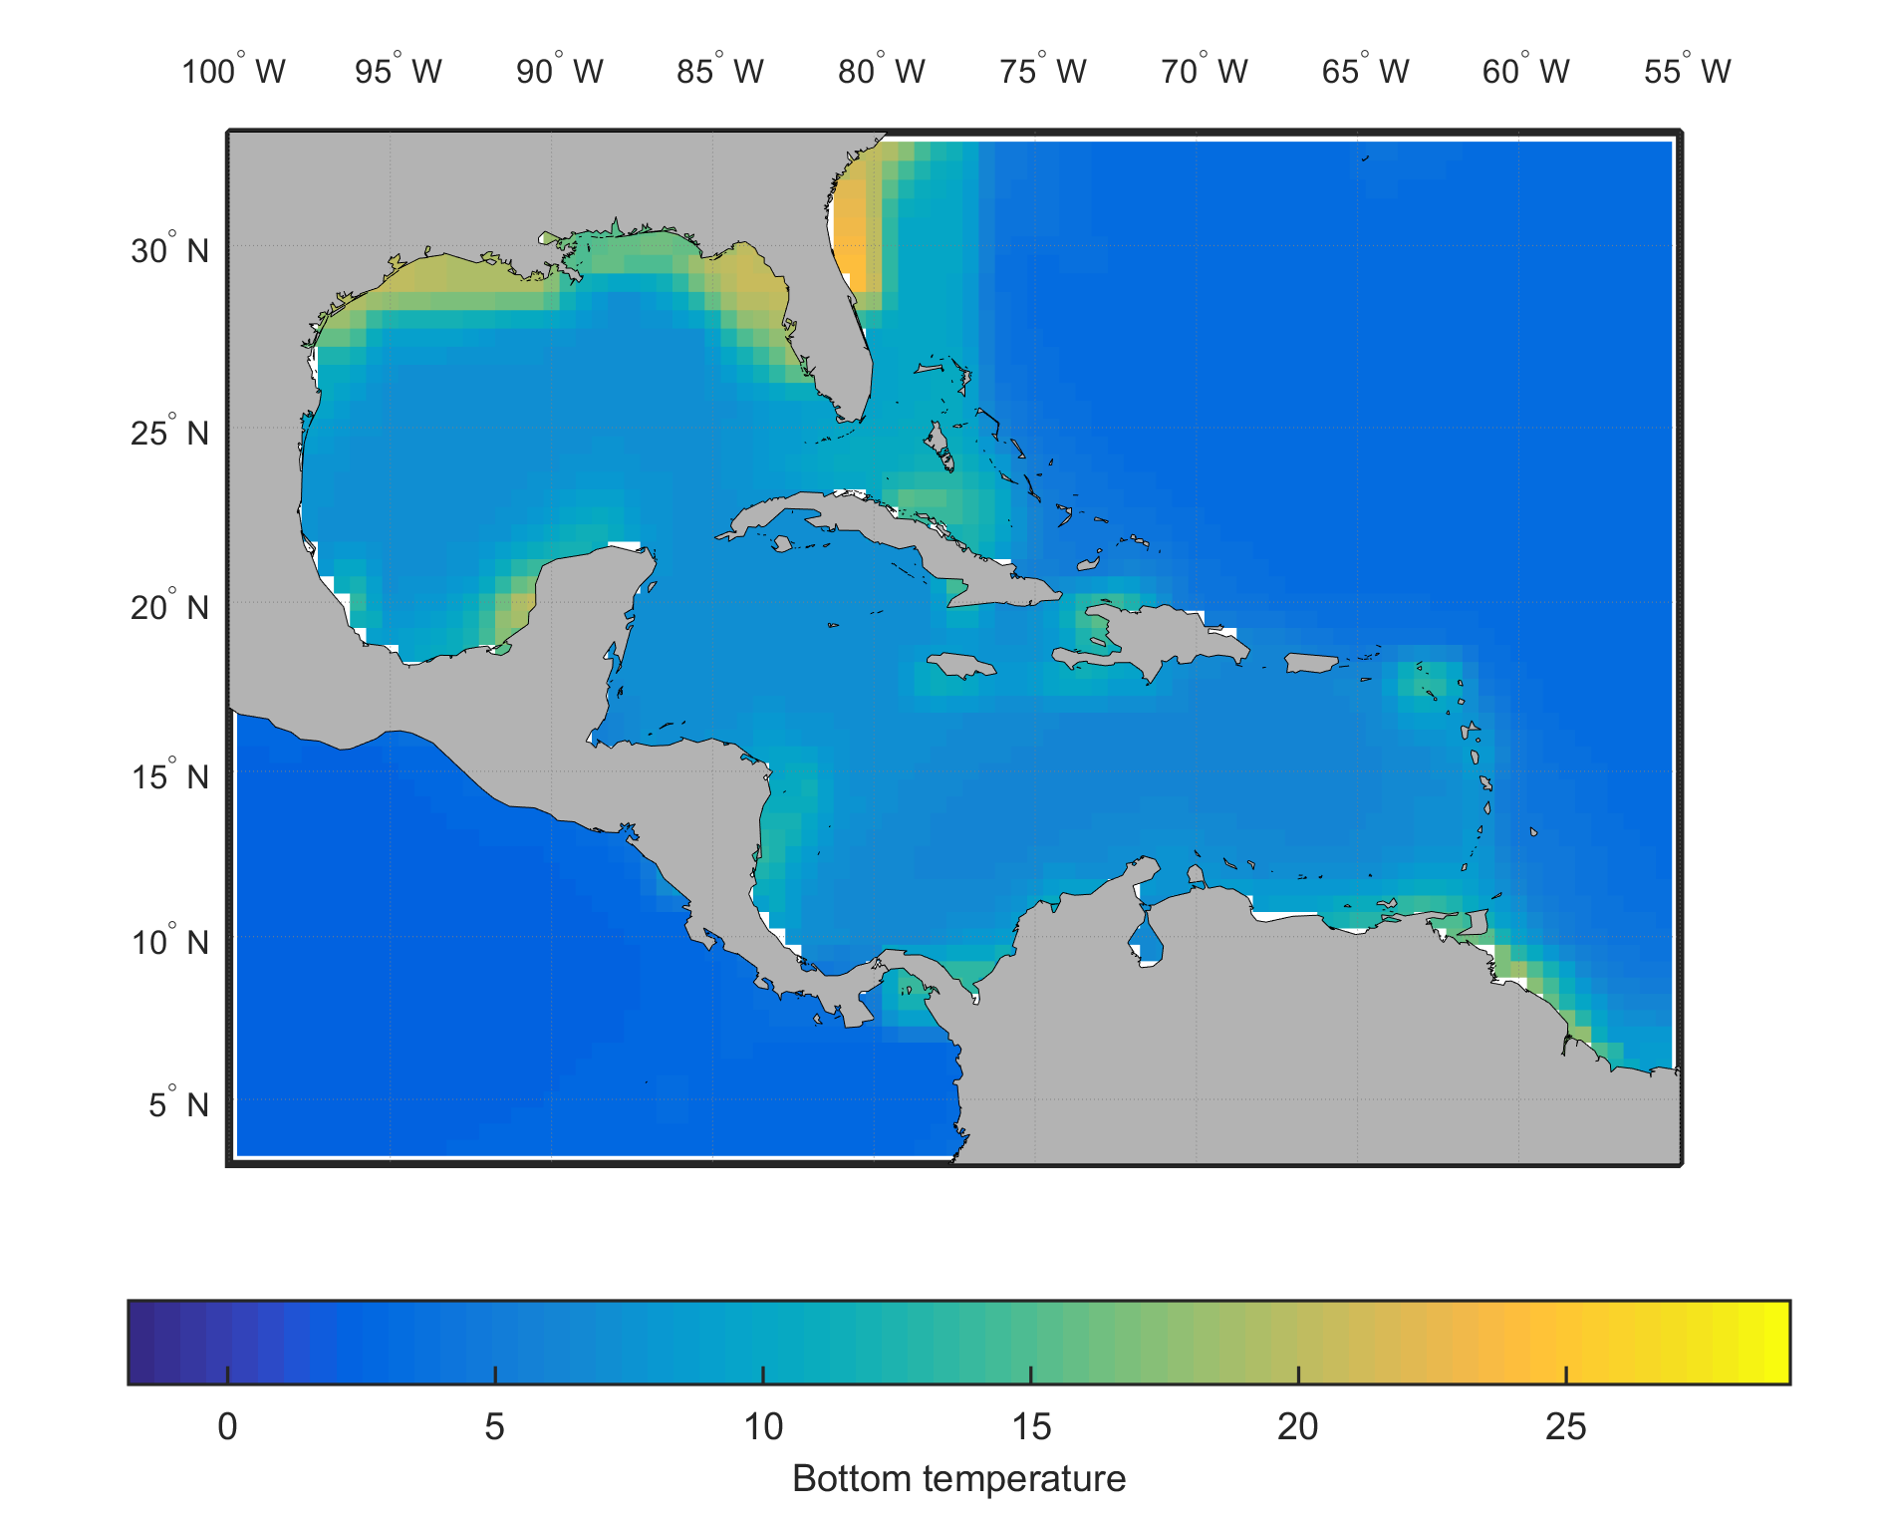
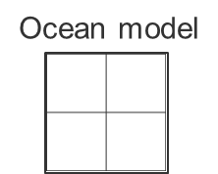
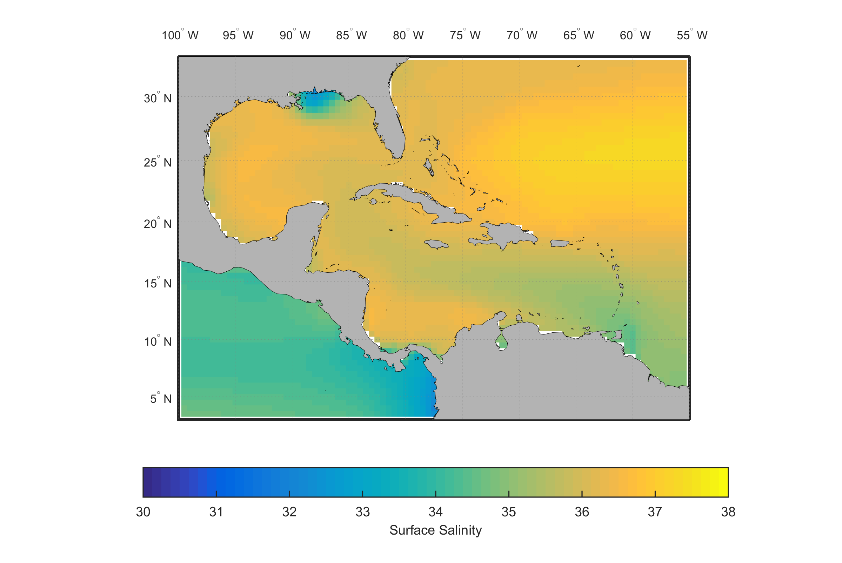
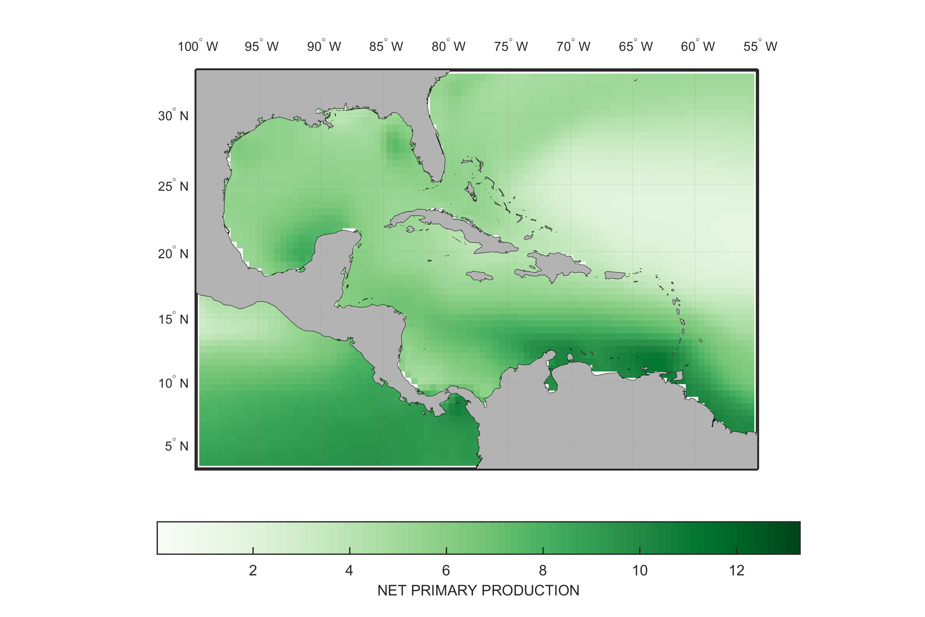
Lower-Resolution Climate Projections Coupled Model Intercomparison Project - Phase 5
Temperature
Sea bottom
Sea surface
Salinity
Net primary production

Slide 11
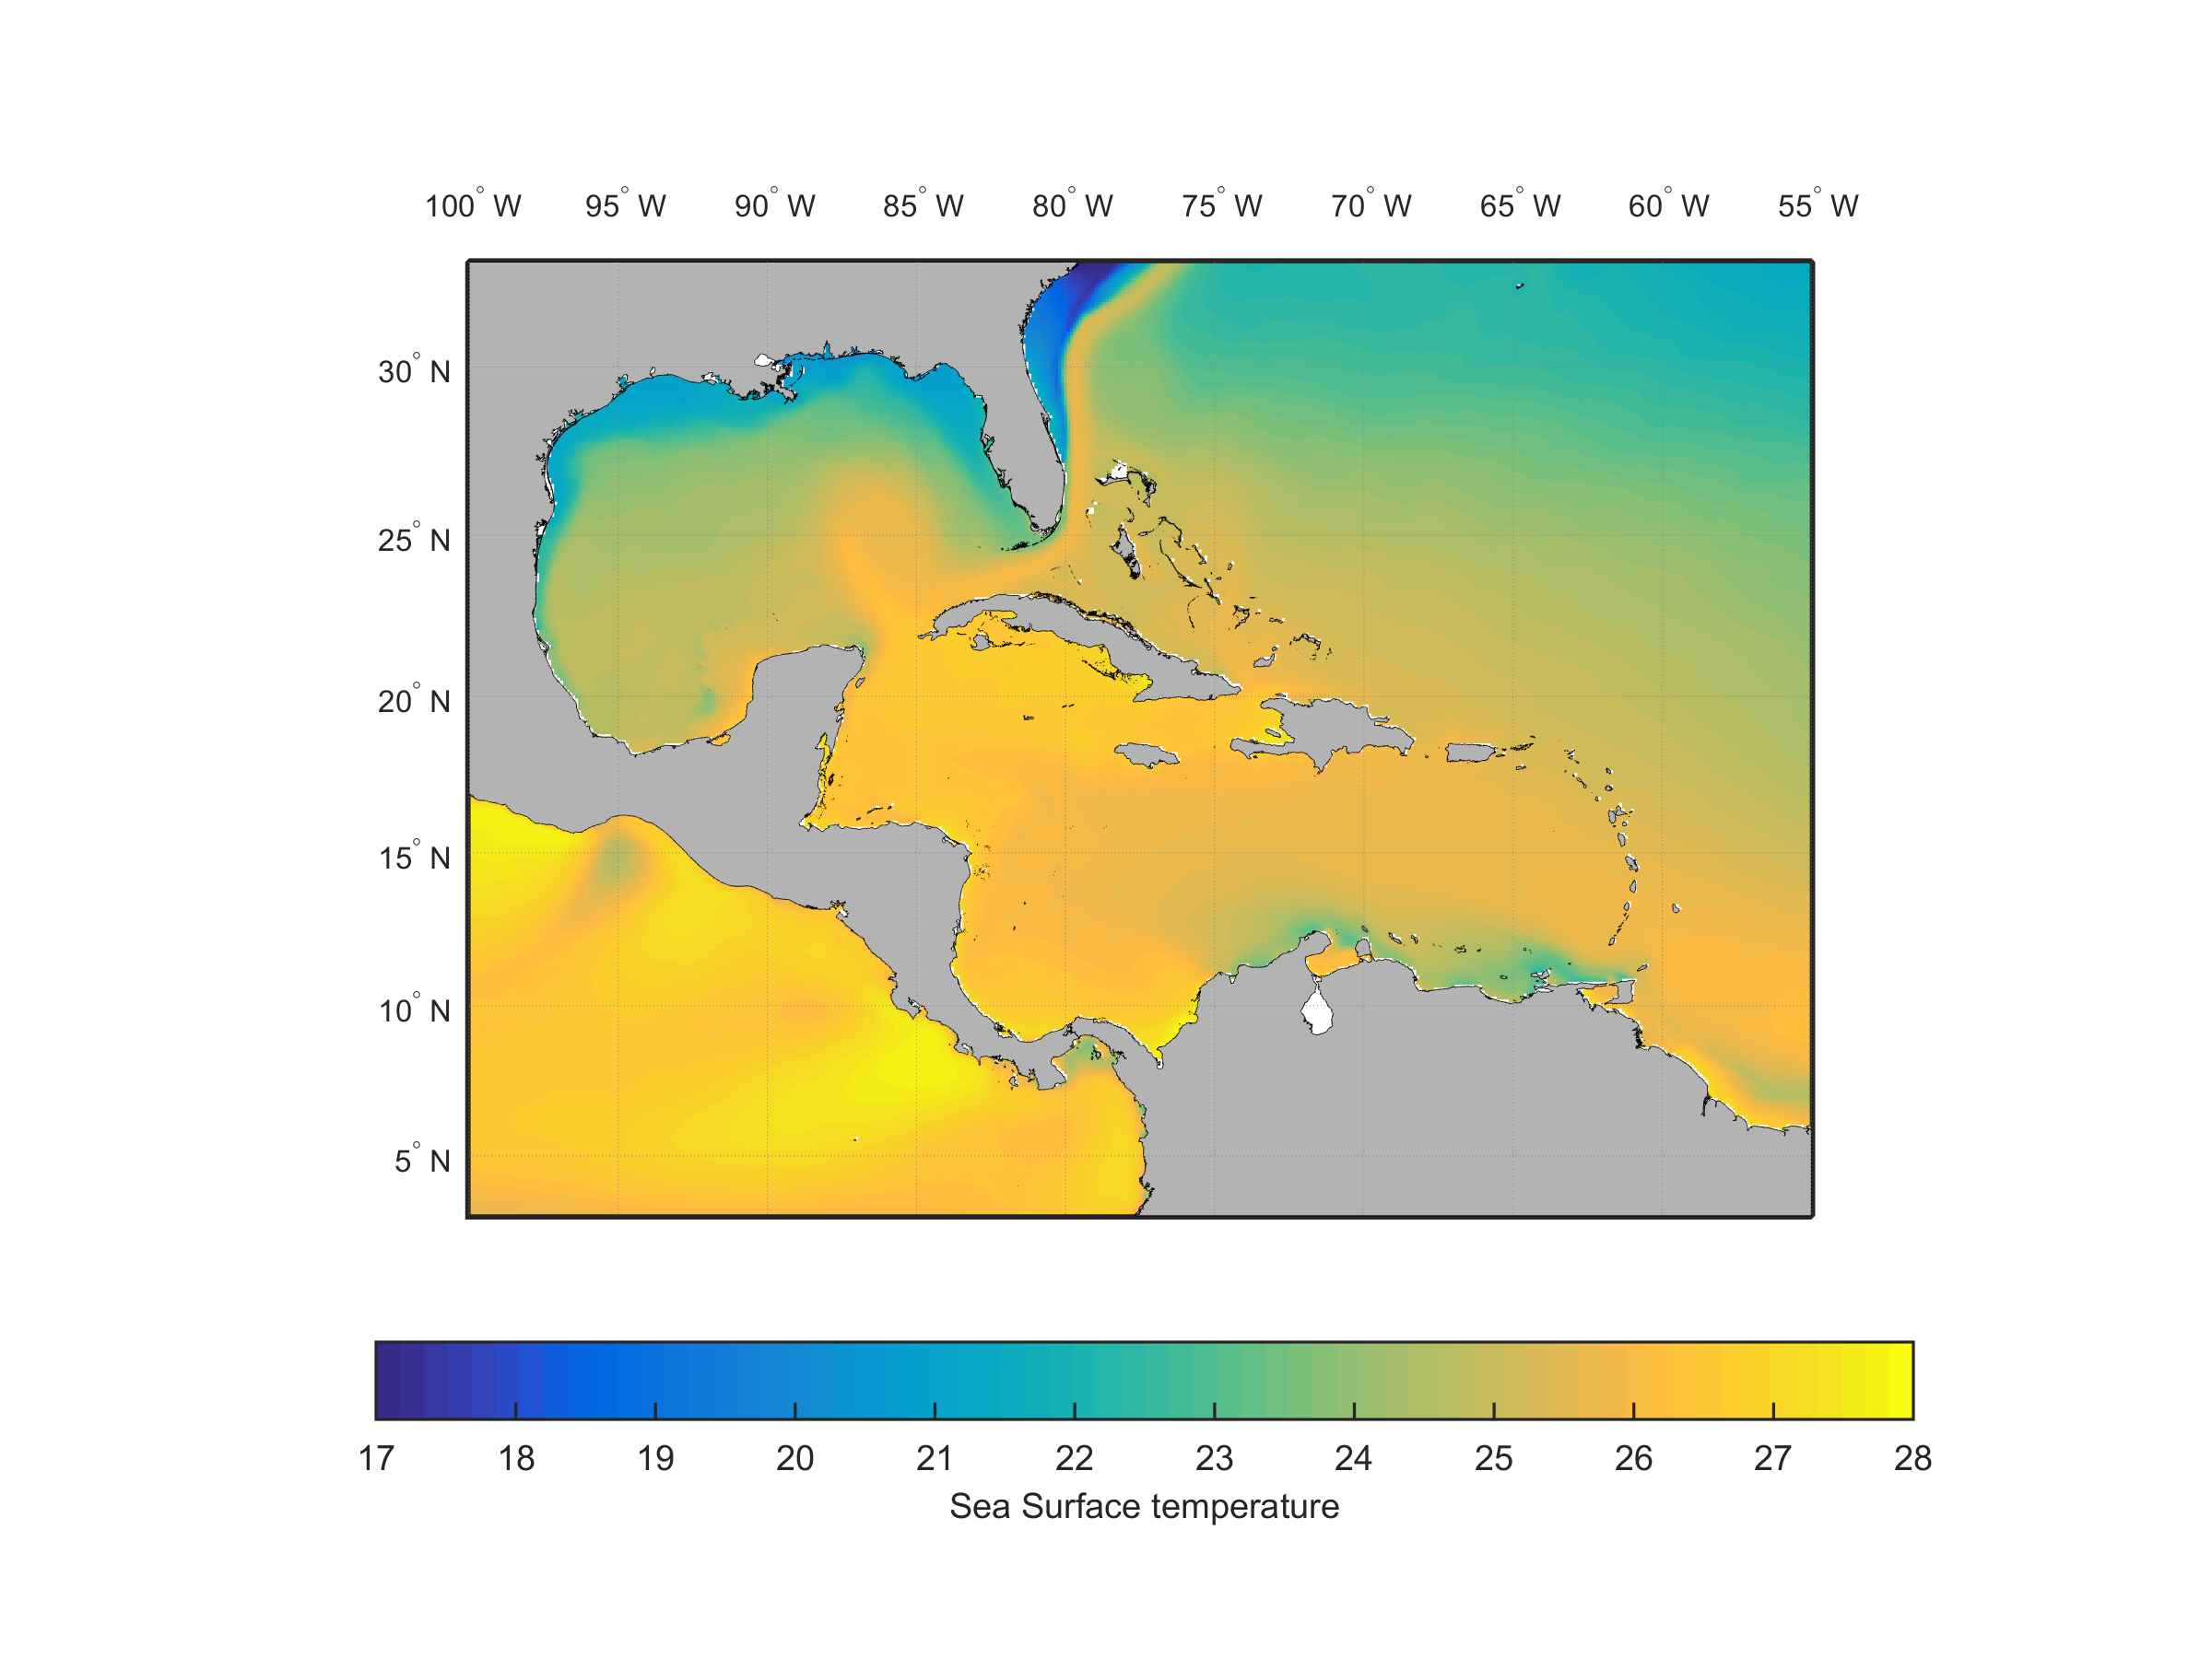
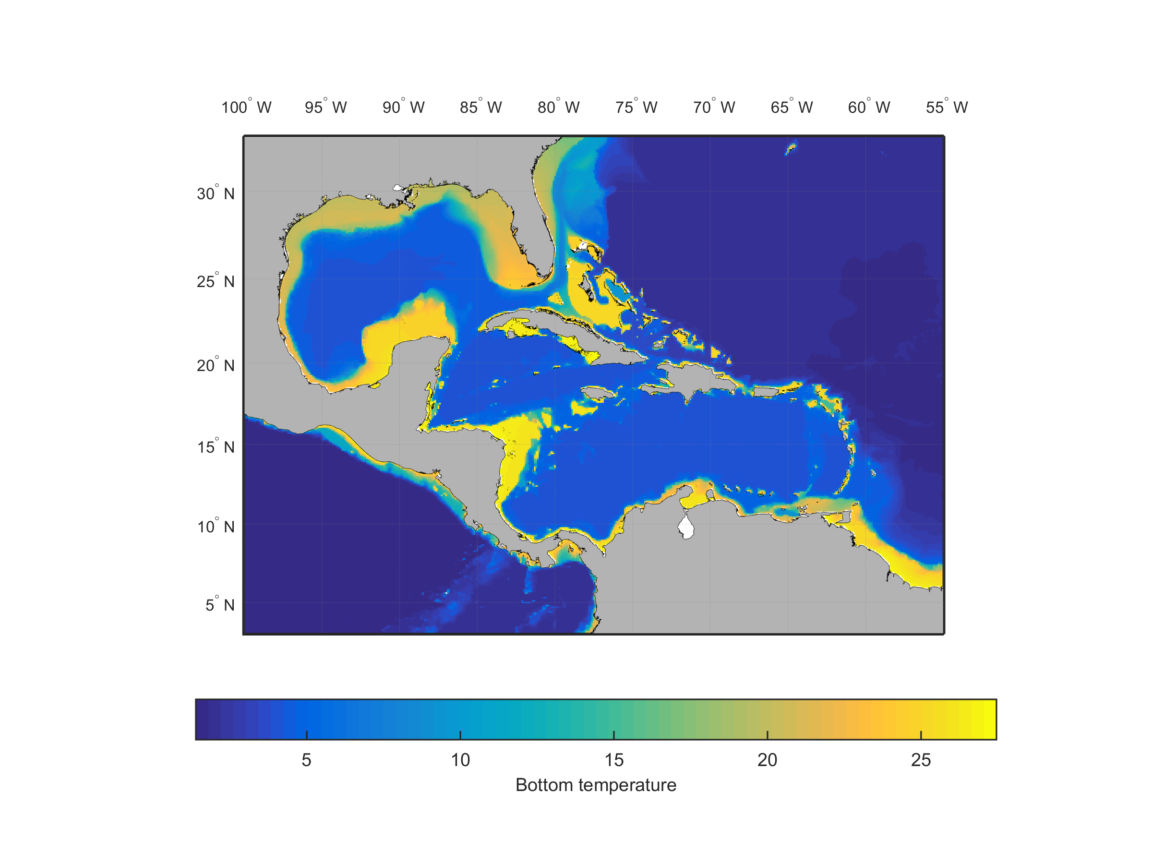
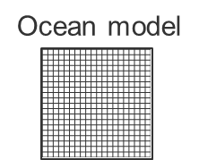
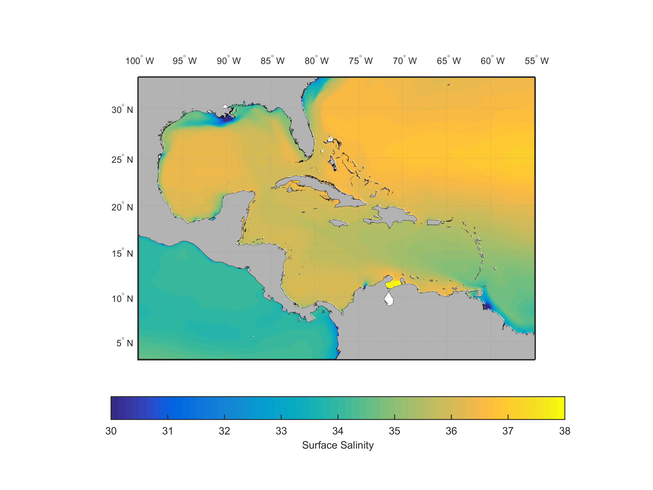
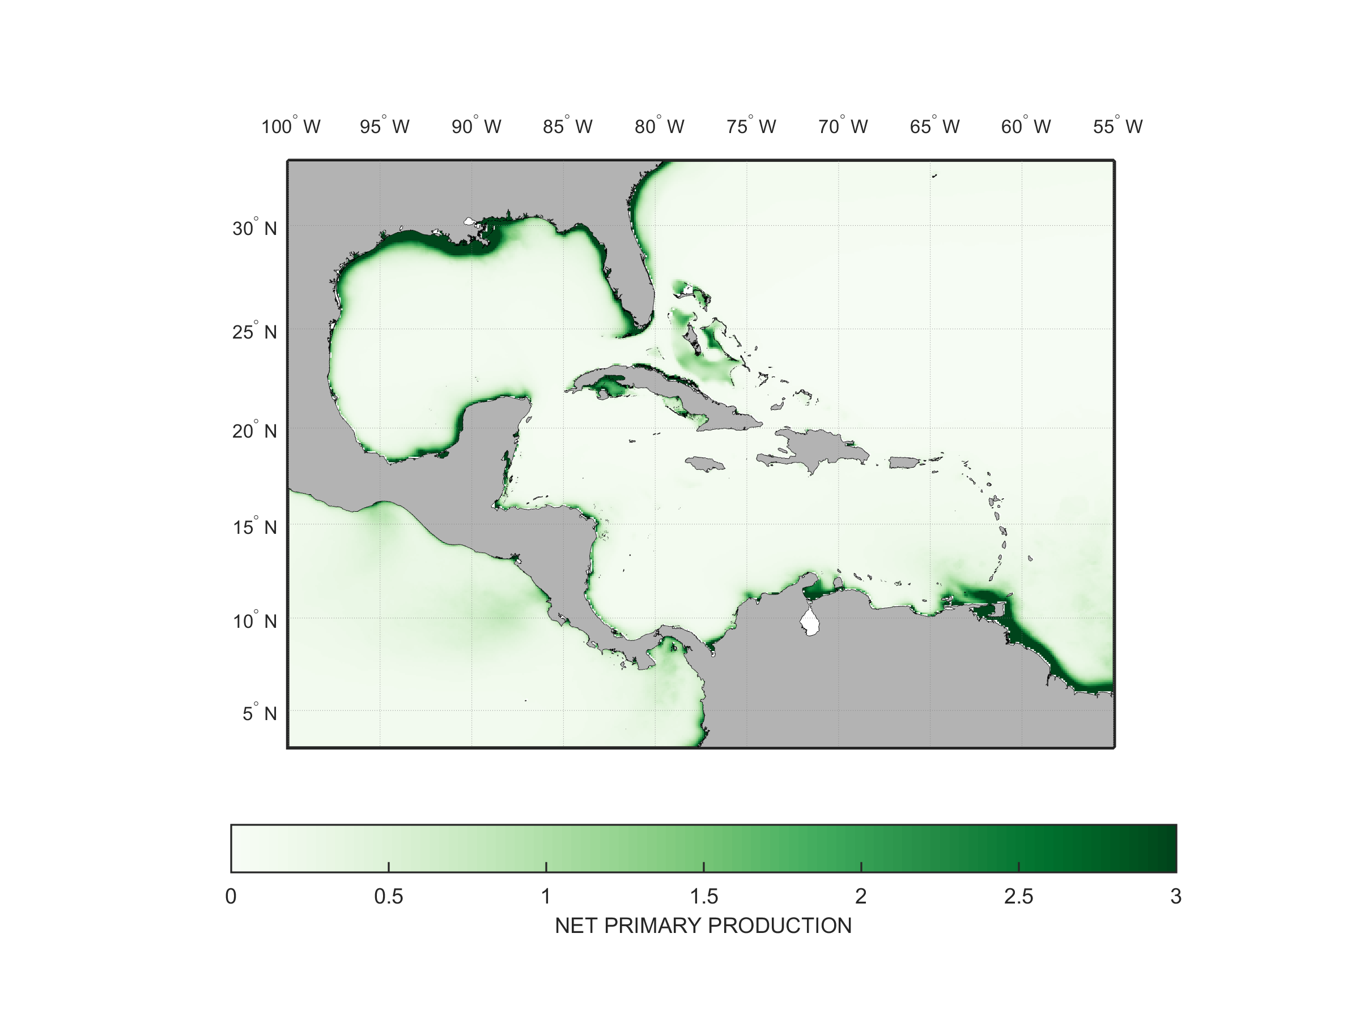
Higher-Resolution Climate Projections GFDL CM 2.6
Temperature
Sea surface
Sea bottom
Salinity
Net primary production

Slide 12
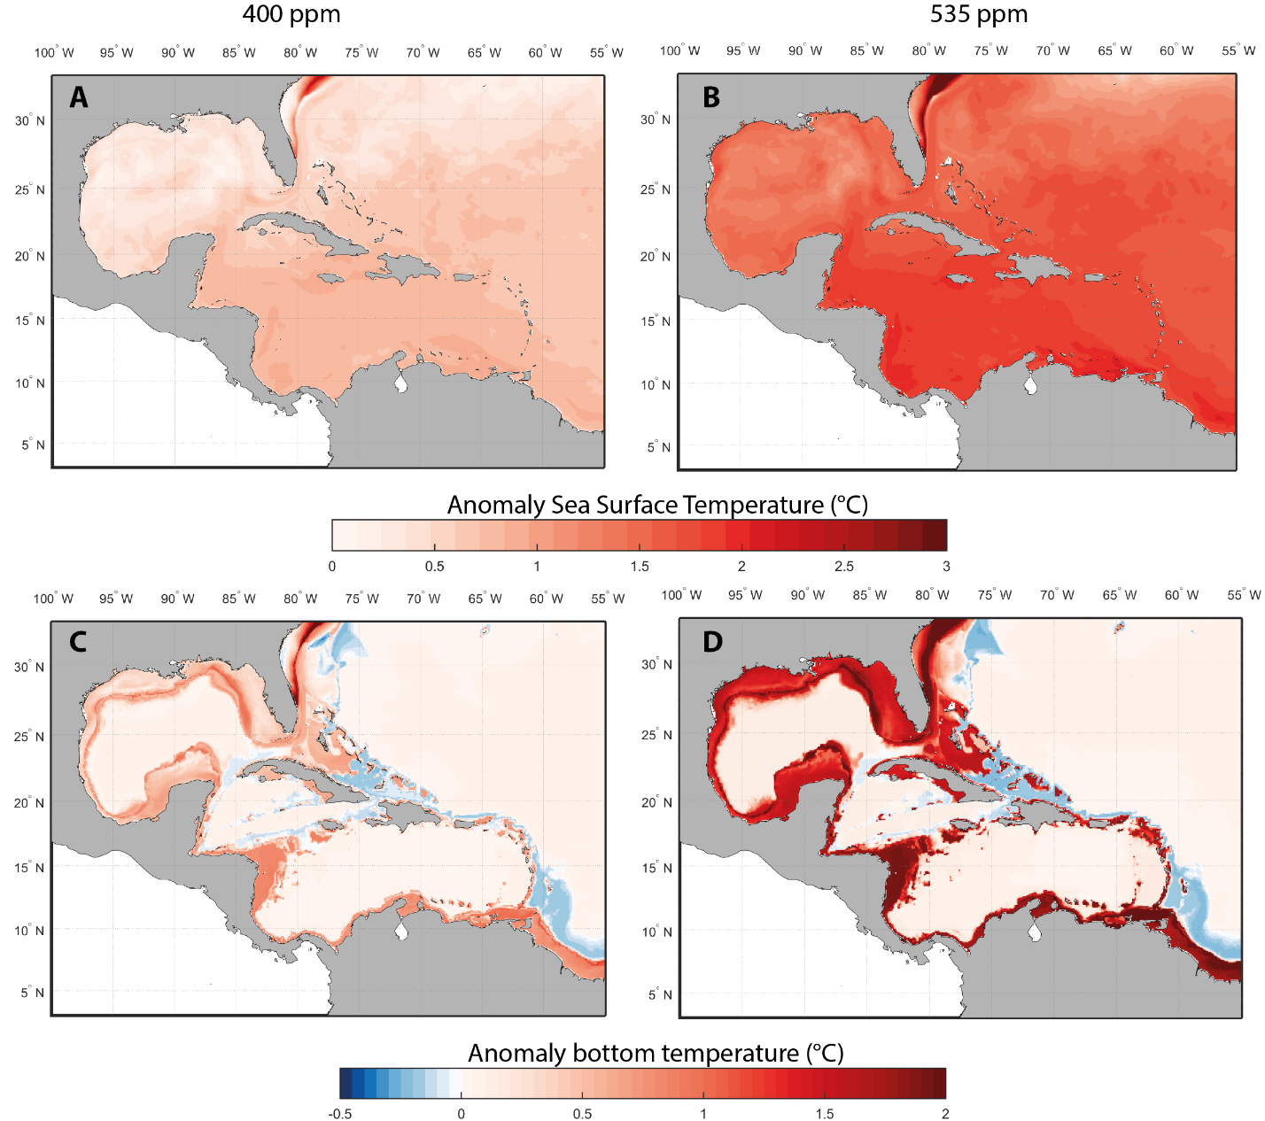
Future Conditions of the Caribbean Sea
Warmer, less oxygenated, with higher acidity, lower primary production and higher salinity across scenarios and models
Lower CO₂ concentration
Higher CO₂ concentration
Notes:
Regardless of global model and emissions scenario use, future climate and ocean conditions in the Caribbean sea are expected to be warmer, more acidic, with higher salinity and less oxygen.
Temperature is the primary driver of biological impacts of climate change on exploited fish stocks and so we show projected changes in sea temperature. These are projected changes in sea surface temperature (A, B) and sea bottom temperature (C, D) from the high resolution Earth system model (GFDL CM2.6) under an average atmospheric CO2 concentration of 400 ppm (A, C) and 535 ppm (B, D).
Warming of surface waters is projected be more homogenous across the Caribbean Sea compared to warming of bottom water, although surface water temperature is projected to increase more in the southern and western parts of the Caribbean Sea. In contrast, warming of bottom water is generally projected to follow bathymetry, with a greater increase in temperature projected to occur along shallow shelf and coastal areas. Across the water column, warming is projected to be positively related to atmospheric CO2 concentration (scenarios of higher carbon dioxide concentration in the atmosphere correspond to more warming). Warming trend is less pronounced in the bottom environment owing to the diffusion of the heat from the surface to the bottom.
Spatial patterns of projected ocean warming in the Caribbean Sea are consistent across the high and low resolution Earth system models’ outputs.
The following slides briefly describe each of the 3 analytical approaches we used and related results.

Slide 13
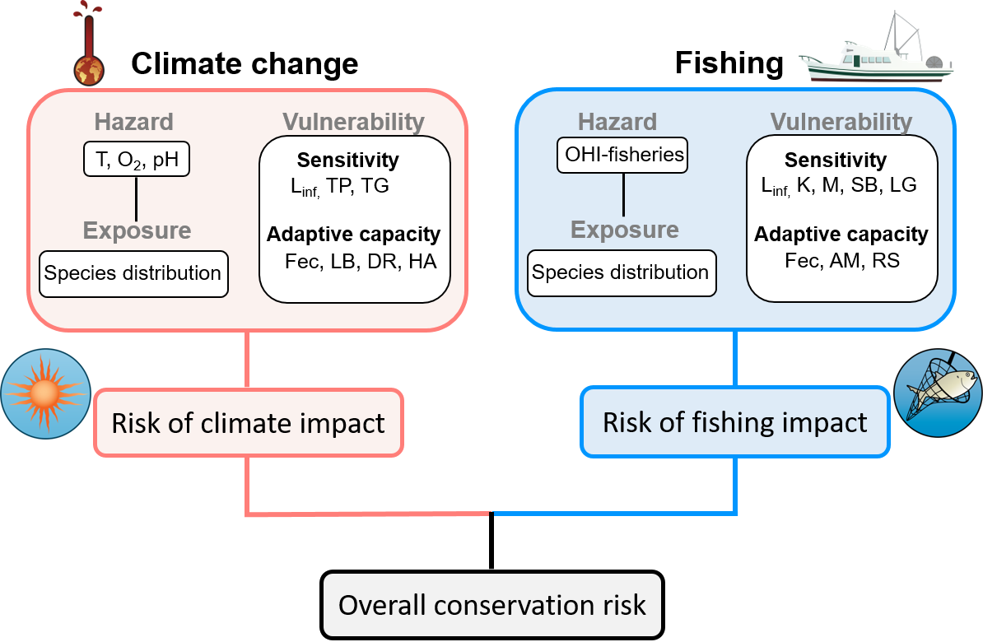
Fuzzy Logic Models
Adapted published algorithms and used pre-defined heuristic rules to calculate indices of vulnerability and risk of climate (including ocean acidification) and fishing impact
Indices calculated for two future periods for different scenarios
Vulnerability and risk of impacts expressed on a scale from 1 to 100, 100 being the most vulnerable and at risk
Notes:
We assessed the climate risk, risk of fishing impact and overall conservation risk of 106 marine fish and invertebrate species of interest to key stakeholders in the Caribbean using indices generated through fuzzy logic. The risk assessment framework we used is summarized in this diagram.
In this framework, risk of climate impact (or climate risk) consists of three components: exposure to climate hazards, sensitivity to climate hazards, and species capacity to adapt to climate changes. Exposure is the nature and degree to which a species might be subjected to climate hazards (i.e., predicted changes in the physical environment). Sensitivity refers to the degree to which species are sensitive to any changes in the environment they experience as a result of climate change. Adaptive capacity is the ability of species to respond and adjust to changes from climate stresses, and to cope with, and recover from these. Each of the components is described by a specific set of variables accounting for changes in ocean conditions, biological characteristics of the selected priority species in relation to their sensitivity to environmental changes, and the likelihood a species may reduce its sensitivity to climate change through rapid adaptation (via evolutionary or phenotypic changes). Climate risk as well as sub-indices are expressed on a scale of 0 to 100, with higher values being more vulnerable or at risk.
====
Notes:
[In each geographic cell of the 0.5˚ latitude x 0.5˚ longitude grid, we expressed the local climate hazard as changes in mean condition of each variable relative to annual variability of the historical period of the Earth system model simulations (standard deviation of annual values from 1951 – 2000) for two future periods: the mid-21st century (average of 2041 – 2060) and the end of the 21st century (average of 2081 – 2100).]

Slide 14
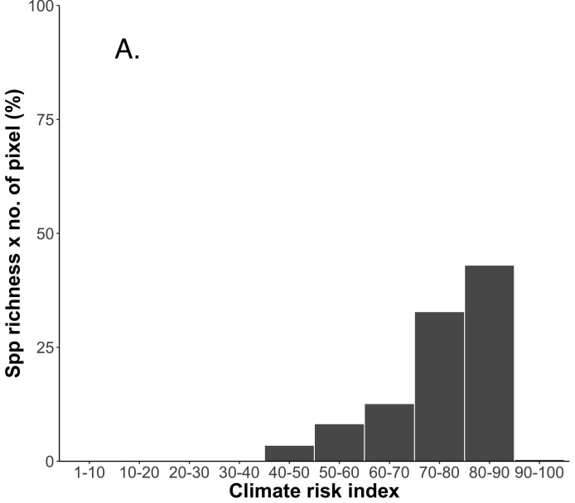
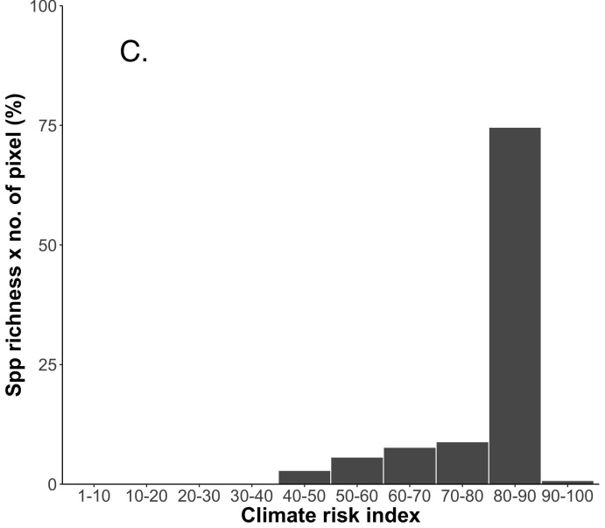
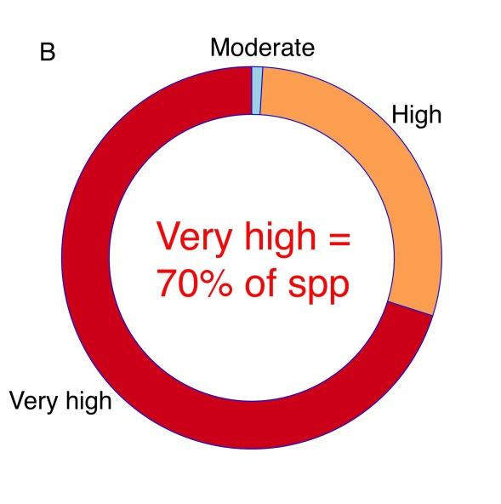
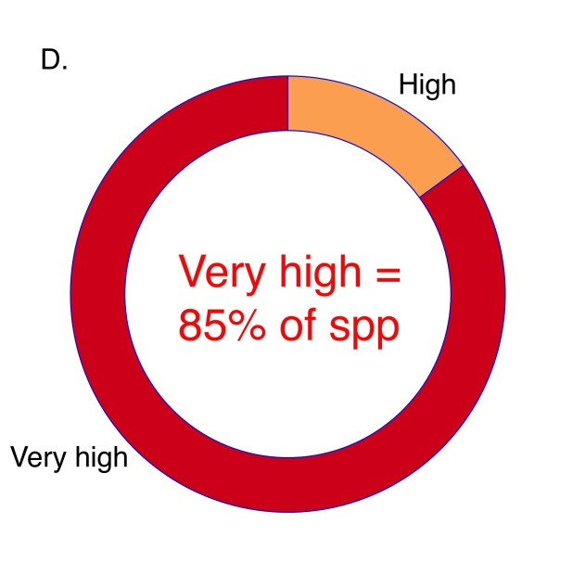
Regional Climate Risk by 2050s
RCP 2.6
RCP 8.5
N = 106 spp.
1 = Low risk
100 = Very high risk
Notes:
This slide summarizes results of the projected climate risk index for the 106 selected marine fish and invertebrate species in the Caribbean Sea using the fuzzy logic risk assessment model. Figures A and C show the frequency distribution of the percentage of pixels (in the 0.5˚ latitude x 0.5˚ longitude grid) by climate risk index for all 106 species under RCP2.6 and RCP8.5, respectively. (B, D) The proportion of species categorized according to different levels of climate risk in the region under RCP2.6 and RCP8.5, respectively.
Combining species’ exposure to climate hazards with their vulnerability, we estimated a very high risk to climate change impacts for the majority of the 106 selected marine fish and invertebrates species. Projections show that most of the Caribbean Sea would register a climate risk index >75 under both RCP2.6 and RCP8.5. Under RCP8.5, more than 70% of pixels (geographical cells of the 0.5˚latitude x 0.5˚ longitude grid) were estimated to have a climate risk index >80. More than 70% of selected Caribbean marine species were projected to have a very high risk to climate impacts. Under RCP8.5, no species were categorized as at low or moderate risk. The climate risk index is significantly correlated with the risk of extinction as defined by the IUCN Red List of Endangered Species
====
Notes:
[See Appendix A.5 in research paper A for detailed methods.]

Slide 15
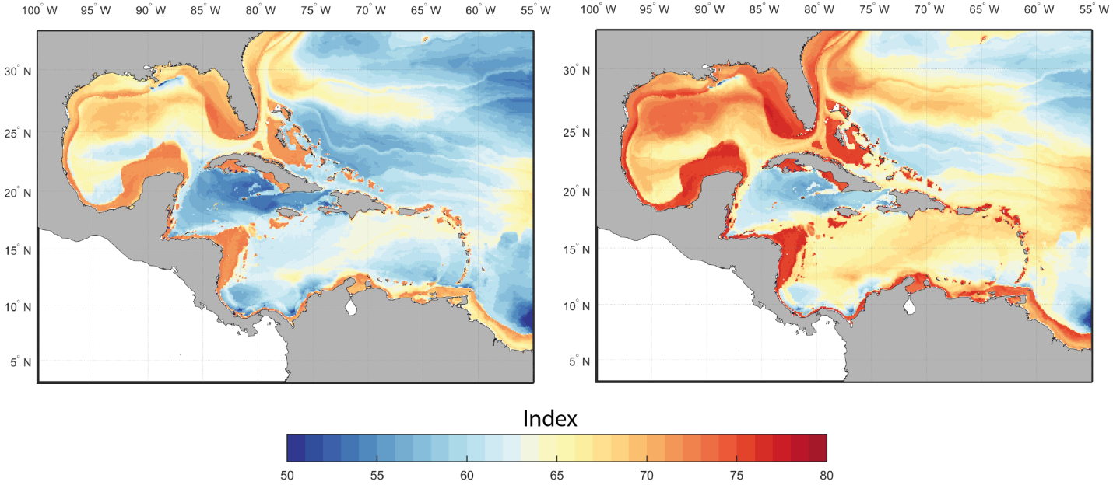
Maps of Climate Risk Averaged Across Species
RCP2.6
RCP8.5
Medium risk
Very high risk
Notes:
Here is an example of a mapped output of the work on fuzzy logic modelling. It shows the estimated average climate risk index for the 106 selected marine fish and invertebrate species projected spatially using the predicted species habitat suitability of each species under RCP2.6 (left side) and RCP8.5 (right side) by the mid-21st century.
These spatial projections show that climate risk of species assemblages are highest along the coastal and shelf seas region. Offshore, climate risk is greater in the southern part of the Caribbean Sea, while the northern region is projected to have a slightly lower (moderate level) climate risk. Across both scenarios, the area between Cuba, Mexico, Guatemala and Honduras register consistently lower climate risk indices, as do two small pockets along Costa Rica and Panama.

Slide 16
Species Distribution Modelling
Modelled current and future distribution of 110 marine species using an environmental niche approach
This approach quantifies the environmental preferences (e.g., temperature, salinity) of marine species and projects their potential distribution in present and future conditions
Used four environmental niche models to account for uncertainty
Estimated Habitat Suitability Indices (HSI) and local species gain (loss)
Notes:
The current and future distributions of the selected 110 marine species were modelled using an environmental niche approach (sensu Hutchinson 1957). This method quantifies the environmental preferences (e.g., seawater temperature, salinity, dissolved oxygen) of marine species and projects their potential distribution according to present and future conditions.
A multi-model approach was adopted to best approximate the environmental niche of each species; four environmental niche models (ENMs) were used. For each of the 110 selected marine species, the models quantify individual species’ environmental envelope by estimating the best combination of environmental conditions that describe a given species current distribution in the Caribbean Sea. The spatial distribution of each species from the four ENMs was then projected for the current period (average of the last 30 years of the historical run), as well as for mid-century and end-of-the-century conditions for the Caribbean region.
Species richness is determined as the number of species present in each cell with a predicted Habitat Suitability Index (HSI) above a specific threshold for current environmental conditions. Local species gain represents the number of species newly occurring in a geographical area relative to the number in that area during the reference period. Local species extinction (losses) represent(s) the number of species no longer found in a geographical cell relative to the reference period.

Slide 17
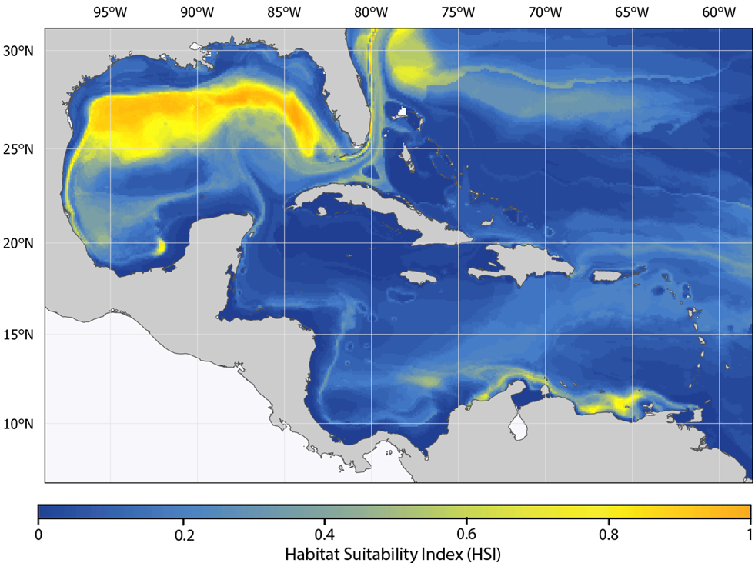
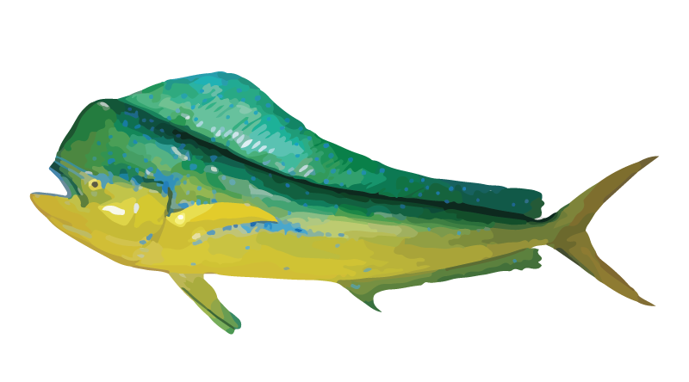
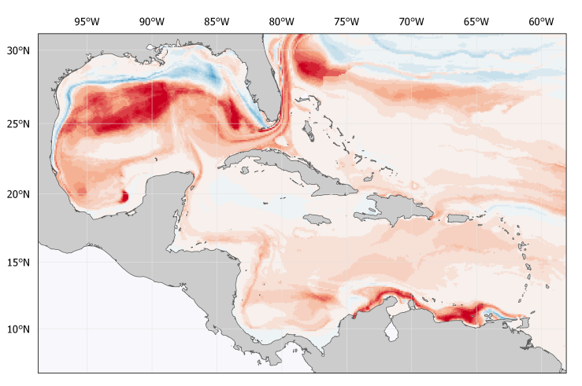
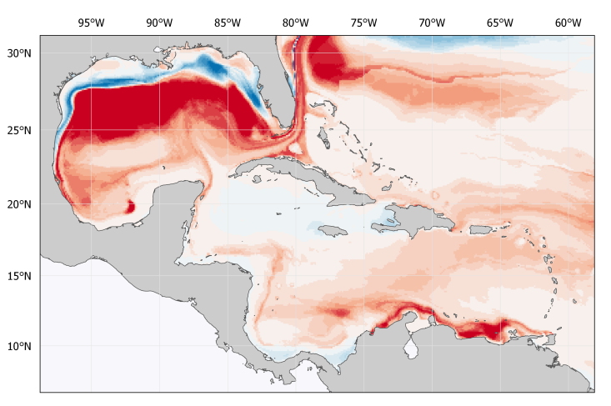
Projected Changes in Habitat Suitability Ensemble average – Example – Common Dolphinfish
Current distribution (1970-2000)
Common Dolphinfish (Coryphaena hippurus)
Lower CO₂ concentration
Higher CO₂ concentration
Notes:
Results for all individual species are available in the report and as maps in the project portal. This slide presents model outputs for the common dolphinfish. Habitat suitability for common dolphinfish is projected to experience modest declines throughout much of the wider Caribbean Sea and very strong declines in areas of currently high habitat suitability in the northern Gulf of Mexico. In both of these regions, declines in more southerly areas are expected to be associated with increases in habitat suitability in more northerly areas. In the Caribbean Sea, habitat suitability is expected to decline most strongly along the northern coastlines of South America, while habitat suitability in the central Caribbean between Cuba, Mexico, and Haiti is expected to slightly increase as southerly populations move north. In the Gulf of Mexico, a similar pattern is observed where habitat suitability declines offshore, but increases closer to the northern shore of the Gulf. These projections suggest that ongoing development of pelagic fisheries may be a more successful adaptation strategy for Jamaica and Haiti than for nations in the Lesser Antilles.
====
Notes:
[In this context, ensemble average refers to average results of outputs from the four ecological niche models.]

Slide 18
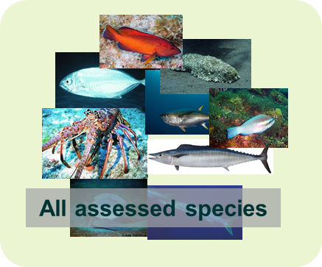
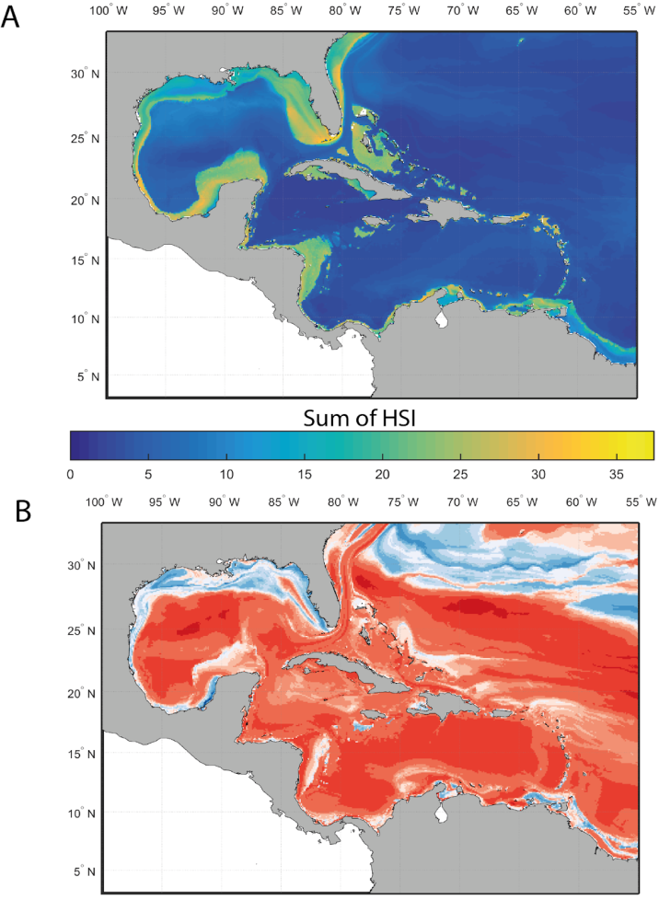
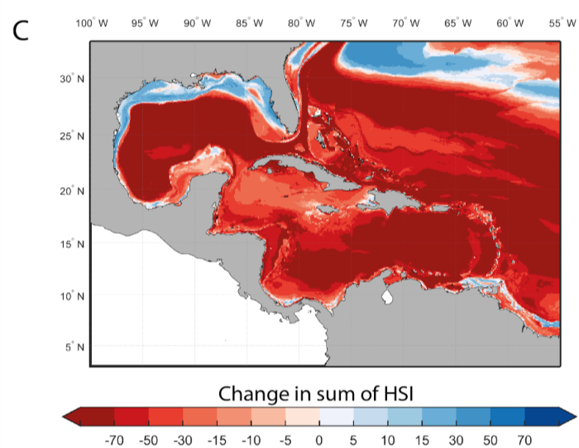
Projected Changes in Habitat Suitability Ensemble average – Changes in the total habitat suitability index of all species
Current distribution (1970-2000)
Lower CO₂ concentration
Higher CO₂ concentration
Notes:
Habitat conditions in the Caribbean Sea for marine fishes and invertebrates are projected to decrease under the higher CO2 emission scenario. Across the region, the sum of individual marine species’ habitat suitability index, an indicator of the environmental quality for the species, is projected to decline substantially under both ~400 ppm and ~535 ppm atmospheric CO2 concentration conditions. This pattern was particularly pronounced for the southern and eastern Caribbean Sea.

Slide 19
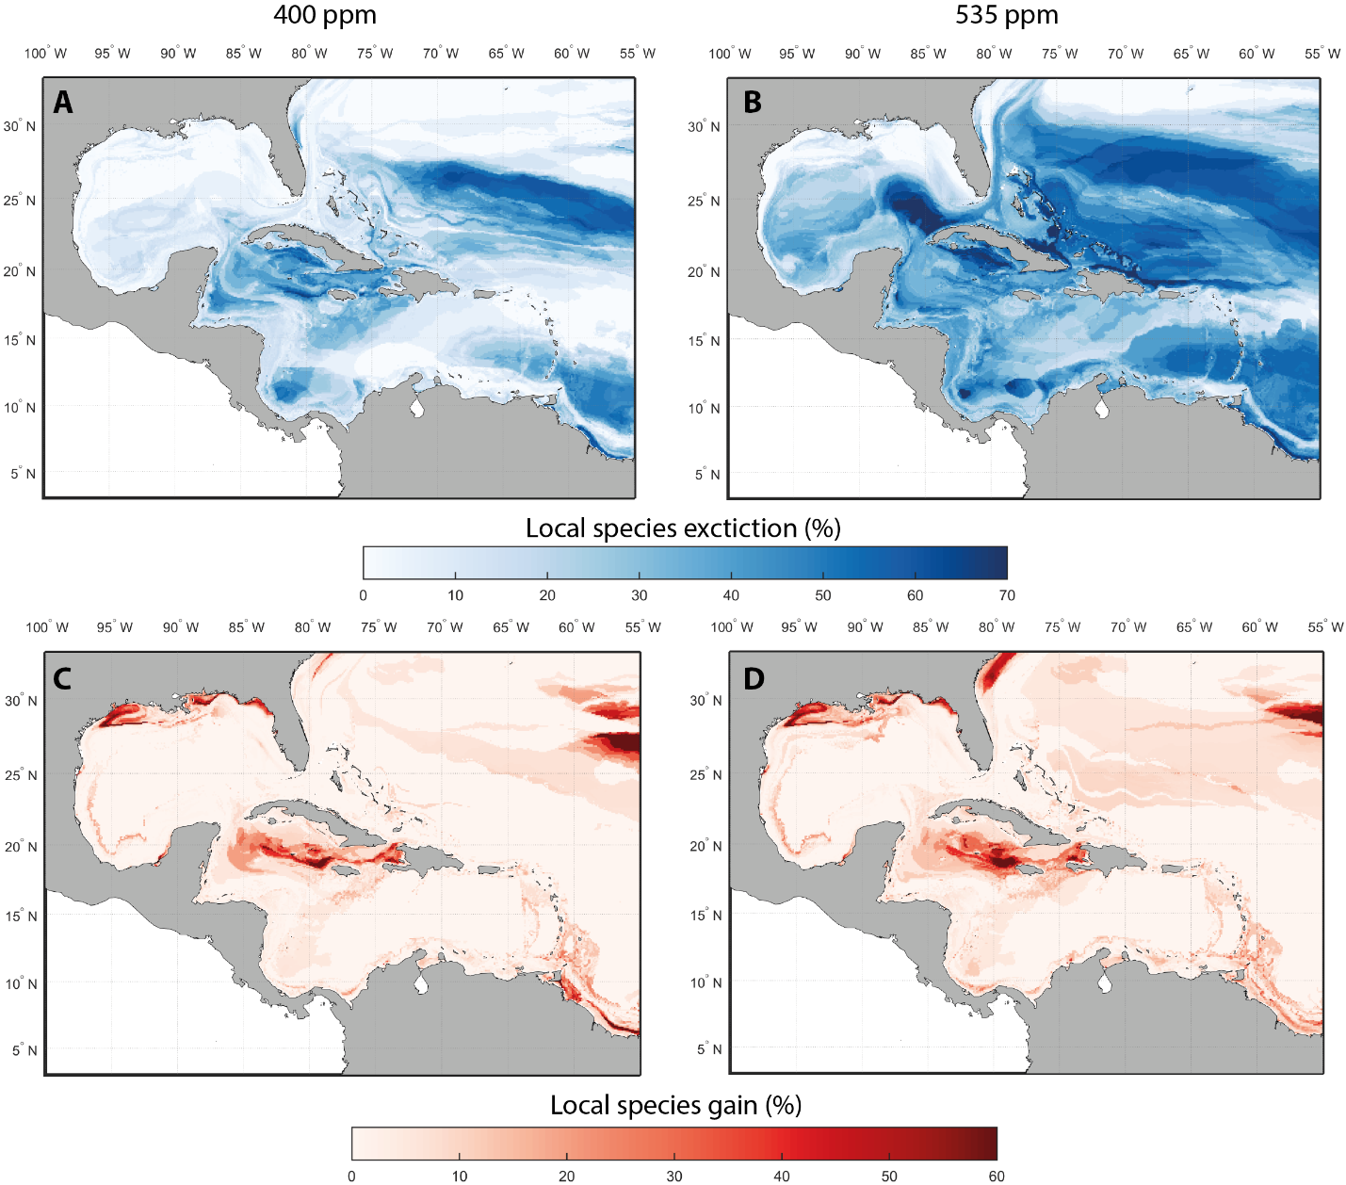
Projected Changes in Species Assemblages Ensemble average – Local extinction and local gains
Lower CO₂ concentration
Higher CO₂ concentration
Local extinction:
Number of species that disappear from a cell relative to initial species richness
Species gains:
Number of species newly occurring in a cell relative to initial species richness
Notes:
The projected species range shifts and large declines in habitat suitability result in large changes in species assemblages across the Caribbean Sea. The loss of suitable habitat for the majority of species under the higher CO2 emission scenario is projected to result in high rates of local extinction, particularly in the northern and southwestern part of the Caribbean Sea - including the area around Cuba and throughout the Bahamas. In contrast, species gains were projected for the northern parts of the Gulf of Mexico along the Texas and Louisiana state coasts, in an area west of the Dominican Republic and south of Cuba, as well as along the coast of Venezuela and northern Brazil. The overall percentage local extinction and species gains were projected to increase with higher atmospheric CO2 concentration. The fact that areas of greatest species gains are similar across both CO2 concentrations is attributable to oceanographic conditions that remain similar under these future climates.

Slide 20
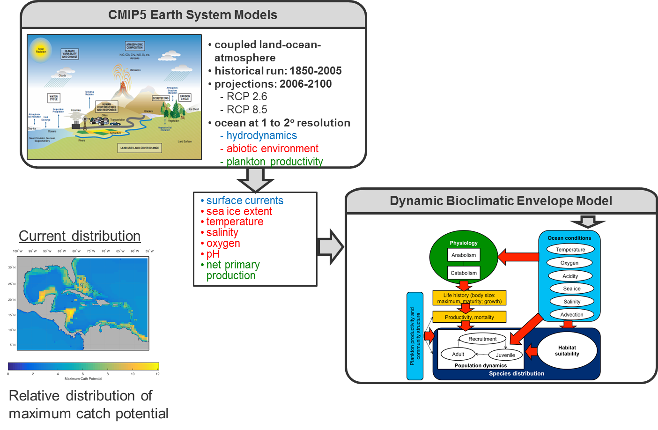
Spatially-Explicit Population Modelling
Notes:
The Dynamic Bioclimate Envelope Model (DBEM) was used to project future changes in maximum catch potential for exploited marine fishes and invertebrates in the Caribbean Sea region. DBEM is a spatially-explicit population dynamic model that simulates changes in distribution, abundance and potential catches of species on a 0.5º latitude x 0.5º longitude grid of the global ocean.
Besides temperature, DBEM takes into account ocean acidity, salinity, net primary production, sea ice extent and advection current. The last attribute is important because the movement of water mass through ocean currents determines larval dispersal patterns. Temperature, oxygen and salinity affect physiology, in turn affecting life history and population dynamics. All in all, DBEM simulates ghe effects of changes in ocean conditions on physiological, population and community responses.
For each simulation, changes in total annual maximum catch potential by mid-century (2050: 2041-2060) and relative to 2000 (1996-2005) under RCP2.6 and RCP8.5 were calculated for the Caribbean region.
====
Notes:
[A summary of steps in modelling using the DBEM appears in pages 25 and 26 (section 2.2.3) of Paper A in the CRFM research paper collection.]

Slide 21
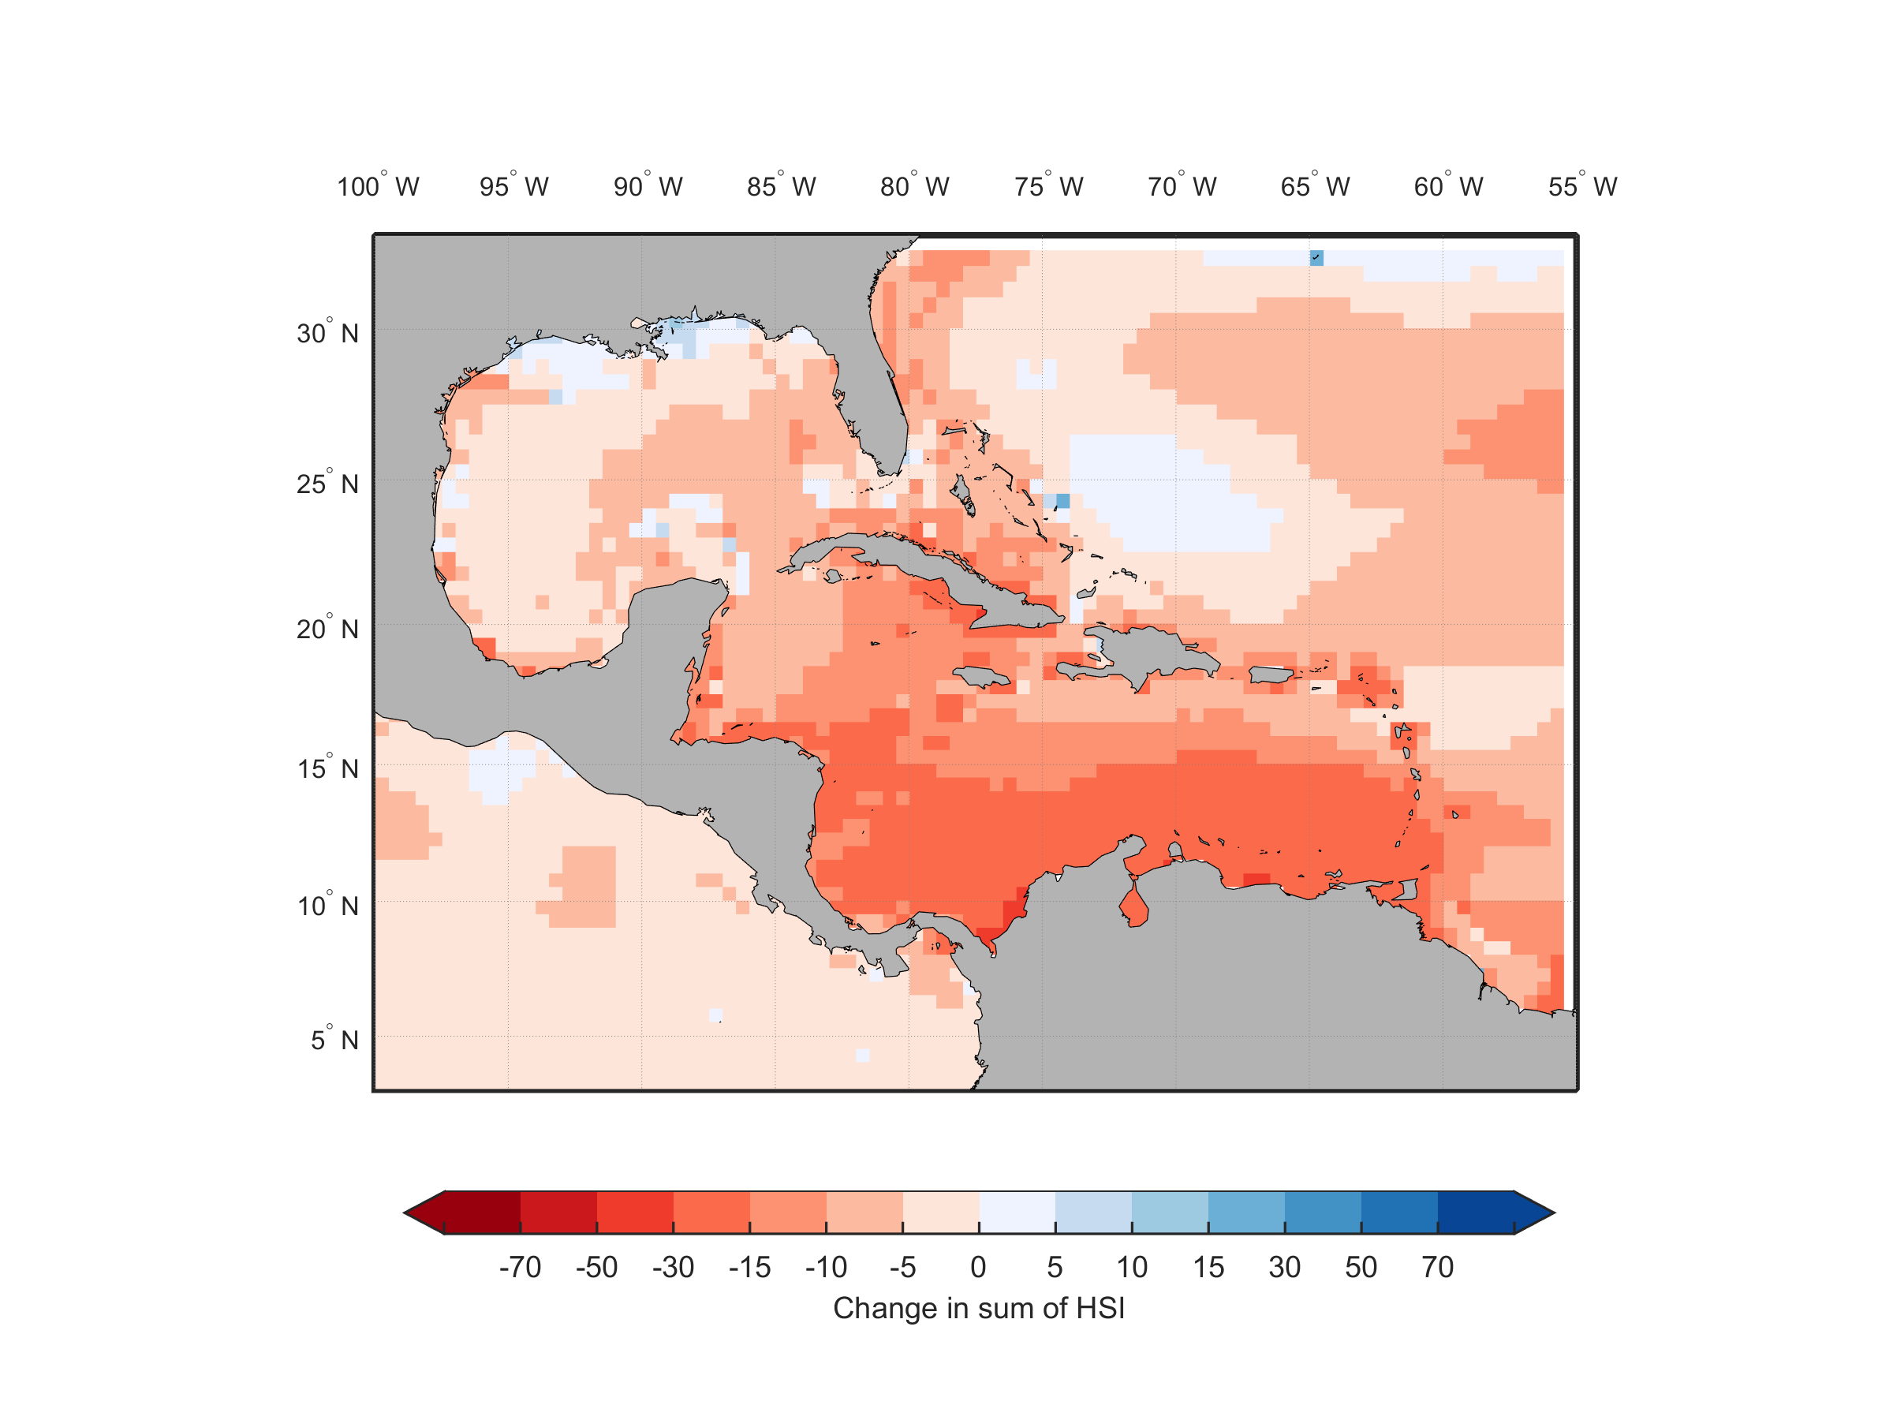
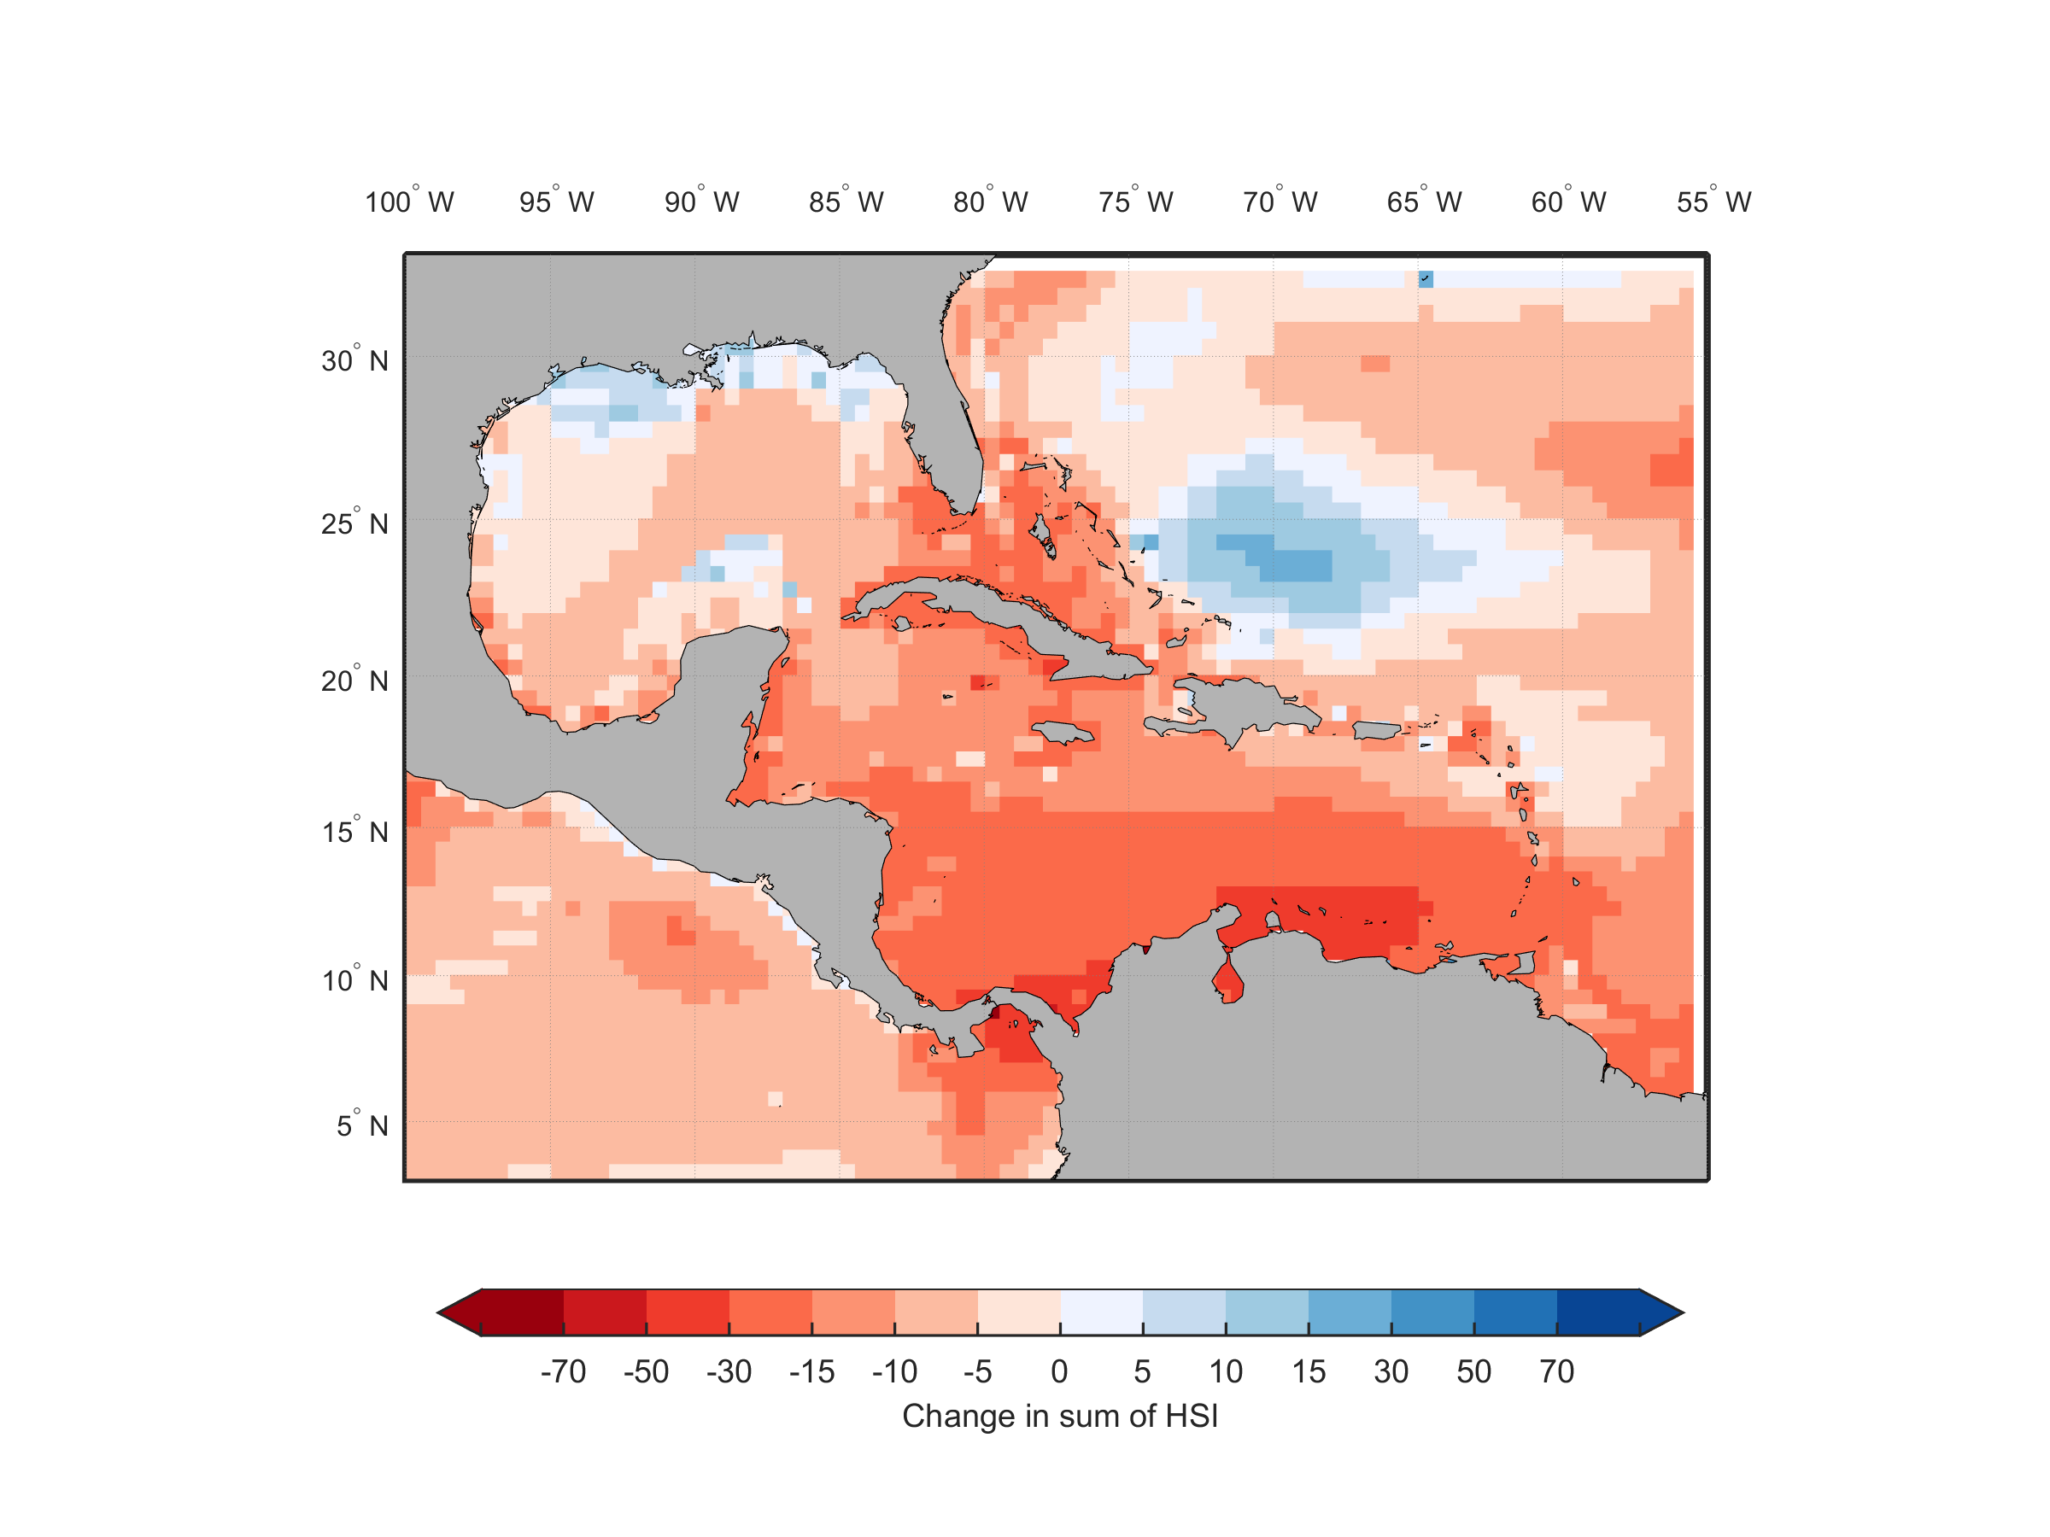
Projected Changes in Fisheries Catch Potential Ensemble average – Maximum Catch Potential (MCP)
Current distribution (1970-2000)
RCP2.6
RCP8.5
By 2050, substantial declines (up to >30% - particularly in the southern Caribbean across both RCPs).
Notes:
The ensemble average across maximum catch potential projections from the three earth system models (GFDL ESM 2G, IPSL-CM5A-MR, and MPI-ESM-MR) are presented here.
Climate change is projected to result in a substantial decline in maximum fisheries catch potential throughout the Caribbean region. MCP is expected to drop due to species losses and some species gains (i.e., species being caught today not the species caught 'tomorrow').
Overall, maximum fisheries catch potential across all exploited species were projected to decrease by 2050-2059 relative to 1970-2000 under RCP8.5. Although these projections were based on the coarse resolution Earth system models, the atmospheric CO2 concentration in these two time frames under RCP8.5 closely correspond to the ~400 ppm and ~535 ppm projection outputs from the high resolution Earth system model. Regionally, the decline in maximum catch potential was projected to be highest throughout the southern part of the Caribbean Sea.
Even under RCP2.6 maximum catch potential is projected to decrease. Even with significant GHG mitigation efforts (RCP 2.6), climate change will continue to have substantial impacts on the oceans for the next 60 years, due to ongoing biogeochemical processes.

Slide 22
Marine species in the Caribbean Sea are highly vulnerable to climate change and fishing impacts
Results support conclusions from previous global-scale assessments and science studies
Species assemblages in the region are highly sensitive to climate change
Narrow thermal tolerances compared to temperate species
Strong associations to particular habitats during part or all of their life history stages
New insights are available to help fisheries nations and communities prepare
Southern areas of the Caribbean Sea region are most at risk from climate change impacts
The most vulnerable and at risk species to climate change are of high value, such as groupers, snappers and parrotfishes
Smaller reef and pelagic species are more tolerant to the warmer ocean
Compared to today’s harvest levels, sustainable fishing in the 6 countries could reduce risk to fished species from climate change and fishing by 20 percentage points
Notes:
[These are selected high-level takeaways from the regional assessment. Results support conclusions from previous global assessments and studies.]
With regard to new insights, analysis shows that the southern part of the Caribbean Sea region emerges as amongst the most at risk and impacted under ocean conditions to be expected over the next few decades. The projected decrease in maximum catch potential and changes in species assemblages will likely pose substantial challenges to the fishing communities in the region. Many of the highly vulnerable and at risk species to climate change are commonly targeted and highly valuable species such as groupers, snappers and parrotfishes. The loss of these species may have large impacts on coastal fisheries and dependent communities from both a food security as well as livelihood perspective. Some species that are tolerant to the warmer ocean will be less affected by climate change, with our analysis suggesting that these species are likely to be smaller reef and pelagic species that are currently afforded lower market values, but still provide reasonable nutrition.

Slide 23
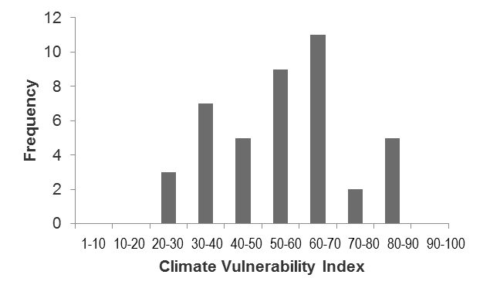
How is climate change likely to affect marine species?
Why is it important to study the ecological impacts of climate change on fisheries species?
How could species distribution shift by 2050?
Fisheries contribute significantly to food and livelihood security. 95% of reported catches are for local consumption and local sales.
The fisheries sector already suffers damage and loss from major storms, including declines in fish catches. Climate change adds to the threat.
Offshore areas closer to the west side of the island are expected to see modest species losses (10-20%). Offshore areas to the southwest are expected to see the greatest species gains (30-40%).
How vulnerable are exploited fish species to climate change?
How could catch availability decline by 2050?
Moderate
N = 42 spp.
Across species:
L:15-30%
H:30-60%
Snappers, groupers:
L &H: 80%
L=low emissions scenario; H=high emissions scenario
1 = Low
100 = Very high vulnerability
Notes:
[This is a summary of national-level results for Dominica. Paper B in the CRFM research paper collection presents national discussions of results for the six focal countries. You can draw on this paper to share additional information and results, as is relevant to the target audience]
Dominica’s fishery is predominantly artisanal in nature and diverse, targeting a wide range of demersal species along the island’s steep and narrow shelf, and focusing on offshore large pelagic species. Amongst the 42 species assessed, the ones with the highest vulnerability index were blue parrotfish (Scarus coeruleus, index =90), midnight parrotfish (Scarus coelestinus, index = 88), and hogfish (Lachnolaimus maximus, index = 88). Those with the lowest vulnerability index were mackerel scad (Decapterus macarellus, index = 24), sergeant major (Abudefduf saxatilis, index = 27) and balao halfbeak (Hemiramphus balao, index = 27).
Overall, the sum of habitat suitability indices across selected species in the EEZ of Dominica was projected to decrease by 20.25% and 48.90%, under atmospheric CO2 concentrations similar to the 2030-2039 and 2050-2059 periods under RCP8.5. Species that were projected to have the largest decrease in HSI include sailfish (Istiophorus albicans), Spanish mackerel (Scomberomorus maculatus) and bluefin tuna (Thunnus thynnus)
We projected that catch potential will decline by 5% to 15% and 15% to 30% by 2030-2039 and 2050-2059 relative to the 1970-2000 period, respectively, under RCP2.6. The projected declines in MCP almost doubled for both time periods under RCP8.5.

Slide 24
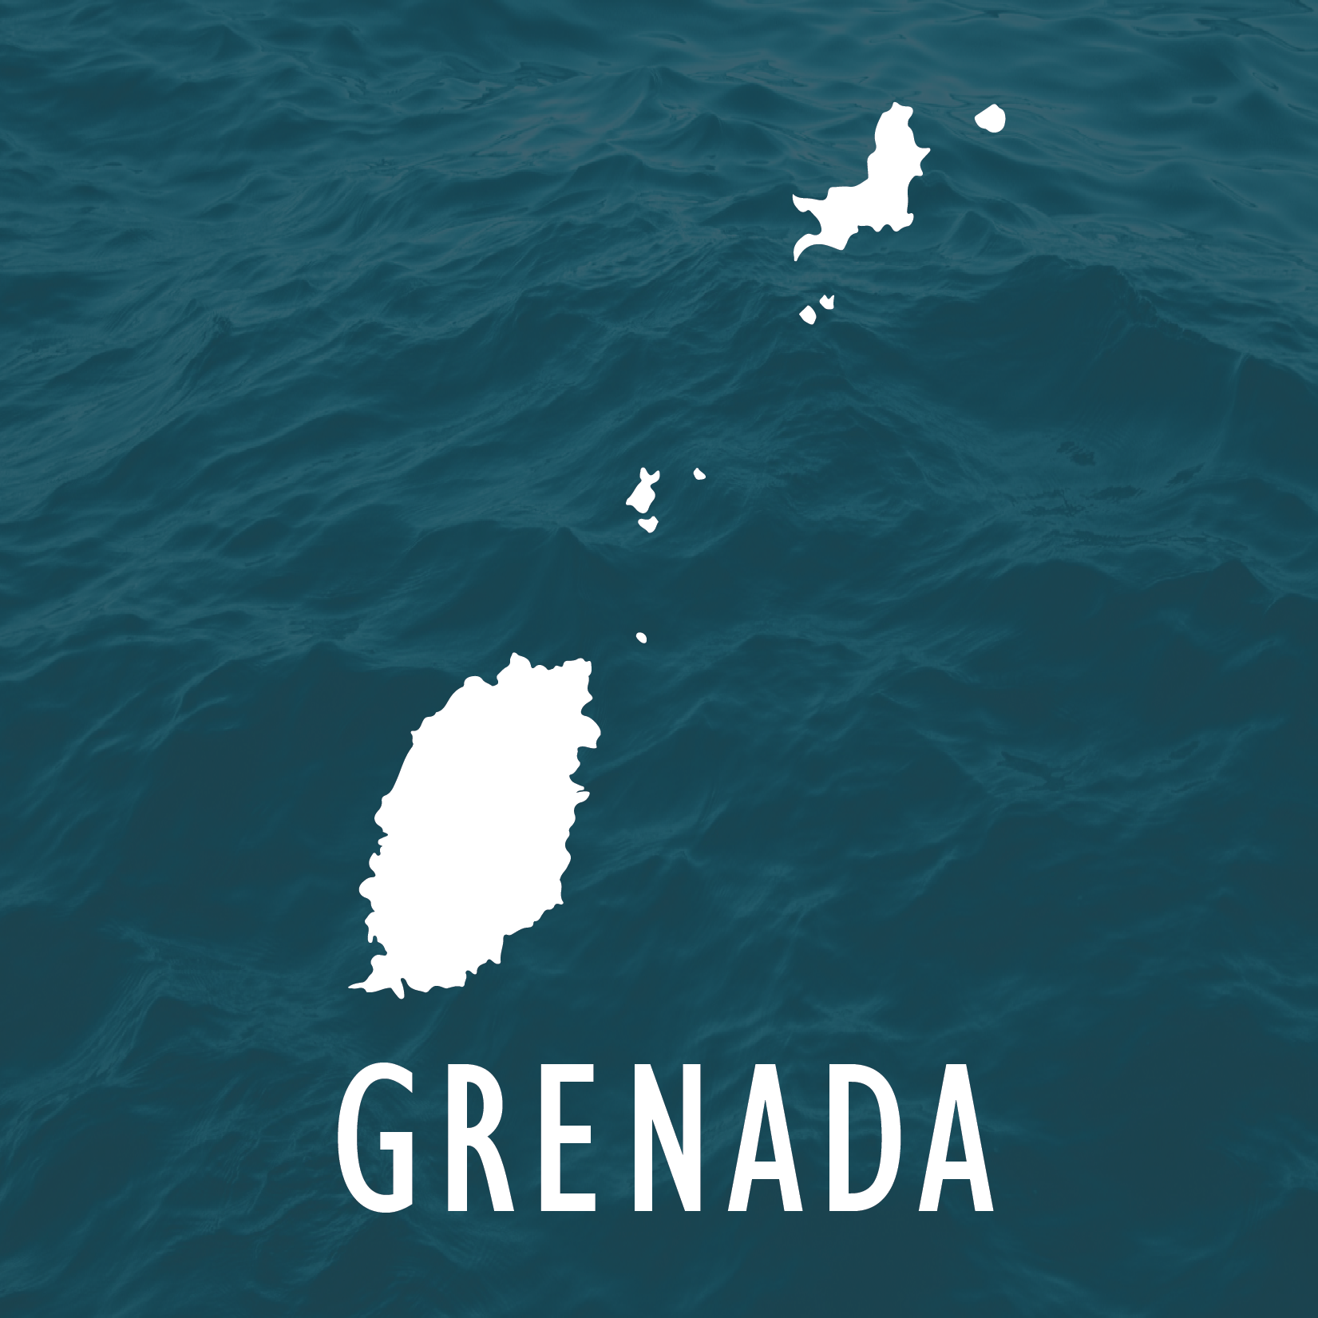
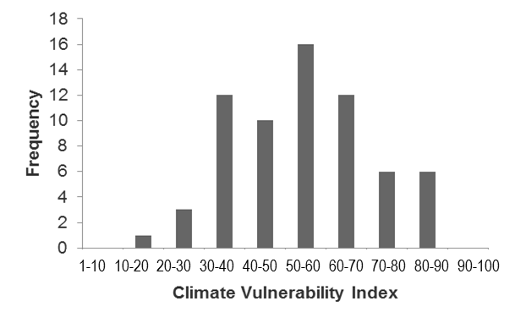
How is climate change likely to affect marine species?
Why is it important to study the ecological impacts of climate change on fisheries species?
How could species distribution shift by 2050?
Fisheries contribute significantly to livelihood security and a growing industrial sector.
The combined effect of climate change, pollution, overfishing and mangrove clearance is a threat to the health of Grenada’s reef system and related inshore fisheries.
Offshore areas to the east and south are expected to see modest species gains (20-40%). Species losses (up to 50-60%) will be seen in all offshore areas surrounding the islands, but less so throughout the Grenadine Bank
How vulnerable are exploited fish species to climate change?
How could catch availability decline by 2050?
Moderate
N = 66 spp.
Across species:
L:15-30%
H:30-60%
Snappers, groupers:
L &H:
50-60%
L=low emissions scenario; H=high emissions scenario
1 = Low
100 = Very high vulnerability
Notes:
[This is a summary of national-level results for Grenada. Paper B in the CRFM research paper collection presents national discussions of results for the six focal countries. You can draw on this paper to share additional information and results, as is relevant to the target audience]
Amongst the 66 species assessed, blue parrotfish (Scarus coeruleus, index =90), midnight parrotfish (Scarus coelestinus, index = 88), and hogfish (Lachnolaimus maximus, index = 88) scored the highest vulnerability index. Mackerel scad (Decapterus macarellus, index = 24), sergeant major (Abudefduf saxatilis, index = 27) and blue tang (Acanthurus coeruleus, index = 31) on the other hand had the lowest vulnerability indices.
Amongst the 66 selected species assessed, those with the highest risk of impact index included yellowtail snapper (Ocyurus crysurus), red hind (Epinephelus guttatus) and horse eye jack (Caranx latus). Those with the lowest risk of impact index included furry sea cucumber (Astichopus multifidus), graysby (Cephalopolis cruentata) and blue tang (Acanthurus coeruleus).
Overall, the sum of habitat suitability index across the selected species in the EEZ of Grenada was projected to decrease by 11.3% and 28%, under atmospheric CO2 concentrations that would be similar to the 2030-2039 and 2050-2059 periods under RCP8.5. Species that were projected to have the largest decline in HSI included donkey dug sea cucumber (Holothuria (Halodeima) mexicana
We projected that catch potential will decline by 5% to 15% and 15% to 30% by 2030-2039 and 2050-2059 relative to the 1970-2000 period, respectively, under RCP2.6. The projected declines in MCP almost doubled for both time frames under RCP8.5.

Slide 25
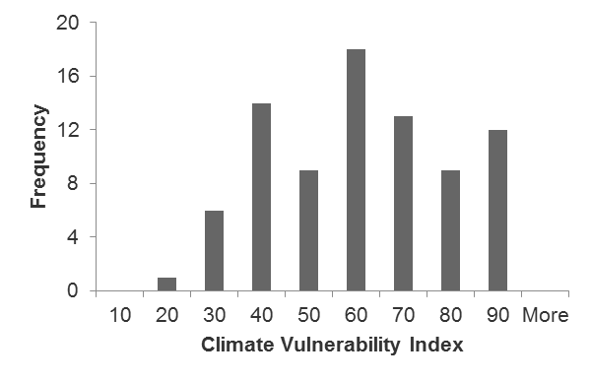
How is climate change likely to affect marine species?
Why is it important to study the ecological impacts of climate change on fisheries species?
How could species distribution shift by 2050?
Fisheries contribute significantly to livelihood and food security, and are a source of export earnings.
The combined effect of climate change, pollution, overfishing and poor land-use practices hampers marine ecosystems’ ability to support reef fisheries.
Offshore areas in the Gulf de la Gonâveare expected to see the greatest species gains (40-60%), as well as losses (30-50%). The north coast is expected to see a high proportion of species losses.
How vulnerable are exploited fish species to climate change?
How could catch availability decline by 2050?
Moderate
N = 82 spp.
N = 82 spp.
Across species:
L:10-30%
H:20-60%
Snappers, groupers, invertebrates:
L &H:
~100%
1-10 10-20 20-30 30-40 40-50 50-60 60-70 70-80 80-90 90-100
L=low emissions scenario; H=high emissions scenario
1 = Low
100 = Very high vulnerability
Notes:
[This is a summary of national-level results for Haiti. Paper B in the CRFM research paper collection presents national discussions of results for the six focal countries. You can draw on this paper to share additional information and results, as is relevant to the target audience.]
Haiti’s fisheries focus mainly on demersal (reef) fish species and a limited quantity of pelagic fish. Amongst the 82 species assessed, the ones with the highest vulnerability index were Mutton snapper (Lutjanus analis, index =90), jack (Caranx spp., index = 88), and gray snapper (Lutjanus griseus, index = 88). Those with the lowest vulnerability index were spotted goatfish (Pseudupeneus maculatus, index = 19), mackerel scad (Decapterus macarellus, index = 24) and sergeant major (Abudefduf saxatills, index = 27).
Amongst the 82 selected species, those with the highest risk of impact index included yellowtail snapper (Ocyurus crysurus), red hind (Epinephelus guttatus) and mutton snapper (Lutjanus analis) (Table 3). Those with the lowest risk of impact index included donkey dung sea cucumber (Holothuria mexicana), blue tang (Acanthurus coeruleus), and graysby (Cephalopolis cruentata).
Changes in ocean conditions under increased atmospheric CO2 concentrations were projected to result in a decline in the habitat suitability for selected species in the EEZ of Haiti. Overall, the sum of the habitat suitability index across the selected species in the EEZ of Haiti was projected to decrease by 25.2% and 29%, under atmospheric CO2 concentrations that would be similar to the 2030-2039 and 2050-2059 periods under RCP8.5. Species that were projected to have the largest decline in HSI include the Florida sea cucumber (Holothuria (Halodeima) floridana), fourwing flyingfish (Hirundichthys affinis) and red hind (Epinephelus guttatus)

Slide 26
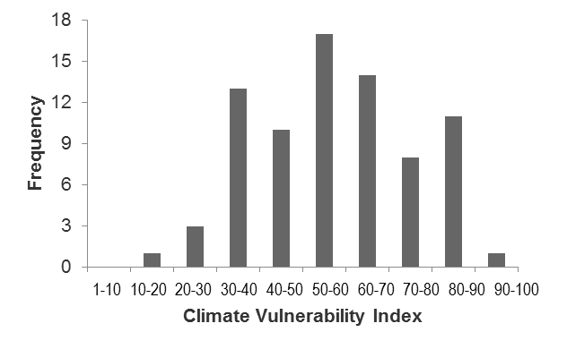
How is climate change likely to affect marine species?
Why is it important to study the ecological impacts of climate change on fisheries species?
How could species distribution shift by 2050?
Fisheries contribute significantly to food security, local livelihoods and are an important source of export earnings.
Jamaica’s marine resources are severely depleted. Climate change adds to the cumulative stresses facing reef ecosystems.
Offshore areas to the northwest were projected to have both high species gains (>50%) and extinctions (40-50%). Pedro Bank may see relatively lower impacts in terms of shifting species composition and local losses.
How vulnerable are exploited fish species to climate change?
How could catch availability decline by 2050?
Moderate
N = 78 spp.
Across species:
L:10-30%
H:20-60%
Snappers, groupers, invertebrates:
L &H:
~100%
L=low emissions scenario; H=high emissions scenario
1 = Low
100 = Very high vulnerability
Notes:
[This is a summary of national-level results for Jamaica. Paper B in the CRFM research paper collection presents national discussions of results for the six focal countries. You can draw on this paper to share additional information and results, as is relevant to the target audience.]
Vulnerability of selected species occurring in Jamaica was evaluated as moderate. A total of 78 of the selected study species were reported to occur in the EEZ of Jamaica (i.e., in the Changing Ocean Research Unit global marine biodiversity database), with a median climate vulnerability index of 57.5 (25th and 75th quartiles = 44.3 and 70.5, respectively, with 100 = maximum vulnerability). Amongst the 78 species, the ones with the highest vulnerability index were cubera snapper (Lutjanus cyanopterus, index =93), mutton snapper (Lutjanus analis, index = 90), dog snapper (Lutjanus jocu, index = 90) and blue parrotfish (Scarus coeruleus, index = 90). Those with the lowest vulnerability index were spotted goatfish (Pseudupeneus maculatus, index = 19), balao halfbeak (Hemiramphus balao, index = 27) and sergeant major (Abudefduf saxatills, index = 27).
Overall, the sum of the habitat suitability index across the selected species in the EEZ of Jamaica was projected to decline by 17.9% and 29.4%, under atmospheric CO2 concentrations that would be similar to the 2030-2039 and 2050-2059 periods under RCP8.5. Species that were projected to have the largest decrease in this included the Florida sea cucumber (Holothuria (Halodeima) floridana), the donkey dung sea cucumber (Holothuria (Halodeima) Mexicana) and the white margate (Haemulon album).
Maximum catch potential (MCP) was projected to decrease in the EEZ of Jamaica across time frames and scenarios (Figure 20). We projected that catch potential will decline by 5% to 15% and 10% to 30% by 2030-2039 and 2050-2059 relative to the 1970-2000 period, respectively, under RCP2.6. The projected decline in MCP almost doubled in both time frames under RCP8.5. Local extinction rates were very high for groupers, parrotfish, the graysby, and coney (almost 100% under the high CO2 concentration condition).

Slide 27
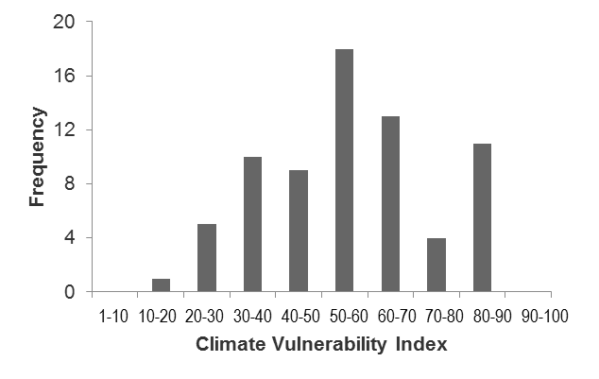
How is climate change likely to affect marine species?
Why is it important to study the ecological impacts of climate change on fisheries species?
How could species distribution shift by 2050?
Fisheries contribute significantly to livelihood and food security. As well, about 30% of reported catches are industrial.
The fisheries sector already suffers damage and loss in major storms, including damage to coastal ecosystems. Climate change adds to the threat.
Offshore areas to the south and west are projected to have large species losses (up to 50-60%). Species gains (30-40%) will be concentrated in limited offshore areas east of the island.
How vulnerable are exploited fish species to climate change?
How could catch availability decline by 2050?
Moderate
N = 72 spp.
Across species:
L:10-30%
H:20-60%
Snappers, groupers:
L &H: 80%
L=low emissions scenario; H=high emissions scenario
1 = Low
100 = Very high vulnerability
Notes:
[This is a summary of national-level results for Saint Lucia. Paper B in the CRFM research paper collection presents national discussions of results for the six focal countries. You can draw on this paper to share additional information and results, as is relevant to the target audience.]
Vulnerability of selected species occurring in the Saint Lucia EEZ was evaluated as moderate. A total of 72 of the selected study species were reported to occur in the EEZ of Saint Lucia (i.e., in the Changing Ocean Research Unit global marine biodiversity database), with a median climate vulnerability index of 57.0 (25th and 75th quartiles = 43.5 and 66.0, respectively, with 100 = maximum vulnerability). Amongst the 72 species, dog snapper (Lutjanus jocu, index =90), mutton snapper (Lutjanus analis, index = 90), and blue parrotfish (Scarus coeruleus, index = 90) registered the highest vulnerabilities. Spotted goatfish (Pseudupeneus maculatus, index = 19), sergeant major (Abudefduf saxatills, index = 27) and mackerel scad (Decapterus macarellus, index = 24) on the other hand had the lowest vulnerabilities.
Overall, the sum of the habitat suitability indices across the selected species in the EEZ of Saint Lucia was projected to decrease by 25.6% and 39.2%, under atmospheric CO2 concentrations that would be similar to the 2030-2039 and 2050-2059 periods under RCP8.5. Species that were projected to have the largest declines in HSI include donkey dung sea cucumber (Holothuria (Halodeima) Mexicana), the Florida sea cucumber (Holothuria (Halodeima) floridana) and the vermilion snapper (Rhomboplites aurorubens) (see online data portal associated with this project for maps of HSI for all individual species).
Maximum catch potential (MCP) was projected to decline in the EEZ of St. Lucia across time frames and scenarios (Figure 25). We projected that catch potential will decline by 5% to 15% and 10% to 30% by 2030-2039 and 2050-2059 relative to the 1970-2000 period, respectively, under RCP2.6. The projected declines in MCP almost doubled in both time frames under RCP8.5.

Slide 28
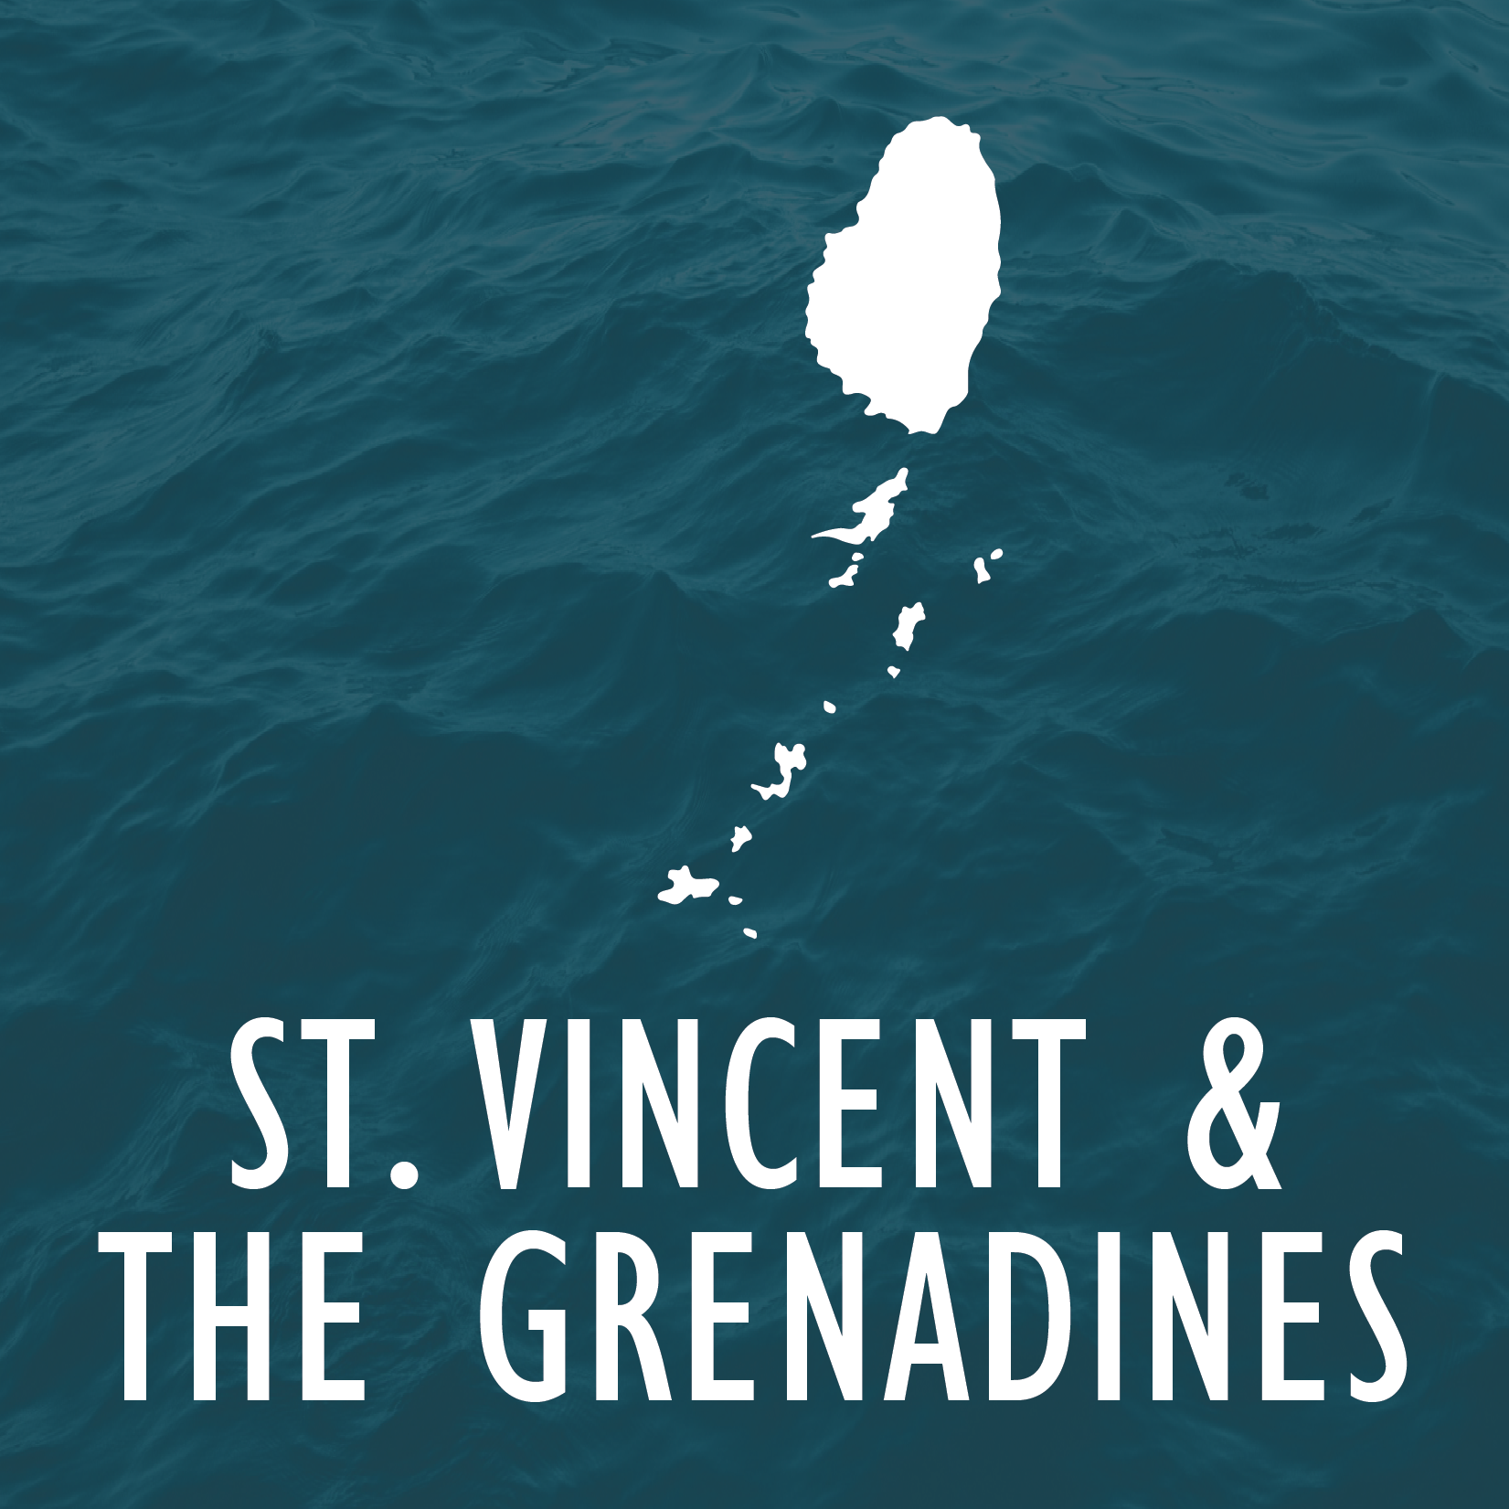
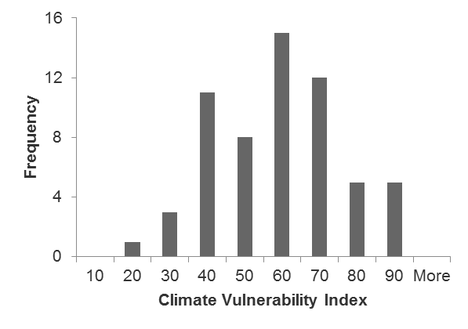
How is climate change likely to affect marine species?
Why is it important to study the ecological impacts of climate change on fisheries species?
How could species distribution shift by 2050?
Fisheries contribute significantly to livelihood and food security. As well, about 30% of reported catches are industrial.
The fisheries sector already suffers damage and loss in major storms, including damage to coastal ecosystems. Climate change adds to the threat.
Offshore areas to the east are expected to see modest species gains (20-30%). Species losses (up to 50-60%) will be seen in all offshore areas surrounding the islands, although less pronounced throughout the Grenadine Bank.
How vulnerable are exploited fish species to climate change?
How could catch availability decline by 2050?
Moderate
N = 60 spp.
Across species:
L:10-30%
H:20-60%
Snappers, groupers:
L &H:
50-60%
0-10 10-20 20-30 30-40 40-50 50-60 60-70 70-80 80-90 90-100
L=low emissions scenario; H=high emissions scenario
1 = Low
100 = Very high vulnerability
Notes:
[This is a summary of national-level results for Saint Vincent and the Grenadines. Paper B in the CRFM research paper collection presents national discussions of results for the six focal countries. You can draw on this paper to share additional information and results, as is relevant to the target audience.]
A total of 60 species of the selected study species were reported to occur in the EEZ of SVG (i.e., in the Changing Ocean Research Unit global marine biodiversity database), with a median climate vulnerability index of 55.5 (25th and 75th quartiles = 41.3 and 64.0, respectively, with 100 = maximum vulnerability). Amongst the 60 species, the ones with the highest vulnerability index were blue parrotfish (Scarus coeruleus, index =90), midnight parrotfish (Scarus coeruleus, index = 88), and hogfish (Lachnolaimus maximus, index = 88). Those with the lowest vulnerability index were spotted goatfish (Pseudupeneus maculatus, index = 19), sergeant major (Abudefduf saxatills, index = 27) and blue tang (Acanthurus coeruleus, index = 31).
Overall, the sum of habitat suitability index across the selected species in the EEZ of SVG was projected to decline by 31.4% and 46.6%, under atmospheric CO2 concentrations that would be similar to the 2030-2039 and 2050-2059 periods under RCP8.5. Species that were projected to have the largest decrease in HSI include donkey dung sea cucumber (Holothuria (Halodeima) mexicana), Atlantic bluefin tuna (Thunnus thynnus) and Atlantic sailfish (Istiophorus albicans).
Maximum catch potential (MCP) was projected to decline in the EEZ of SVG across time periods and scenarios (Figure 30). We projected that catch potential will decline by 5% to 15% and 10% to 30% by 2030-2039 and 2050-2059 relative to the 1970-2000 period, respectively, under RCP2.6. The projected declines in MCP almost doubled in both time periods under RCP8.5.

Slide 29
Economic Consequences of Climate Change for the Fisheries Sector in Six Caribbean Islands
Richard Boyd and Justin Ryan, Canada
Notes:
====
Notes:
[Prior to sharing results of the ecological modelling work we recommend reading and becoming familiar with the contents of paper C: Economic Consequences of Climate Change for the Fisheries Sector in Six Caribbean Countries. This paper is part of the CRFM research paper collection, containing reported outputs from Work Package 1.]
[The slide acknowledges the two Canadian economists who led the economic study.]
[The next 24 slides present highlights from the ecological assessment work. It draws on some of the research, there is the potential to extract much more, depending on your objectives and target audience.]

Slide 30
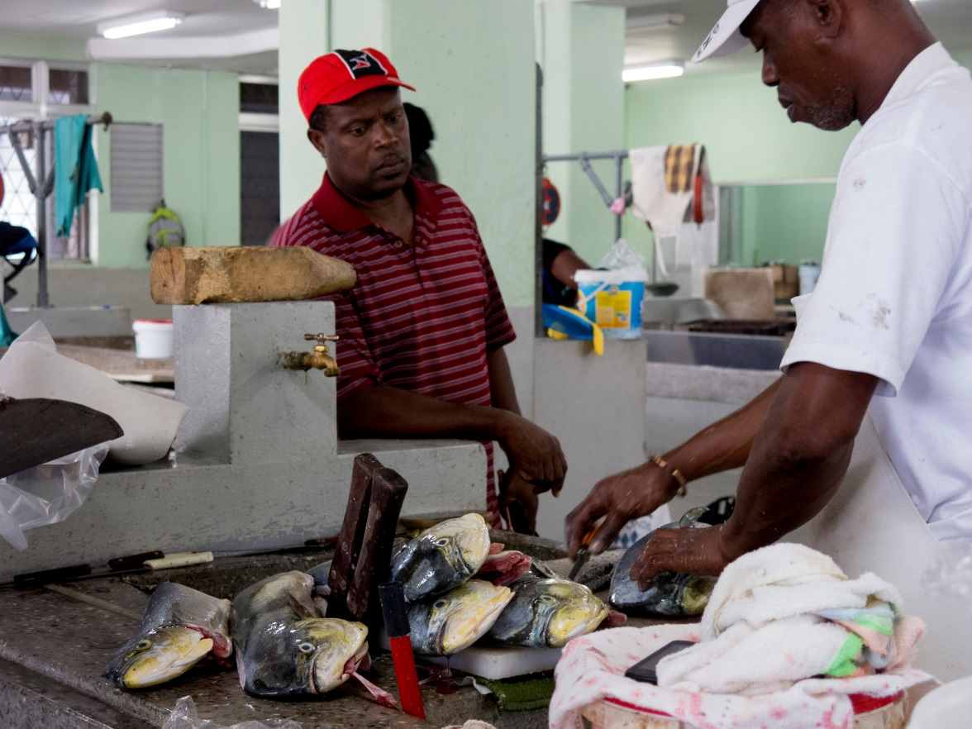
Objectives
To estimate national-level economic losses in the fisheries sector from:
Projected changes in catch availability due to climate change
Projected changes in the average intensity of storms due to climate change
To assess the impact of these economic losses on food security
Notes:
Fisheries and marine resources in the Caribbean region are vulnerable to a range of climate change impacts. Among them, further rising sea surface temperatures (SST), increased ocean acidification, further sea-level rise (SLR), and increases in the (average) intensity of tropical cyclones are likely to exacerbate ongoing challenges facing the sector in the near- and long-term. These climate change impacts will result in direct and secondary economic consequences for both harvesting and post-harvesting activities in the fisheries sector.
Data availability and interests of project stakeholders shaped the scope of the research on the economic consequences of climate change, which focused on analyzing and presenting the economic impacts of changes in fishery production (landings) due to:
**Changing ocean conditions (reflecting rising SSTs and ocean acidification), building on the results of the complementary ecological impact assessment, which generated estimates of changes in fishery production (catch) for each country under different climate scenarios (specifically, RCP (Representative Concentration Pathway) 2.6 and RCP 8.5); and
**Changes to the (average) intensity of tropical cyclones
**The impact of these economic losses on food security are also explored.
Economic estimates are presented at the national level for each of the countries with Pilot Program on Climate Resilience (PPCR) activities: Dominica, Grenada, Haiti, Jamaica, Saint Lucia and Saint Vincent and the Grenadines (SVG).

Slide 31
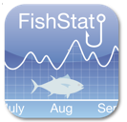
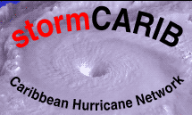
Overall Framework
Data assembly
Modelling & analysis
Key indicators
Collate economic, fishery production and population data
Assembly of tropical cyclone and sea-surface temperature data
Statistical modelling to generate supply, demand and income elasticities
Projected changes in domestic fish prices
Market supply -demand model
Projected changes in annual income
Projected changes in fish consumption
Traditional welfare economic analysis
**Estimated % reductions in catch available due to climate change
Projected impacts on fishery production (tonnage & landed value)
Statistical modelling to generate climate-change adjusted damage-intensity function
Projected loss in economic output
Projected household losses
**Derived from ecological modelling
Notes:
This slide summarizes the overall research framework adopted, which included a data collection phase, modelling & analysis and derivation and presentation of key indicators.
To estimate the economic consequences to fisheries sectors of climate change impacts on landings, a first step was to assemble two sets of data for each of the six countries: (1) economic (e.g., gross domestic product, seafood consumption / production), trade (imports / exports of seafood), landings (weight and value of seafood) and population data for the 2009-2013 baseline period. Fisheries data were compiled for 7 species groupings: Aquaculture, Demersal fish, Pelagic - tuna & billfishes, Pelagic – other than tuna & billfishes, Marine fish – other, Crustaceans and Cephalopods & molluscs. (2) historical tropical cyclone data from 1950 to 2014 (location, category, closes point of approach, whether it made landfall) and sea surface temperature data.
These data are inputs into two distinct analytical approaches, which we will touch on in the next few slides, to generate results to 2030s, 2050s and 2080s for the series of indicators shown here on the right.

Slide 32
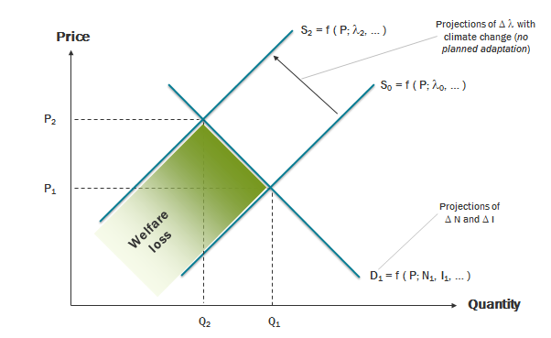
Economic Impacts: Changes in Catch
Approach based on traditional welfare economics
Gains / losses in economic well-being due to shifting relationships between aggregate quantity of goods supplied (e.g., fish), prices of goods and quantity of goods demanded
Requires understanding price and income “elasticities”
% change in the quantity of fish demanded in response to a 1% change in the price of that fish
% change in the quantity supplied in response to a 1% change in price
% change in the quantity of fish demanded in response to a 1% change in income of people who eat that fish
Climate change is introduced as a “shock” to supply
Estimated % reductions in catch, for 7 species groups
Considers two scenario combinations, two time slices
Reference scenario (population and economic growth only)
Emissions scenarios (low - RCP2.6; high - RCP8.5)
2030s, 2050s
Notes:
The economic impacts of climate-induced changes in fishery production (landings) are assessed using a market supply-demand model developed for each of the six case study countries. It is based on theoretical concepts of traditional welfare economics, which seeks to explore how the allocation of resources affects well-being of producers and consumers in an economic system.
A key component of the market supply-demand model is the derivation of price and income elasticities for each aggregate species grouping and country. Elasticity is a quantitative understanding of how changes in price of a good or service or changes in consumer income influence production and consumption patterns. Basic goods, such as food staples, are largely “inelastic”; they have few substitutes and people will continue to buy them even when there are price spikes, for example. We employed regression analysis to estimate three types of elasticities for each of the 7 species groupings for each of the 6 countries. When regression analysis did not yield statistically significant coefficients, we extrapolated values from the literature.
The impacts of climate change are integrated into the modelling framework as a supply shock. Maximum catch potential for 2035 and 2055 derived from the ecological modelling work were converted into % reductions in landings by main species groups by emissions scenario and time period.
With the market supply demand model we first project future demand, prices and quantities supplied without the effect of climate change (the reference scenario) and then overlay climate change as a supply shock (for two emissions scenarios). The results of comparing these two cases measure the incremental impact of climate change or the economic losses (or gains) caused by climate change.
====
Notes:
[The market supply-demand model is based on the analytical framework developed by Dey et al (2016), who evaluated the economic impacts of climate change and climate adaptation strategies for the fisheries sectors of Fiji, Solomon Islands, Timor-Leste and Vanuatu. The full mathematical specification of the model is contained in Dey et al. 2016.]
[The following six slides summarizes key results for each of the six PPCR countries. The results shown are relative to projected future values for 2050s. See the full study for additional results and explanations. The Excel-based market supply and demand models for each country are available for download on the project data portal.]

Slide 33
Projected Market Changes Due to Lower Catches in 2050s (All species groups)
RCP2.6
RCP8.5
+5% + 6%
Rise in aggregate fish prices
Relative to US$5,014 per tonne
-4% -5%
Yearly drop in total fish consumption
Relative to 2,375 tonnes
-4% -4.9%
Loss in annual income / economic well-being
Relative to US$16.8 million
-3.8% -4.9%
Drop in daily fish consumption by individuals
Relative to 85g per person per day

Slide 34
Projected Market Changes Due to Lower Catches in 2050s (All species groups)
RCP2.6
RCP8.5
+6% + 8%
Rise in aggregate fish prices
Relative to US$2,989 per tonne
-4% -5%
Yearly drop in total fish consumption
Relative to 3,702 tonnes
-4.6% -5.6%
Loss in annual income / economic well-being
Relative to US$16.6 million
-4.3.% -5.3%
Drop in daily fish consumption by individuals
Relative to 93.6g per person per day

Slide 35
Projected Market Changes Due to Lower Catches in 2050s (All species groups)
RCP2.6
RCP8.5
+3% + 4%
Rise in aggregate fish prices
Relative to US$2,097 per tonne
-4% -5%
Yearly drop in total fish consumption
Relative to 48,167 tonnes
-5.2% -6.3%
Loss in annual income / economic well-being
Relative to US$114 million
-4.3.% -5.3%
Drop in daily fish consumption by individuals
Relative to 92g per person per day

Slide 36
Projected Market Changes Due to Lower Catches in 2050s (All species groups)
RCP2.6
RCP8.5
+5% + 6%
Rise in aggregate fish prices
Relative to US$2,120 per tonne
-4% -5%
Yearly drop in total fish consumption
Relative to 90,607 tonnes
-4.3% -5.2%
Loss in annual income / economic well-being
Relative to US$253.6 million
-4.3.% -5.2%
Drop in daily fish consumption by individuals
Relative to 94.5g per person per day

Slide 37
Projected Market Changes Due to Lower Catches in 2050s (All species groups)
RCP2.6
RCP8.5
+5% + 7%
Rise in aggregate fish prices
Relative to US$7,560 per tonne
-4% -5%
Yearly drop in total fish consumption
Relative to 5,098 tonnes
-4.3% -5.3%
Loss in annual income / economic well-being
Relative to US$54.9 million
-3.8.% -4.9%
Drop in daily fish consumption by individuals
Relative to 77.6g per person per day

Slide 38
Projected Market Changes Due to Lower Catches in 2050s (All species groups)
RCP2.6
RCP8.5
+6% + 7%
Rise in aggregate fish prices
Relative to US$4,883 per tonne
-4% -5%
Yearly drop in total fish consumption
Relative to 2,062 tonnes
-4.8% -5.7%
Loss in annual income / economic well-being
Relative to US$14.8 million
-4.4.% -5.1%
Drop in daily fish consumption by individuals
Relative to 52.3g per person per day

Slide 39
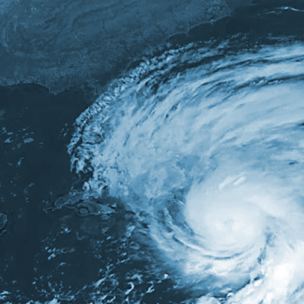
Economic Impacts: More Intense Tropical Cyclones under Climate Change
Use historical storm data (1950-2013) to estimate a “damage-intensity function”
Quantitative link between fishery output (tonnage) as a function of tropical cyclone intensity (max sustained wind speeds) among other factors
Modify key metric to reflect the impact of projected climate change
% damage as a function of changes in maximum sustained wind speeds
Integrate modified metric into estimated damage-intensity function to simulate fishery losses due to climate change
Compare losses without and with climate change
Present results for two emissions scenarios and two time slices
Emissions scenarios (low - RCP2.6; high - RCP8.5)
2050s, 2080s
Notes:
To assess the impact of climate change on the economic consequences of tropical cyclones for fisheries, a three-staged process was followed, using a tried and tested method (see Nordhaus (2010) and Acevedo (2016)).
** Historical data is used to estimate a damage-intensity function, in which a measure of fishery output (as the dependent variable) is related to a measure of tropical cyclone intensity (independent variable) among other things;
**The measure of tropical cyclone intensity is modified (i.e., uprated) to reflect the impact of projected climate change, as reflected in changes in maximum sustained windspeeds. Note that potential changes in frequency or in storm tracks are not taken into account.
**The modified tropical cyclone intensity metric is integrated into the estimated damage-intensity function and used to determine fishery losses attributable to climate change, all else being equal.
**Results are presented for all species groups, and account for uncertainty by using two emissions scenarios and reporting on statistical uncertainty.
In brief, the storm analysis simulates the incremental economic impact of a 'what if' scenario: all else being equal (historical catches, prices, adaptation, etc.), what if the same sample of storms reoccurred but with higher intensities anticipated with warming sea-surface temperatures? By incremental economic impact we mean the difference between lower catches attributable to the storms without and with climate change enhanced wind speeds.
====
Notes:
[The slide shows the generic formulation of the damage function used to relate more intense tropical cyclones to fisheries output. Various specifications of this equation are estimated standard (ordinary least squares) regression. Time invariant variables include: size of EEZ (km2), area of country (km2), length of coastline (km), ratio of coastline to area (%) and elevation span (m).]
[The following six slides summarizes key results for each of the six PPCR countries. These are the full range of estimated incremental direct impacts on fisheries production for the six case-study countries if the wind speeds of all historical storms (1950-2013) increased in response to rising SSTs projected under RCP 2.6 and RCP 8.5 by the 2050s. An important point to note when considering the results presented in the next 6 slides that they measure the incremental or additional impact of climate change over and above the impacts that these storms would have otherwise caused in the absence of further warming. Hence, even though the incremental impact of climate change may seem relatively low, the absolute impact of individual tropical cyclones may still be catastrophic. See the full study for additional results and explanations. The Excel-based market supply and demand models for each country are available for download on the project data portal.]

Slide 40
Simulated Losses Due to More Intense Tropical Cyclones in 2050s (All species groups) Central estimates
RCP2.6
RCP8.5
-50 to -170
-90 to -300
Loss in landed value
US$ thousand
Total loss in economic output
US$ thousand
-61 to -207
-109 to -365
Total loss in household income
US$ thousand
-14 to -49
-26 to -86
Drop in daily food supply as fish
Per person, relative to 2009-2013 average
0% to -0.8%
-0.1% to -1.5%

Slide 41
Simulated Losses Due to More Intense Tropical Cyclones in 2050s (All species groups) Central estimates
RCP2.6
RCP8.5
-40 to -150
-77 to -255
Loss in landed value
US$ thousand
Total loss in economic output
US$ thousand
-49 to -183
-97 to -317
Total loss in household income
US$ thousand
-11 to -43
-23 to -74
Drop in daily food supply as fish
Per person, relative to 2009-2013 average
0% to -0.5%
0% to -0.8%

Slide 42
Simulated Losses Due to More Intense Tropical Cyclones in 2050s (All species groups) Central estimates
RCP2.6
RCP8.5
-0.42 to -1.4
-0.73 to -2.45
Loss in landed value
US$ million t
Total loss in economic output
US$ million
-0.51 to -1.7
-0.89 to -3
Total loss in household income
US$ million
-0.12 to -0.4
-0.21 to -0.7
Drop in daily food supply as fish
Per person, relative to 2009-2013 average
0% to -0.7%
-0.1% to -1.1%

Slide 43
Simulated Losses Due to More Intense Tropical Cyclones in 2050s (All species groups) Central estimates
RCP2.6
RCP8.5
-1.7 to -5.5
-2.9 to -9.7
Loss in landed value
US$ million
Total loss in economic output
US$ million
-2.0 to -6.7
-3.5 to -11.8
Total loss in household income
US$ million
-0.47 to -1.6
-0.83 to -2.8
Drop in daily food supply as fish
Per person, relative to 2009-2013 average
-0.1% to -0.7%
-0.1% to -1.3%

Slide 44
Simulated Losses Due to More Intense Tropical Cyclones in 2050s (All species groups) Central estimates
RCP2.6
RCP8.5
-40 to -150
-80 to -260
Loss in landed value
US$ thousand
Total loss in economic output
US$ thousand
-55 to -181
-95 to -316
Total loss in household income
US$ thousand
-13 to -42
-22 to -74
Drop in daily food supply as fish
Per person, relative to 2009-2013 average
0% to -0.8%
-0.1% to -1.4%

Slide 45
Simulated Losses Due to More Intense Tropical Cyclones in 2050s (All species groups) Central estimates
RCP2.6
RCP8.5
-58 to -195
-102 to -340
Loss in landed value
US$ thousand
Total loss in economic output
US$ thousand
-70 to -237
-124 to -413
Total loss in household income
US$ thousand
-16 to -55
-29 to -97
Drop in daily food supply as fish
Per person, relative to 2009-2013 average
-0.1% to -0.7%
-0.1% to -1.3%

Slide 46
Climate change impacts on fisheries pose significant economic risk to islands in the Caribbean region
Climate change-induced ecological impacts on catch availability are projected to:
Increase domestic fish prices
Reduce domestic demand for fish and fish consumption by families
Reduce the wealth of producers and consumers
Climate change adds to the economic losses already felt due to the passage of tropical cyclones, including:
Increased losses in the quantity of fish caught and landed
Reduced revenues from landings
Reduced economic output of the sector
Reduced household income
Reduced fish available to eat
Notes:
====
Notes:
[These are selected high-level takeaways from the economic impact assessment. In addition to the specific quantitative estimates reported in the study, it is worth reflecting on the qualitative directional changes that the study has shed light on.]

Slide 47
Take-Home Messages
The majority of important fisheries species for the 6 Caribbean islands studied will face a greater risk of extinction under climate change.
Species distributions will shift. Suitable habitats are projected to decline across most of the Caribbean region, resulting in substantial local loss of species.
Fisheries catch potential is projected to decline across the region. Catch composition will change.
With lower catches due to climate change, Caribbean nations are projected to suffer losses in economic well-being due to too little production and consumption of seafood.
Climate change will exacerbate the fisheries sector’s vulnerability to economic loss and damage from tropical cyclones.
Climate change threatens food security. Lower catches and related price changes in addition to supply disruptions from more intense tropical cyclones under climate change will alter patterns of household fish consumption.
The short time frame over which these impacts are projected to occur poses substantial challenges for both the ecological and human systems to adapt, demanding swift transformations across the fish value chain.
Notes:
Virtually no species, including commercially-important fishery species, are expected to be spared negative impacts under a future climate. Climate change places most exploited species at high conservation risk, as habitats become increasingly unsuitable .
As a consequence of changes in species distributions and abundances, potential fisheries catches are projected to decline. Smaller catches will have significant repercussions for those involved in harvesting and post-harvesting activities and for the economy overall, in the absence of adaptation. These repercussions include adjusting to price increases, changing consumption patterns and reduced wealth of both producers and consumers. In addition, climate change will exacerbate the economic impacts of extreme events.
The rate of ecological change projected, especially if global carbon emissions continue largely unabated following the “business-as-usual” scenario, will demand swift transformations across the fish value chain.
====
Notes:
[Each take home message is worth discussing with stakeholders. Inspiring action requires an appropriate and evidence-based understanding of the risks faced but stakeholders should not feel disempowered. Self-efficacy – or the belief that one has the power and capability to do something – is a key emotion to convey.]
[Module 4 in this series of PPT slides includes local and national perspectives on current challenges in the sector and priorities for climate change adaptation.]

Slide 48
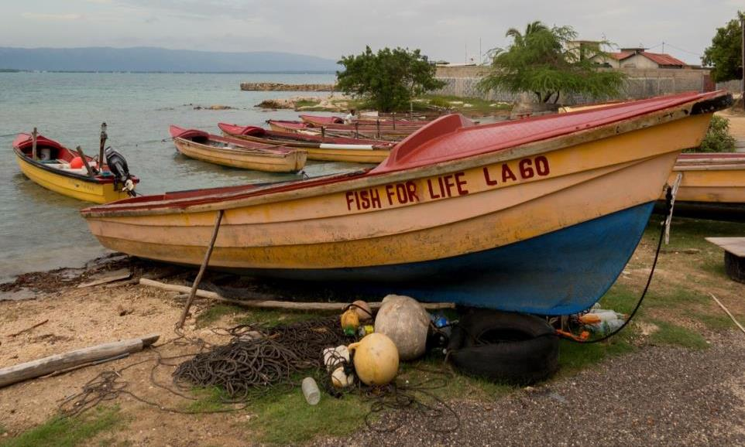
Thank You!
Contacts
Name (name@email.com)
Acknowledgements
We would like to thank ….
Full Citation / Further Information
Citation or Website

