Slide 1
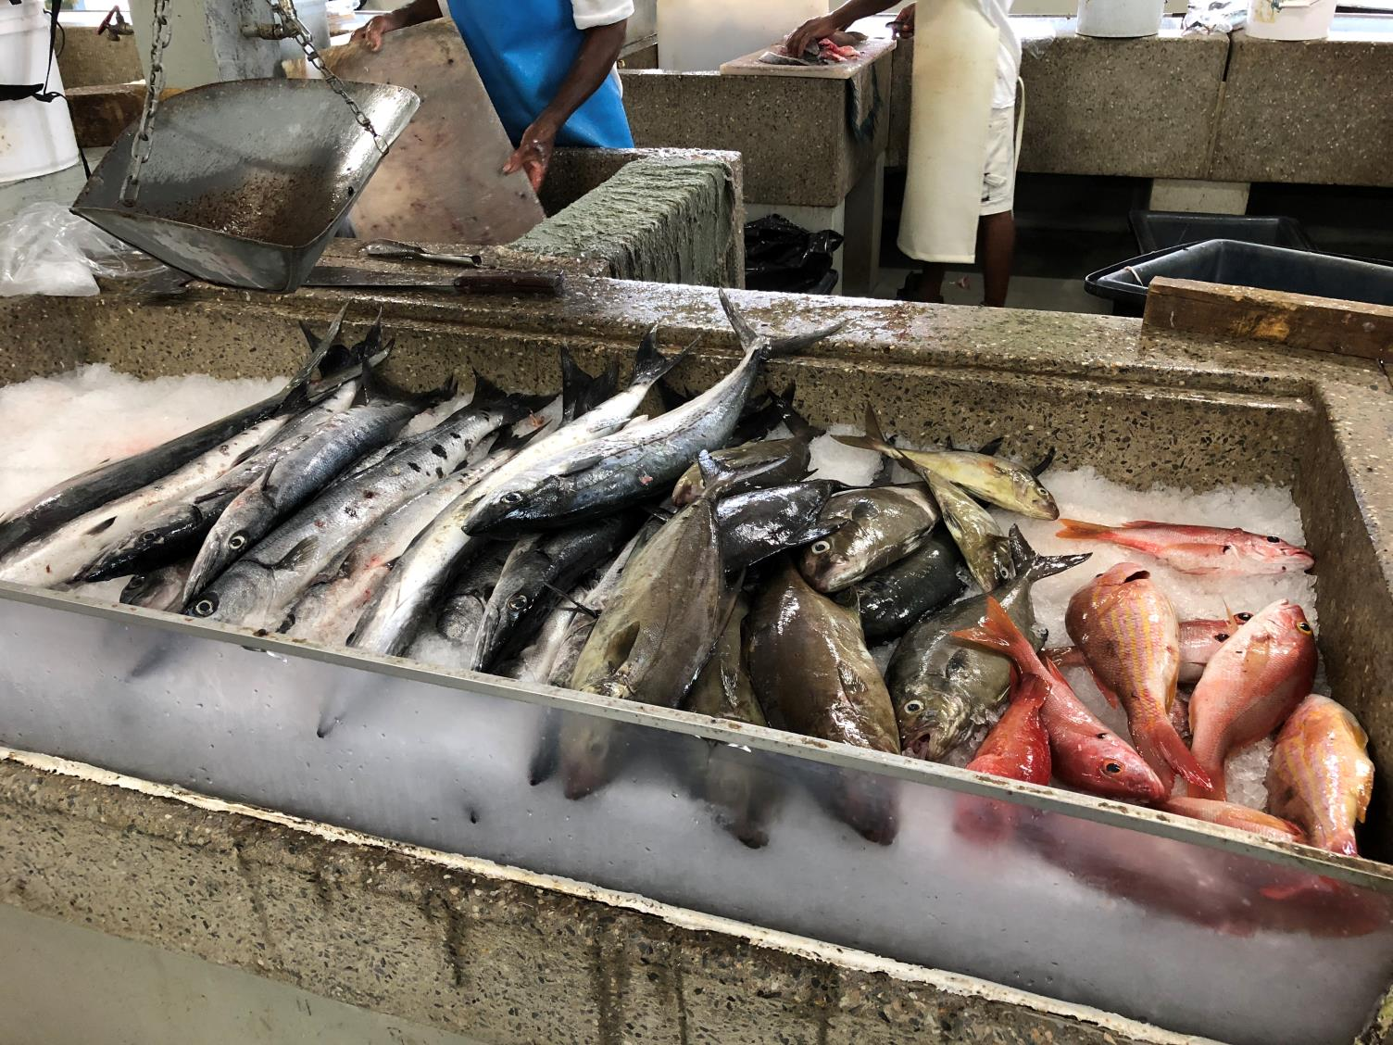
Module 4: Adaptive Capacity of Caribbean Fisheries Sectors
PRESENTERS
Location, Date
Produced by ESSA Technologies Ltd. for the Investment Plan for the Caribbean Regional Track of the Pilot Programme for Climate Resilience

Slide 2
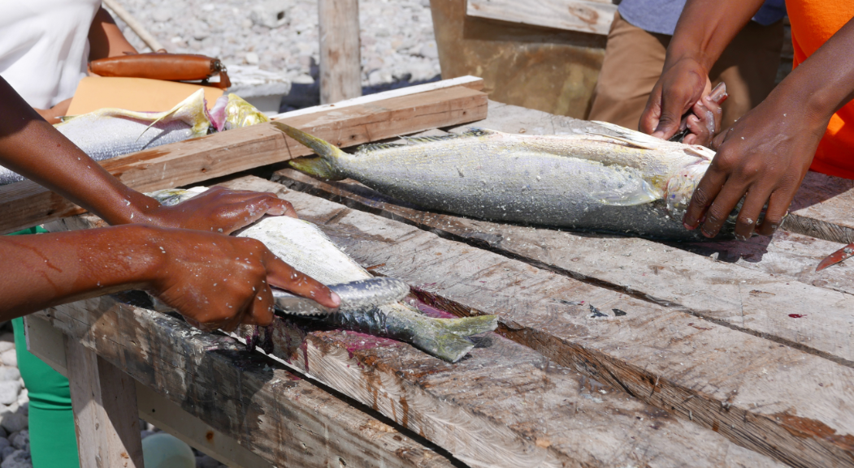
Objectives
Share local knowledge and perspectives from a range of sectoral stakeholders to understand key vulnerabilities and capacities to adapt
Shed light on potential priorities for action toward climate-smart fisheries and value chains
Notes:
The project included opportunities for qualitative research with local stakeholders to learn about baseline factors that increase or reduce vulnerability to climate change as well as perspectives on adaptation priorities.

Slide 3
Overall Approach
Complementary qualitative methods used to understand the sector’s vulnerabilities and capacities
Local fisherfolk, resource managers, policy actors and other along the value chain to identify their own vulnerabilities, expectations and priorities to address these issues
Takes a systems approach, recognizing that fisheries are complex socio-ecological systems and that climate change is one driver of many
Entry point for climate change outreach, adaptation planning and disaster-risk reduction
Notes:
The quantitative climate change impact assessment work completed under Work Package 1 provided important information on the sector’s exposure and sensitivity to climate change, producing results at a species level, national and regional scales. This type of work focuses less on understanding key aspects of human adaptive capacity, which is best addressed through qualitative, social science research. Two different project activities involved field-based data collection at selected fishing sites and served to (1) characterize knowledge attitudes and current action on climate change and (2) characterize assets and vulnerabilities across seafood value chains.
Although the focus of both streams of work (the KAP study and value chain analysis) was on hearing from fisherfolk, views from resource managers, policy actors and other stakeholders in the sector were also sought. Both research activities adopted a systems lens, recognizing the intimate connections between ecosystem health, environmental change and human activities at different scales and recognizing the importance of not looking at climate change in isolation of ongoing stresses and threats.
The aim was for this work to inform climate change outreach, sectoral adaptation planning and disaster risk reduction.
====
Notes:
[This Module picks up concepts introduced in Module 2. You may want to include some slides from Module 2 as part of the introduction to the Knowledge-Attitudes-Practice and value chain research.]

Slide 4
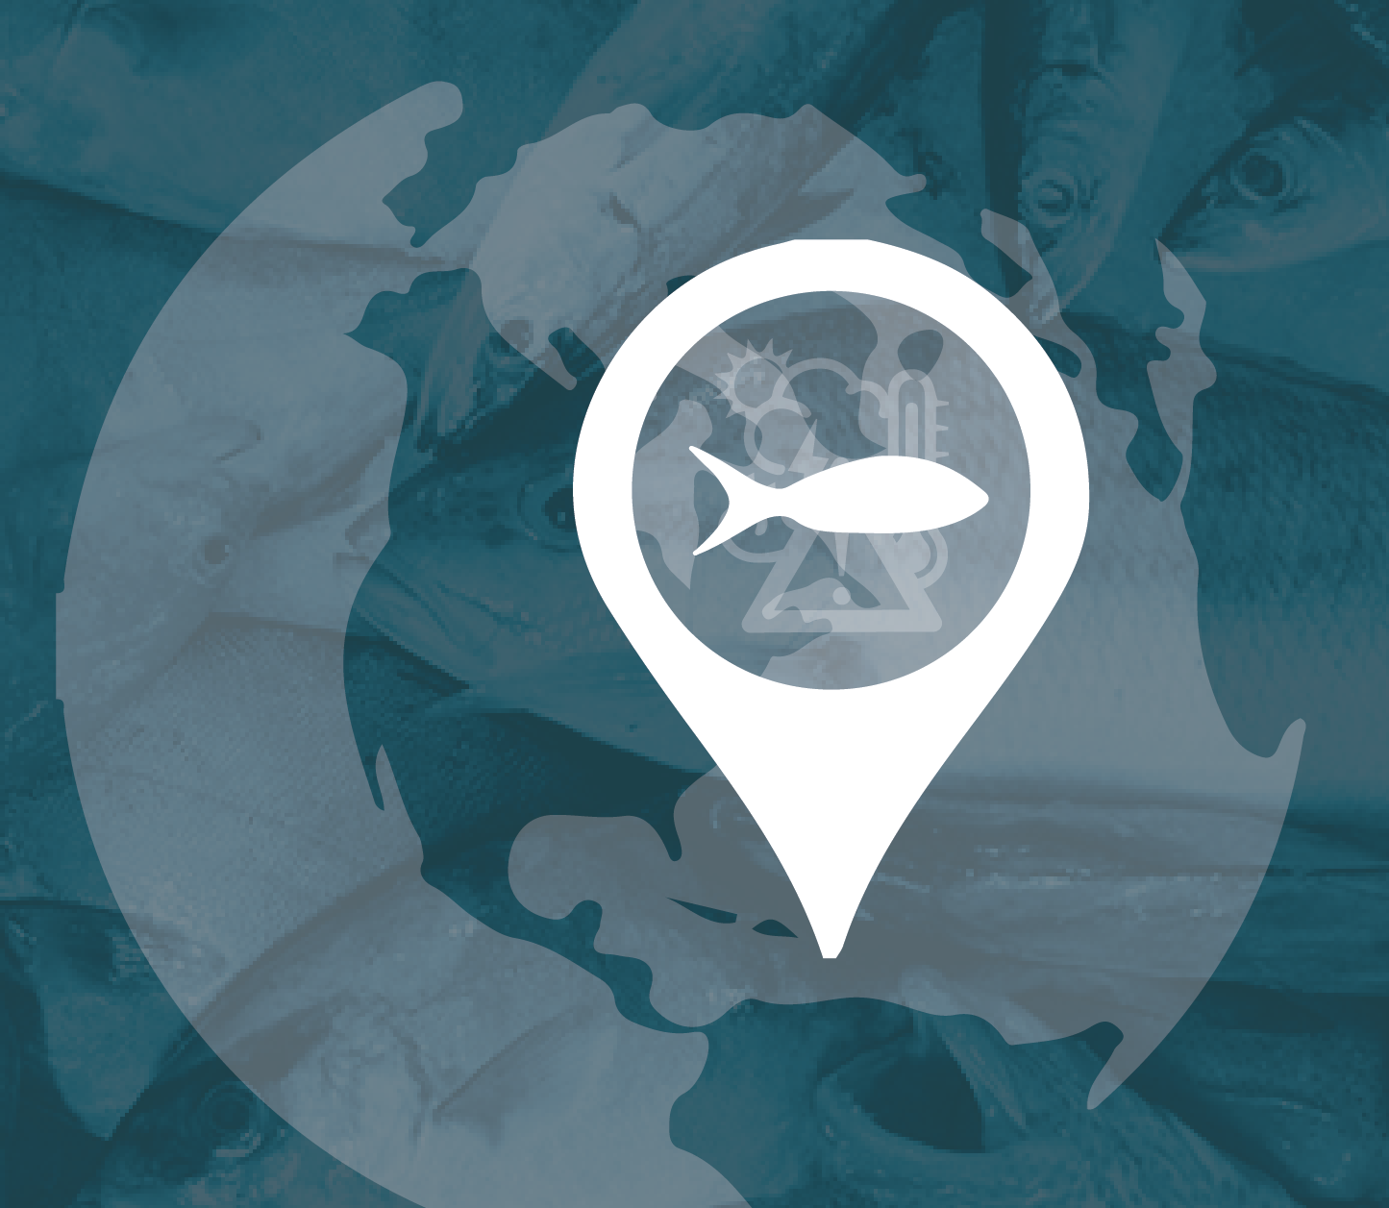
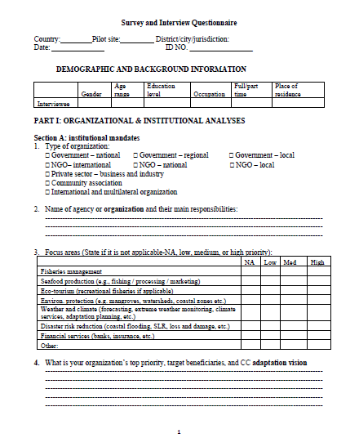
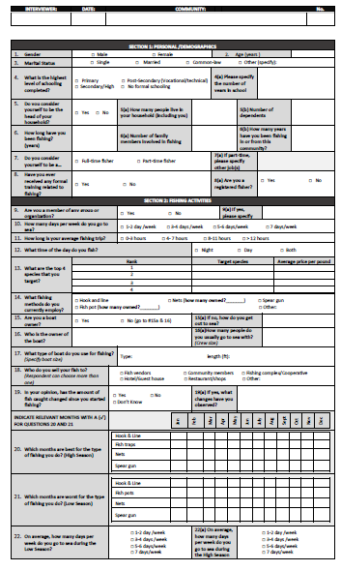
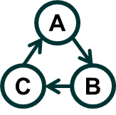
Methods
Select study sites for local research
Verify with national representatives
Design research approaches and data-collection instruments
Fieldwork to collect data in 3 target communities, supported by fisheries authorities (April – September 2018)
Data analysis and reporting
Notes:
This slide summarizes the broad approach taken for the two research activities. Because of budget and logistical limitations it was important to select sites for local research and this was the very first step, followed by design of data collection instruments (questionnaire, online survey, interview guides), field work in 3 target fishing sites, which took place in 2018, qualitative and semi-quantitative data analysis and preparation of reports.
====
Notes:
[Contents of this presentation draw from two sources: (1) paper D in the CRFM Research Paper Collection – Toward Climate-Smart Value Chains in Caribbean Fisheries and (2) the Knowledge-Attitudes-Practice Study, which was a main output of Work Package 3. Both sources are available on the project data portal.]

Slide 5
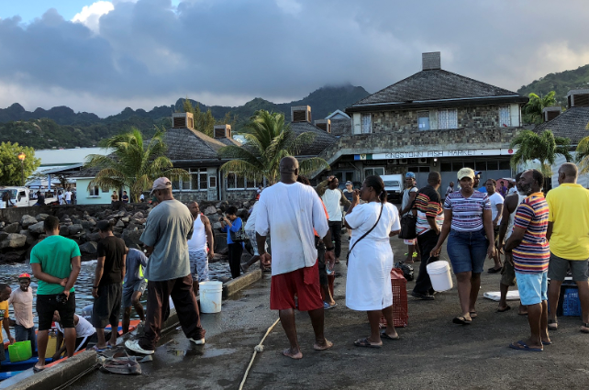
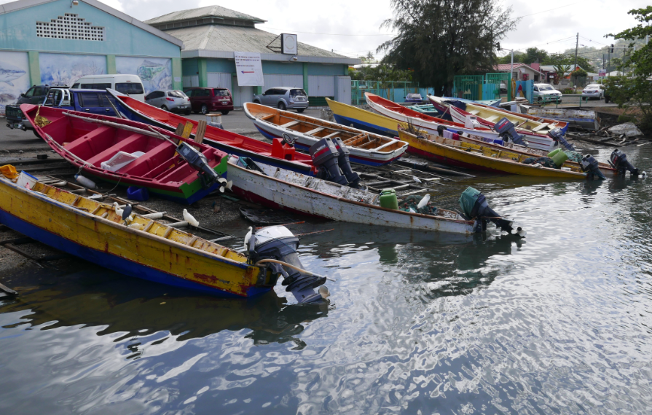
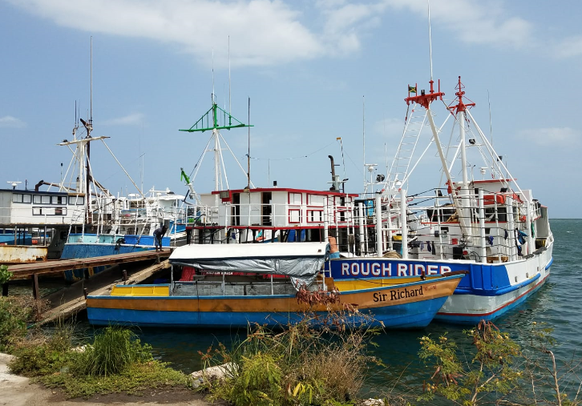
Selection of Study Sites Criteria
Representativeness (critical habitats, fishing activity, West / East)
Strong coupling of ecological and social systems
High contribution of / reliance on fisheries to food security, livelihoods and / or trade
Vulnerability of coastal infrastructure and fisheries assets
Level of stakeholder interest in climate resilience
Conducive to undertaking field research / engagement in a way that is socially inclusive and supported by authorities and leaders
Potential access to a wide range of knowledge holders across the value chain
Accessibility for field work (cost-effectiveness, safety)
Availability of secondary data sources
Kingstown (SVG)
Roseau (Dominica)
Montego Bay, Jamaica
Notes:
As mentioned, primary data collection in fishing communities across the 6 PPCR countries was not possible due to budget and logistical constraints. Instead we focused these efforts on 3 pilot study sites identified and approved by the project Working Group in June 2018. These sites are: Montego Bay, Kingstown and Roseau. These 3 sites scored most favourably in our assessment of an initial list of 8 sites scored against the criteria shown on this slide (high, medium and low). Information to score each option came from the Food and Agriculture Organization (FAO) country profiles (http://www.fao.org/fishery/countryprofiles/search/en ) and a preliminary review of the literature.

Slide 6
Type of Study | Coverage and Approach | Application
Knowledge-Attitudes-Practice (KAP)Study | Paper questionnaires, key informant interviews and online survey targeting fishers, policy actors and fisheries sector managers to understand their knowledge, attitudes, and practices with respect to fisheries, climate change impacts, adaptation and disaster risk management, including perspectives on the relevance of a range of adaptation options for fisheries. | Fieldwork: Kingstown (St. Vincent and the Grenadines), Roseau & surroundings (Dominica), Montego Bay (Jamaica) Remote research (online survey, Skype interviews): Six pilot countries
Value Chain Analysis | Key informant interviews and focus group discussions identify key challenges, coping strategies and priorities for action across the fish value chain – from raw material supply from marine ecosystems to harvesting strategies, fishing activities, processing and marketing. Review of secondary sources. | Fieldwork: Kingstown (St. Vincent and the Grenadines), Montego Bay (Jamaica)
Notes:
This slide summarizes what we did, how we did it and where. The next two slides provide additional information on the inquiry areas covered through each of the studies. Inquiry areas were translated into specific questions in data collection instruments.

Slide 7
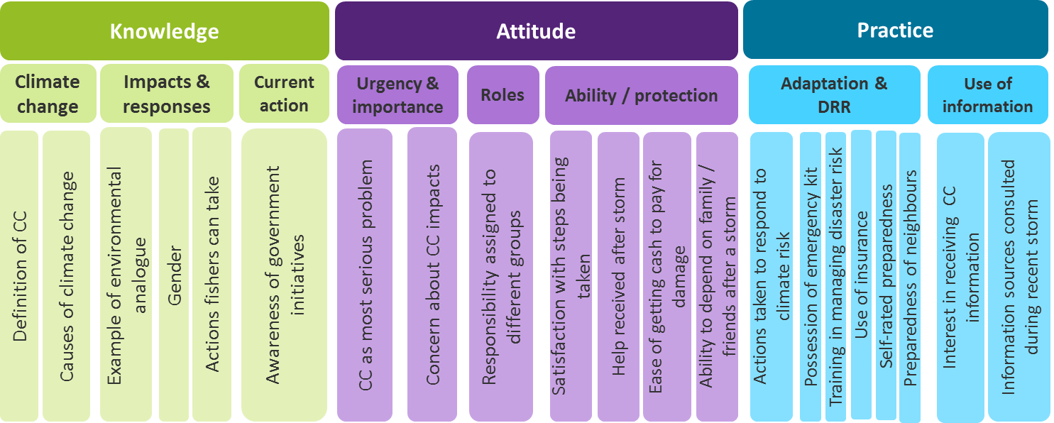
Inquiry Areas for the Knowledge-Attitudes-Practice (KAP) Study
Perceived impact of climate hazards
Perceived adaptation priorities for the fisheries sector

Slide 8
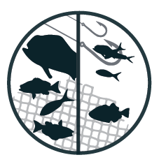
Inquiry Areas for Value Chain Analysis
Coastal & marine governance
Fisheries management and marine resource management
Mainstreaming adaptation into ecosystems and fisheries management
Policy networks and brokerage across the fish value chain
Post-harvest activities
Product differentiation
Value addition and up-scaling initiatives
Supply chain dynamics
Market destinations and consumer preferences
Resource users and fishing households
Current resource use and fishing activities
Cost, earnings and economic performance
Livelihood vulnerability to climate stressors
Responses to climate stressors

Slide 9
Who participated?
KAP Study - Fishers |  |  |  | KAP Study - Managers* and Policy Actors**
Sex | Montego Bay (JAM) | Kingstown (SVG) | Roseau (DOM)
Female | 0 | 1 | 2 | 15
Male | 37 | 59 | 58 | 15
No answer | 3 | 0 | 1
Total |  |  |  | 191
Value Chain Analysis - Jamaica |  |  |  | Value Chain Analysis - SVG
Sex | Fishers | Processors, marketers, retailers | Public officials | Fishers | Processors, marketers, retailers | Public officials
Female | 0 | 0 | 2 | 0 | 0 | 5
Male | 16 | 4 | 2 | 6 | 4 | 8
Total |  |  |  |  |  | 47
* For example, from Montego Bay Marine Park Trust, National Environment and Planning Agency (Jamaica), National Emergency Management Organization (St. Vincent and the Grenadines), 4BluC's (Saint Lucia), Fisheries Divisions & Departments and the CRFM Secretariat.
**Chief Fisheries Officers and a Director of Fisheries
Notes:
Through both research activities we were able to gather knowledge and perspectives from over 230 individuals in the sector, 2/3 of them fishers. Female representation is very low among fisherfolk but balanced among managerial and policy actors.
====
Notes:
[You may wish to engage in a short discussion about your own past experiences in undertaking research and stakeholder engagement, and any issues you have had in being inclusive. You can also discuss potential implications of not incorporating female perspectives in this particular research.]

Slide 10
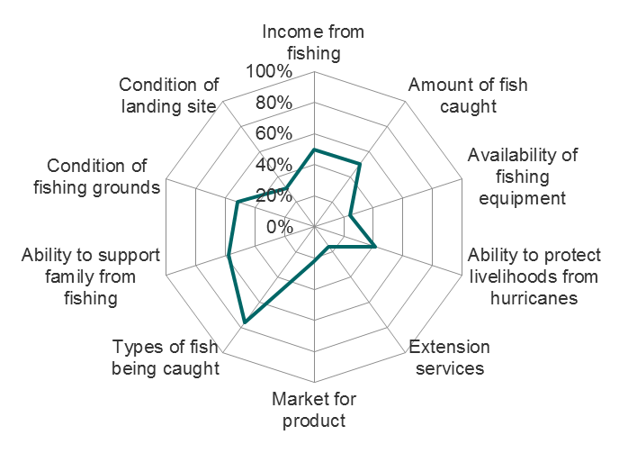
Opportunities, Assets & Challenges Knowledge-Attitude-Practice Study
Fishers
Predominantly male
Mature (50 years average age) and experienced in fishing
Some education. Limited formal training in fishing activities.
Generally high reliance on fishing. Majority fish full time. More part-time fishers in Montego Bay – supplemental income in many cases from activities allied to fishing
% of fishers surveyed who are satisfied
About half of fishers own their boats, the other half rent, borrow, rely on associates or family
Fishers use multiple gears, hook and line most common, followed by fish pots and nets
Average running costs per fishing trip are EC$421, but the range spans two orders of magnitude. Fuel makes up over 50% of running costs
Other community members are most frequent buyer of catch. Fishers also sell to vendors, fishing complex, hotels & restaurants
75% of fishers have seen changes in their catch over their lifetime, mostly less fish, but also more fish (related to FADs) and smaller fish
Top 3 fishes targeted – tuna, dolphinfish, snapper are moderately to highly vulnerable to future climate change
Several aspects of fishing are not satisfactory
Notes:
This series of slides reports on results of KAP study expressed as opportunities and assets or factors that could contribute to climate resilience, as well as vulnerability challenges, by stakeholder group (fishers, managers, policy actors). Fishers surveyed in the KAP study present a range of socio-economic attributes – like age, education and reliance on fishing that in some cases could confer vulnerability. For example, low levels of education can mean fishers are less able to diversify income-generating activities and may have low financial literacy. The bottom half of the slide summarizes key characteristics of the sample’s fishing activities. Of note, a majority of fishers are satisfied with the types of fish being caught; however, the top 3 fish species targeted are vulnerable to future climate change.
====
Notes:
[You may wish to remind or provide your audience a brief background on factors that enhance / reduce vulnerability to climate change and other stressors, as reviewed in Module 2.]
[Because these results are based on case study research, we recommend using these points to elicit discussion with your target audiences. A first step might be to engage your audience in a discussion on which of the points sounds familiar (or are commonly exhibited in their community / constituency). Next, engage your audience in a discussion focused on exploring whether the identified attributes make the community vulnerable or confer resilience.]

Slide 11
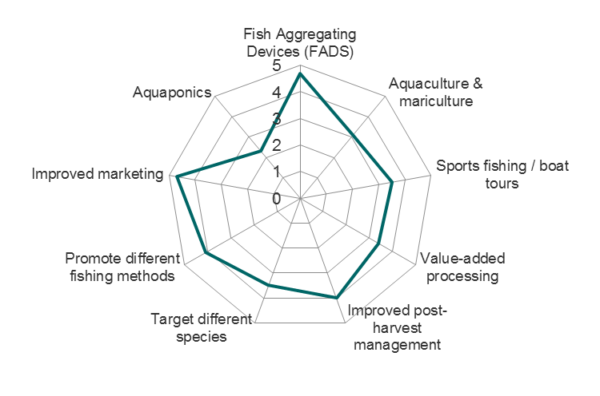
Opportunities, Assets & Challenges (cont.) Knowledge-Attitude-Practice Study
Fishers
Are observing environmental changes. Some fishers connect physical / climatic changes to biological (fish) and socio-economic impact
Report that hurricanes / storms, coastal flooding and coastal erosion have caused the most significant adverse impacts on their communities or fishing areas
Report mixed effects of Sargassum blooms: + increases amount and access to fish; - tangles fishing lines and damages engines and equipment
Have a low awareness of the causes of climate change
K
Feasibility of adaptation options (average scores out of 5)
Conflate environmental degradation and climate change
Can describe actions to cope with severe weather and climate change impacts, including becoming informed and being prepared
Are largely unaware of government action to adapt to climate risk
Believe climate action is a shared responsibility
Consider day-to-day and economic issues – fuel price, market for catch and equipment cost –as their most important problems. Climate change is not top of mind
Are concerned to very concerned about the impacts of climate change
Are confident they could turn to close family / friends if they needed extra help
Are confident in their preparedness to deal with major storms
Report low uptake of measures to reduce disaster risk, particularly home and property insurance
A
P
Notes:
This slide shows key results related to climate change knowledge, attitudes and practice of fishers. Each of these points can inform climate change outreach as well as government action to manage climate risk in the sector.

Slide 12
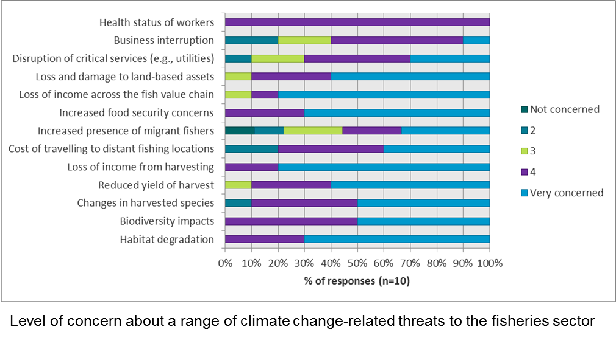
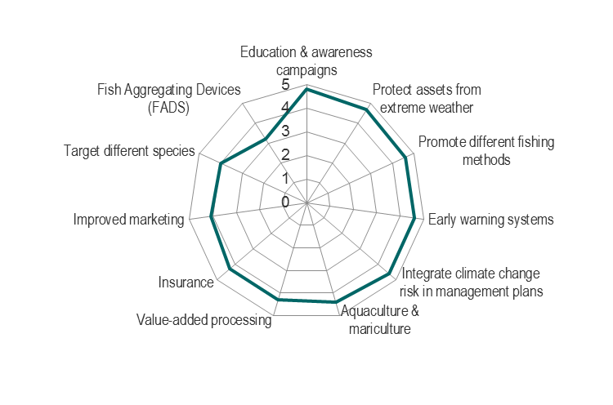
Opportunities, Assets & Challenges (cont.) Knowledge-Attitude-Practice Study
Managers
Are concerned about the ecological, economic and business impacts of climate change
See FADs as the least important adaptation option to pursue and education & awareness campaigns as the most important option
See the cost of adapting, insufficient staff resources and insufficient technical capacity as top 3 challenges their organizations face in addressing climate change
Importance of adaptation options (average scores out of 5)
Notes:
The response rate to the online survey targeting managers was low so the results shown here are highly indicative and meant to spur additional exploration and conversation. Results on this slide show managers’ stated levels of concern about a range of climate change impacts and their assessment of the importance of adaptation option. Of note, managers see FADs as the least important option to pursue whereas fishers regarded this option as most feasible.
With regard to challenges in adapting to climate change, managers highlighted capacity and resource constraints: the cost of adapting (the implication being it’s too expensive for them to adapt), insufficient staff resources and technical capacity. Managers did not register opposition from stakeholders or the public or lack of organizational leadership as challenges to action, indicating good potential to move forward if other structural (e.g., legal mandate, political will) and capacity-related assets are in place.

Slide 13
Opportunities, Assets & Challenges (cont.) Knowledge-Attitude-Practice Study
Climate-proof fisheries infrastructure, vessels and equipment
Policy actors
Highlight a range of potential measures to reduce risk and future impacts of climate change in the sector
Suggest fishers could reduce the impacts of climate change on their communities through the following strategies:
Build quantitative models to inform fisheries management thresholds and triggers for action
Deliver up-to-date safety at sea training to fishers
Potential measures to reduce risk and future impacts of climate change in the sector
Enhance research, monitoring, information & knowledge management systems, on a partnered basis
Increase penetration of insurance among fishers
responsible fishing
diversification (of target species, fishing methods)
organization (e.g., fishing cooperatives)
optimization and improving value added
Notes:
This slide summarizes highlights of key informant interviews with policy actors in the region (4 chief fisheries officers or fisheries directors) with regard to adaptation action and climate risk management. The diagram contains fiver categories of measures mentioned, ranging from research, monitoring and knowledge management to enhancing penetration of risk transfer mechanisms. Policy actors also had views on strategies fishers could take to protect themselves and their communities from climate change. These four strategies are “no regrets” in that their implementation could yield good results regardless of exposure to climate change.
====
Notes:
[You can lead a discussion that compares and contrasts preferred or suggested adaptation options by fishers, managers and policy actors. Where is there common ground?]

Slide 14
Opportunities, Assets & Challenges Value Chain Analysis – Coastal & Marine Governance
Legal and policy frameworks exist to support fisheries and coastal governance
Surveys and control measures focus on fish stocks of high commercial value
Marine protected areas or fish sanctuaries are a prominent conservation measure
Seasonal closures, gear & size restrictions are in use for selected fisheries species
Fines and prison terms deter unsustainable fishing practices
However, there are issues with compliance, partly because of weaknesses in surveillance and enforcement
Climate change compounds the task of managing marine resources
Notes:
The next seven slides summarize results from the value chain analysis work. Key points are provided by link in the value chain (coastal & marine governance, harvest and post-harvest activities, culminating with takeaways on future policy directions.
With regard to coastal and marine governance, severe important building blocks are in place to support a climate resilient marines resources. However, enforcement of management rules, control measures and restrictions is an issue, and stressors due to human activities continue to erode ecosystems’ adaptive capacity.

Slide 15
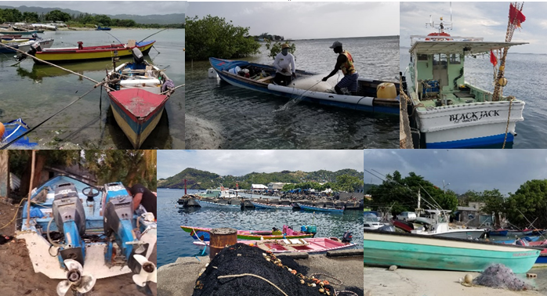
Opportunities, Assets & Challenges Value Chain Analysis – Resource Users and Fishing Households
On board refrigeration, processing requirements, infrastructure needs and consumer demand are influenced by type and amount of catch
Crew composition has a community dimension, also reflected in wage-sharing
For most full-time fishers, fishing contributes 100% to their monthly household income
The independence and the daily wage are draws to fishing, compared to salaried occupation
Finance for fishing operations mainly comes from relatives, also loans from cooperatives and credit unions
Fishers are content with their returns and for no reason want to change occupation nor be retrained to other professions
Most fishers rely on their meagre savings, kinship ties, as well as cooperative schemes to manage losses. Social security and insurance are options younger fishers explore
Notes:
====
Notes:
[Because these results are based on case study research, we recommend using these points to elicit discussion with your target audiences. A first step might be to engage your audience in a discussion on which of the points sounds familiar (or are commonly exhibited in their community / constituency). Next, engage your audience in a discussion focused on exploring whether the identified attributes make the community vulnerable or confer resilience.]

Slide 16
Opportunities, Assets & Challenges Value Chain Analysis- Resource Users and Fishing Households
Demographics influence adaptation options available to fishers
Older fishers face challenges exiting to other industries, so diversification focuses on coastal and marine economic activities
Younger fishers are more tech savvy, can use ICTs in business development, marketing and take advantage of early warming systems
Financial literacy and support for start-ups can help new generations of fishers become both marine stewards and entrepreneurs
Fishers identify FADs as a good way to adapt to climate change
Good catch, less time at sea, and low operational cost especially fuel consumption
Strengthening collective action and cooperation frameworks also has potential
Secure markets (e.g., through partnerships with vendors)
Improve political representation
Explore collective bargaining options
Increase access to finance (e.g., micro-credit)
Address power asymmetries across the value chain (e.g., price setting, seasonality, storage facilities)
Notes:
====
Notes:
[Because these results are based on case study research, we recommend using these points to elicit discussion with your target audiences. A first step might be to engage your audience in a discussion on which of the points sounds familiar (or are commonly exhibited in their community / constituency). Next, engage in discussion about the potential applicability of adaptation actions and measures highlighted by resource users in value chain research.]

Slide 17
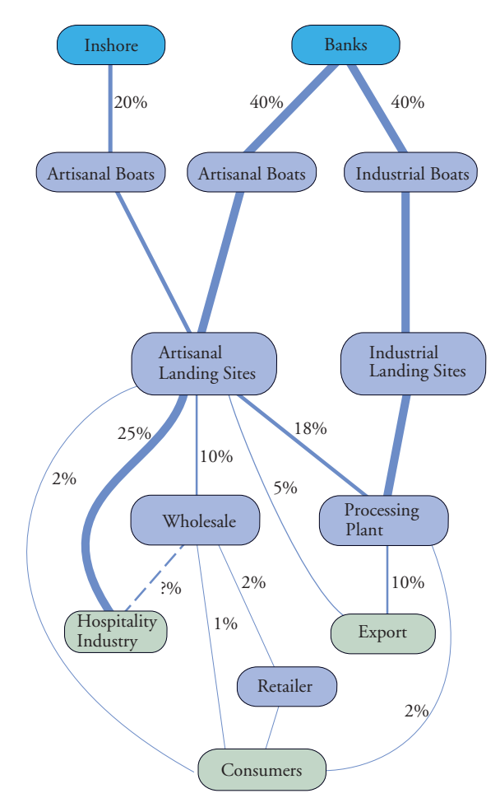
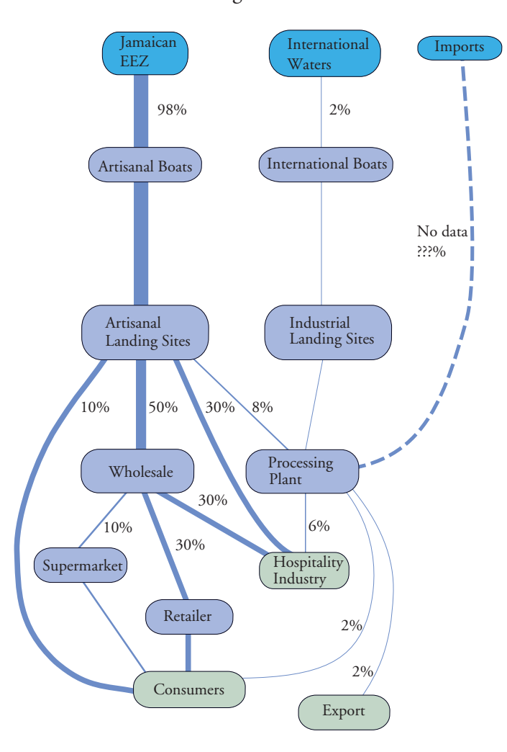
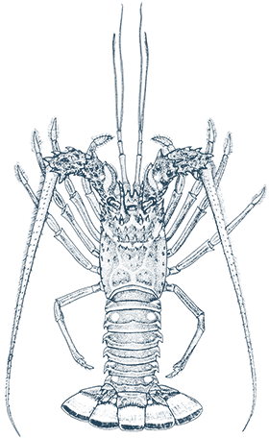
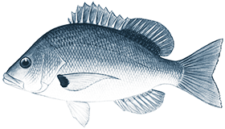
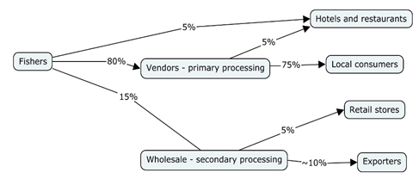
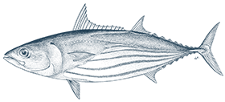
Opportunities, Assets & Challenges Value Chain Analysis – Post-Harvest Activities
Seafood trade is mostly within regional markets as well as with the United States and Canada (mostly for imports)
Two value chains identified:
Short value chains with limited product differentiation (SVG)
Value chains with multiple actors and mechanization (Jamaica)
Lobster
Offshore pelagic
Notes:
Value chain research revealed 2 different types of value chains: (1) short value chains with limited product differentiation, such as the one reflected in the bottom left of the slide and (2) semi-industrial value chains with multiple actors and some mechanization, such as the ones show on the right of the slide.
With about 36 landing sites and about half of that on Saint Vincent, most of the catch is taken to Kingstown due to limited storage and processing infrastructure at other landing sites. The Kingstown Fish Market is a hub for landing fish, reporting catch statistics, as well as processing and having weekly seafood displays and vendors. About 80 to 90% of the local catch harvested goes through vendors with limited value addition and high level of post-harvest spoilage. The 10 to 20% that goes through the Fish Market is sold frozen, often filleted according to retail needs and in the form of weekly supplies to supermarket chains focusing on larger pelagics such as swordfish, barracuda, skipjack tuna and snapper.
In Jamaica, the fish chain is multi-faceted depending on the fish species, ecosystems in which fishing takes place, targeted markets and enabling policy environment for local consumption or export markets. Currently, fishers are interested in a wide variety of commercial species of importance including snappers, parrotfish, conch, kingfish, dolphinfish, lobster and, to some extent, sea cucumbers. The value chain can be very short involving direct sales to households, such as for snappers or lobsters to the hospitality industry. For other commercial species destined for export markets such as conch, the value chain can be longer including brokers, processors, retailers, traders and/or exporters and with mechanized infrastructure. A key feature in Jamaica’s fish chain is the location and operations of one of the largest seafood processor and retailer in the Caribbean: Rainforest Seafoods. Rainforest Foods also has major processing infrastructure and operations in Saint Lucia, Belize and Barbados, with planned operations in Saint Vincent and the Grenadines.
====
Notes:
[The fish species shown on this slide are as follows: Dolphinfish, blackfin snapper, skipjack tuna (SVG value chain) and dolphinfish, blackfin snapper, lobster (Jamaican value chain)

Slide 18
Opportunities, Assets & Challenges Value Chain Analysis – Post-Harvest Activities
Challenges of disconnected and fragmented value chains (Kingstown, Saint Vincent and the Grenadines)
Operational risk
Fuel costs for longer trips not matched by an increase in landed value
Vendors need to adjust inputs, processing and warehousing requirements during supply gluts
Post-harvest spoilage and loss
80 to 90% of local catch goes through vendors with limited value addition
After processing into fillet, about half of the fish are discarded
Notes:
====
Notes:
[Because these results are based on case study research, we recommend using these points to elicit discussion with your target audiences. A first step might be to engage your audience in a discussion on the challenges noted on the slide and what their implications might be for vulnerability to climate change. What opportunities might there be to increase adaptive capacity and resilience?]

Slide 19
Opportunities, Assets & Challenges Value Chain Analysis – Post-Harvest Activities
Issues in sustaining semi-industrial value chains (Jamaica)
An enabling environment for private-sector action
Corporate strategies that integrate product innovation marketing and financing (e.g., attendance at seafood expos, use of brokers)
Accredited laboratories for product testing in conformance with quality and food safety standards
Vessel monitoring and other systems that support traceability and chain of custody rules
Attention to small-scale processing and value addition
Access to finance for small-scale ventures (e.g., processing infrastructure)
Training in social innovation skills (e.g., leadership)
Notes:
====
Notes:
[Because these results are based on case study research, we recommend using these points to elicit discussion with your target audiences. A first step might be to engage your audience in a discussion on the issues noted on the slide and what their implications might be for vulnerability to climate change. What opportunities might there be to increase adaptive capacity and resilience?]

Slide 20
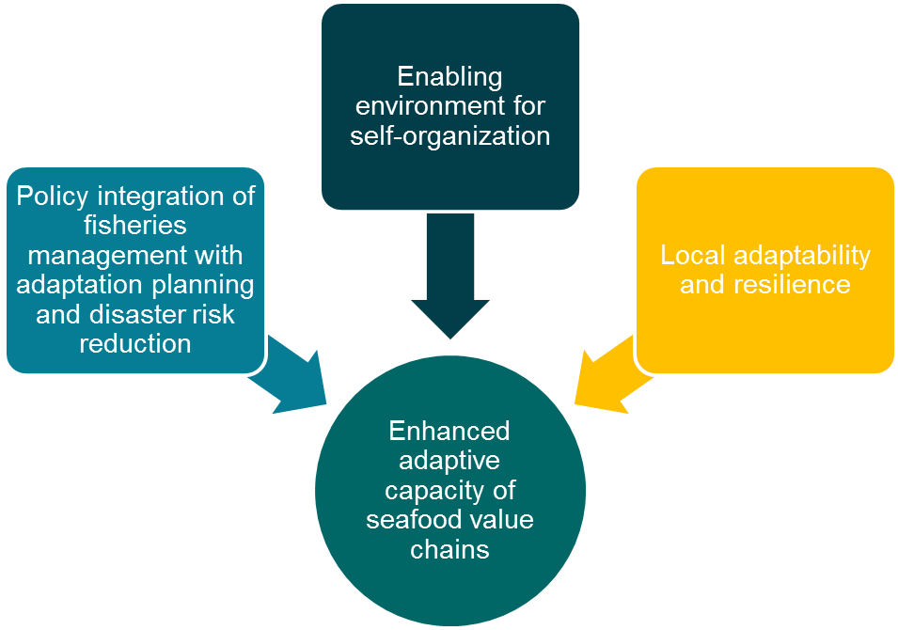
Opportunities, Assets & Challenges Value Chain Analysis – Future Policy Directions
Principles and priorities of the Code of Conduct for Responsible Fisheries addressed within the National Adaptation Plans
Heightened importance of Regional Fisheries Organizations (RFOs) and other complementary regional institutions in sustainable management of fisheries stocks given climate-driven shifts in distributions
Access to insurance and micro-credit through cooperatives and co-management arrangements to support small-scale fisheries
Policy brokerage by NGOs to foster stewardship and branding opportunities
Marketing boards, price-setting panels or a joint associations of fishers and processors for improved margins across the value chain
Harnessing local cooperatives for inclusive multi-user coastal plans and as incubators for community enterprise development , environmental stewardship and emergency preparedness & response
Notes:
Having identified value chain dynamics in the two study sites, this slide offers future policy directions in support of climate smart seafood value chains in the region. Policy directions stem from three inter-related pillars: adaptation mainstreaming, an enabling environment and empowering local action.

