Slide 1
Module 1: Climate Change
PRESENTERS
Location, Date
Produced by ESSA Technologies Ltd. for the Investment Plan for the Caribbean Regional Track of the Pilot Programme for Climate Resilience

Slide 2
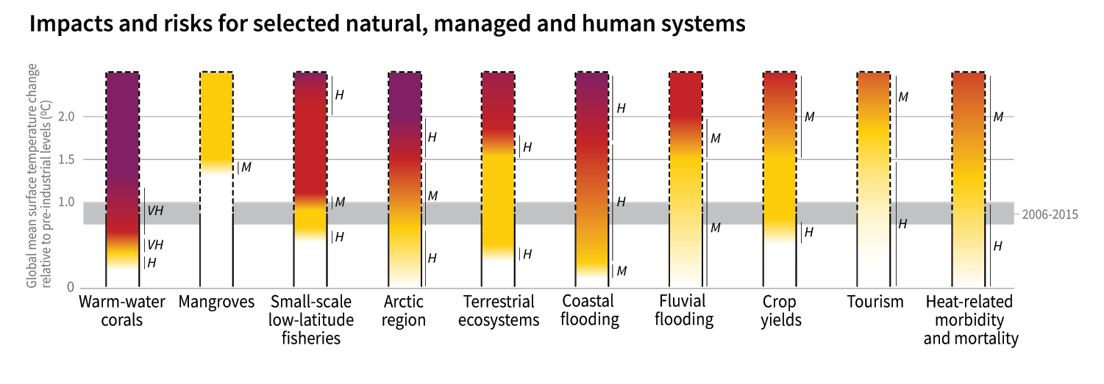
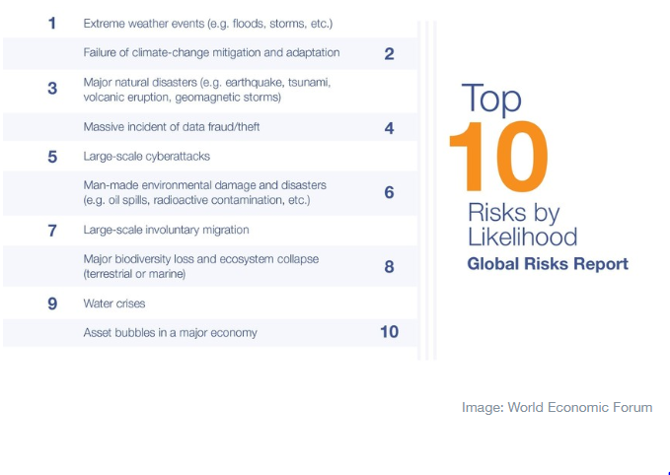
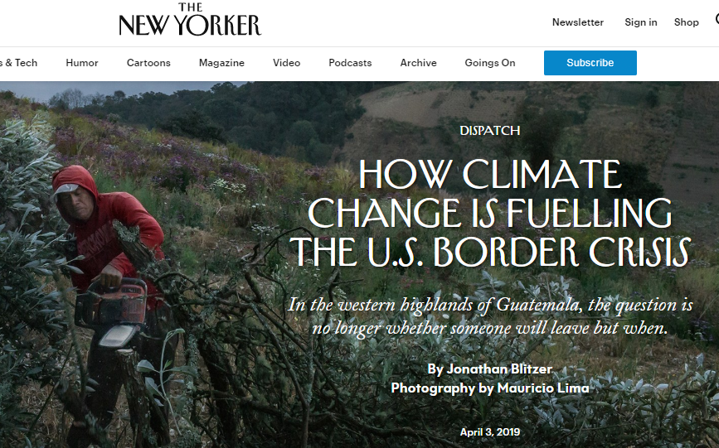
Notes:
Global climate change is one of the biggest challenges facing humanity. The scientific evidence that the global climate is changing and that the changes seen since the mid 1900s are caused by human activity is now unequivocal. Climate change, its impacts and responses, is no longer an issue subject to scientific advances but a top of mind issue for global economic and business affairs; it has also permeated popular discourse.
Climate change demands two responses: greenhouse gas mitigation and adaptation. This means we need cooperative action at the global level to avoid the unmanageable and action at the local level to manage the unavoidable.
This module is an introduction to the basics of global climate change.
====
Notes:
[The top figure is from IPCC AR5 and shows a range of severe impacts of climate change and degree of confidence in their occurrence]
[The figure at the bottom right is from the World Economic Forum, showing that 5 of 10 top risks published in the WEF Global Risks Report are related to climate change.]
[The figure at the bottom left is a news story in The New Yorker, about an increasing concern – the prospect of widespread population displacement due to the impacts of climate change.]

Slide 3
Objectives
Introduce key concepts related to climate change (weather, climate, variability and change)
Define climate change
Explain the enhanced greenhouse effect and climate change
Highlight impacts, consequences and uncertainties
Identify main domains of response – mitigation and adaptation
Notes:
====
Notes:
[The slides in the module are designed to address the listed objectives. You can revisit the objectives and contents based on your own target audience, their levels of knowledge, interests and motivations.]

Slide 4
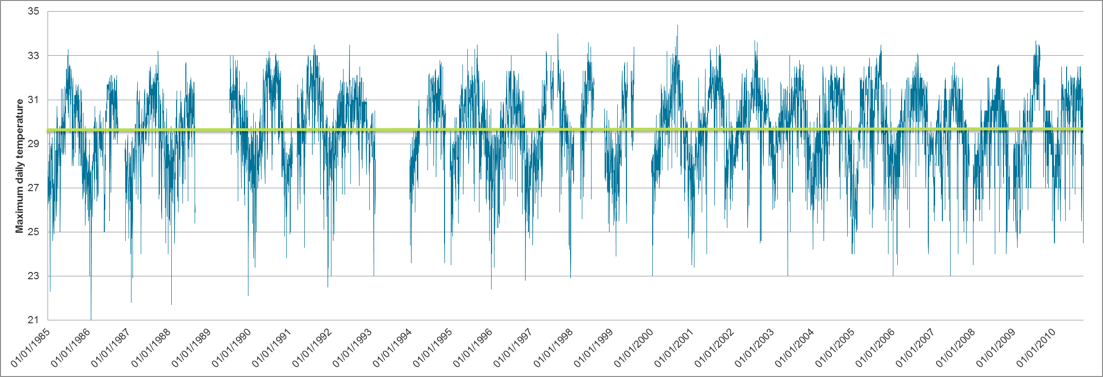
Weather? Climate?
Weather is a short-lived condition you experience (rain, humidity, temperature) at a specific time and place; it changes minute-to-minute, hour-to-hour, day-to-day, and season-to-season
Climate is the average weather over time (30 years or more) for a particular region
Climate is what you expect, but weather is what you get…
Weather = blue wiggles; climate = green line
Notes:
Weather differs greatly from climate. We must not confuse the two. Weather is short-term, daily type of events, whereas climate refers to longer term “averages” of weather. A short term event or “weather” event may not at all be representative of the longer term climate.
====
Note:
[The graphic is a plot of a time series of maximum daily temperature (degrees Celsius) between January 1, 1985 and December 31, 2013 at Worthy Park, Jamaica. There are a few gaps in the dataset.]

Slide 5
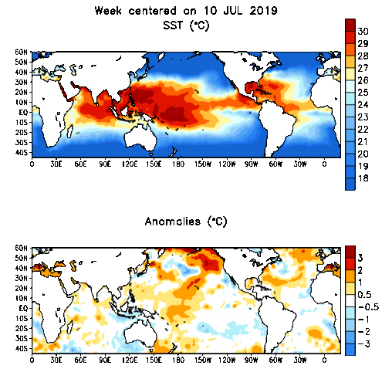
What is climate variability?
Natural fluctuations (of rainfall, temperature, winds…) above or below the average climate
Time scales of seasonal, annual, decadal
They are largely unpredictable!
El Nino/Southern Oscillation (ENSO)
Madden Julian Oscillation (MJO)
North Atlantic Oscillation (NAO)
Image Source: National Oceanic and Atmospheric Administration (NOAA)
Notes:
Although the general historical trend in climate conditions has been changing, there is great seasonal, year to year and decadal natural variability. These figures show the differences in sea surface temperature at a point in time around the world (top figure) and how they can be below or above long –term average conditions (so called “anomalies”) (bottom figure).
There are many different climate cycles which have been identified – each with different effects globally. Perhaps the most well known is the El Nino/ENSO climate cycle. Others are shown here. These cycles vary in how long they last from months to years and as a result in some years they ‘add up’ to produce large changes, whereas in other years they cancel their effects out. These cycles affect our weather patterns and if they persist can affect several years consecutively.
There is still a great amount of research required to fully understand these cycles. They cannot be forecast even in the short term, let alone with any confidence under future climate change.

Slide 6
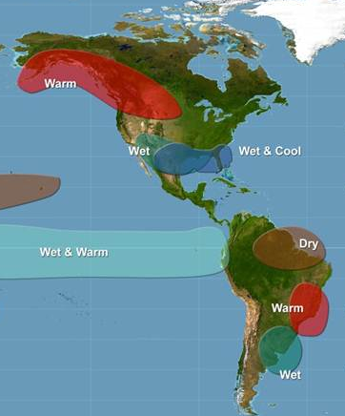
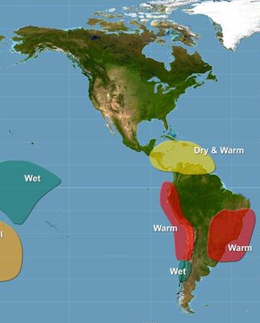
Example: El Niño/La Niña Cycle (ENSO)
Winter - December to February
Summer - June to August
Not much influence – near normal
Drier and warmer conditions
Source: NOAA
Notes:
As a specific example, the most well-know El Nino/Nina cycle has been associated with specific climate conditions globally. This graphic shows how the El Nino cycle can affect Central America and the Caribbean. In the winter little signal is found, whereas in the summer warmer and drier than normal conditions are found.
There has been some research which suggests the frequency of the El Nino phase may change under climate change in the future, but this is still an active research area.

Slide 7
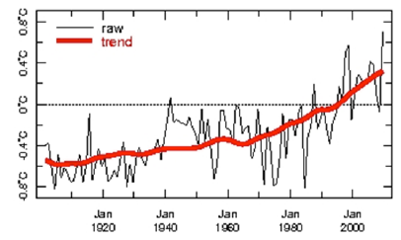
What is climate change?
Climate change is defined as:
Any change in climate over time, whether due to natural variability or as a result of human activity (IPCC).
Changes in average and variability of the climate, persisting for an extended period of time (typically decades or longer).
The best way to assess longer-term change is through the averaging of many years (World Meteorological Organization “normals” period is 30 years)
Source: CSG-UWI Mona
Notes:
Climate change describes long-term changes in the climate (persisting typically decades or longer). Both natural variability and human activities can cause climate change. The World Meteorological Organization and other scientific agencies use 30-year averages of climate parameters to track climate change.
====
Notes:
[The figure on this slide is the average July-October temperature anomalies (degrees over or below “normal” conditions) over the Caribbean from the late 1800s with a trend line imposed. According to researchers at the Climate Studies Group at UWI Mona, the linear trend explains 54% of patterns in the data, 17% of the pattern is explained by decadal variability and 20% by year-to-year fluctuations.]

Slide 8
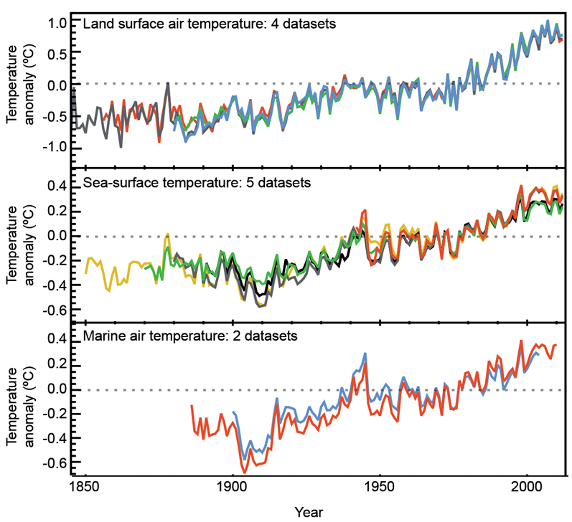
Independent lines of evidence show that the global climate is changing
Since 1880, global average temperatures (air and sea) have ⬆0.85˚C
Source: Stocker et al. (2013)
Notes:
Independent lines of evidence collected by scientists and engineers from around the world tell an unambiguous story: the planet is warming.
Humans began tracking temperatures in the mid-1800s. Since 1880 global average (air and sea) temperatures have increased by 0.85 [0.65 to 1.06] °C. Since the 20th century, almost every decade that goes by is warmer than the previous one. The figures here show global trends in surface temperatures (land surface, sea surface, marine surface).

Slide 9
https://youtu.be/gXXOkhoki8s
This video is a color-coded map displaying the progression of changing global surface temperature “anomalies” from 1880 through 2018.
Anomalies refer to values higher or lower than normal.
Higher than normal temperatures are shown in red and lower than normal temperatures are shown in blue.
Source: NASA

Slide 10
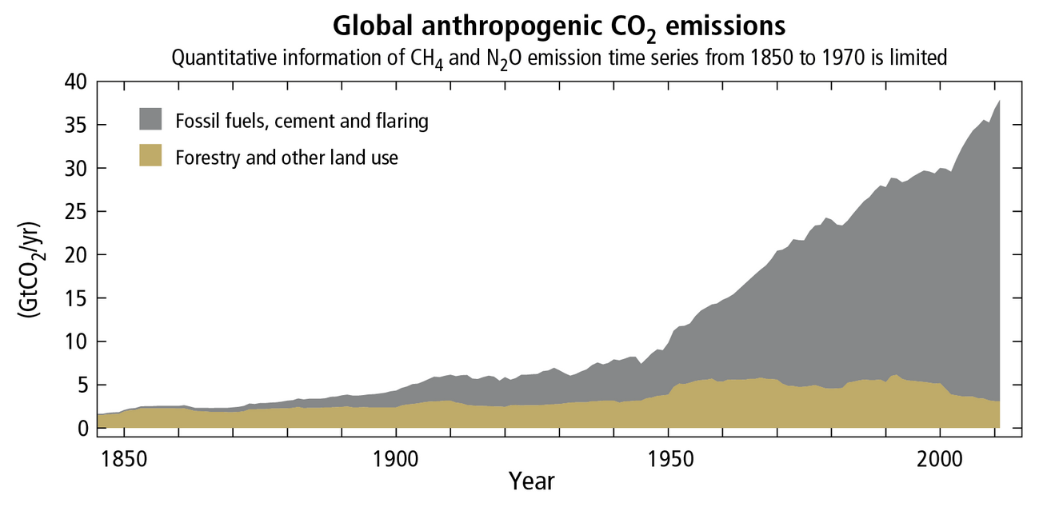
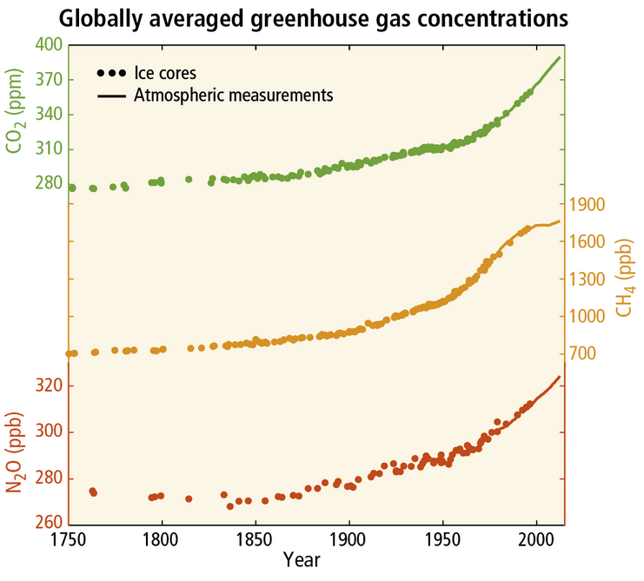
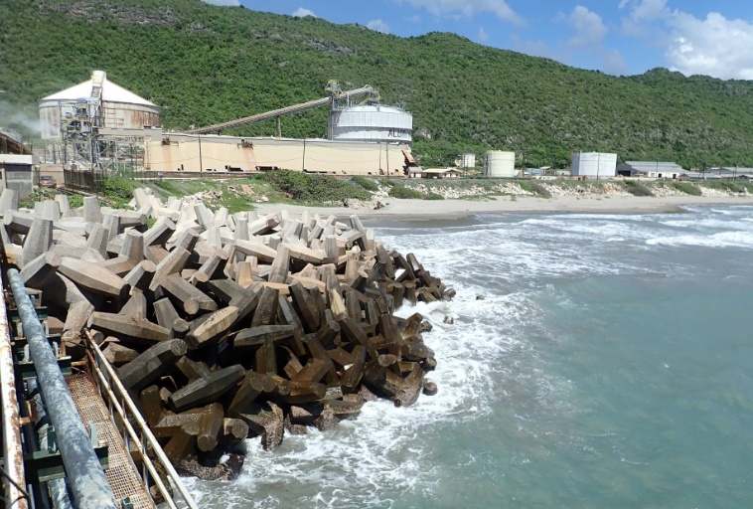
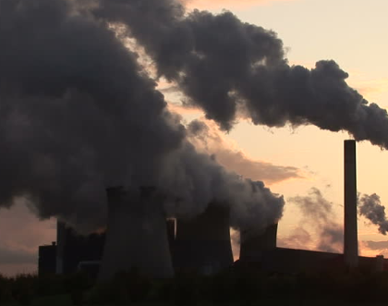
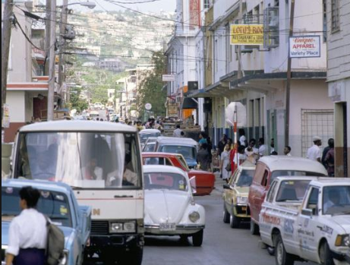
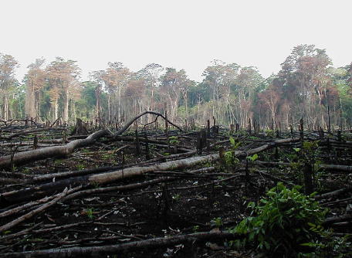
Why is climate changing?
A build up of greenhouse gases in the atmosphere is causing global warming
Notes:
Concentrations of trace gases found in the earth’s atmosphere, called greenhouse gases, have increased progressively over the past century. GHGs include carbon dioxide, methane, nitrous oxide and a range of halocarbons.
Direct measurements of carbon dioxide are available from 1958 on (for methane and nitrous oxide only since the 1970s) and atmospheric levels of GHGs from the distant past have been reconstructed through methods such as analyzing air bubbles trapped in ice sheets. Prior to the industrial revolution, the proportion of carbon dioxide in the atmosphere was about 280 parts per million by volume. Today we are just over 400ppm. GHG concentrations are the highest they have been in the last 800,000 years. [See figure on the left of the slide.]
What produces GHG? Burning of fossil fuels, cement production and deforestation release CO_{2.} Rice and livestock agriculture, biomass burning and landfills release methane (CH₄). Burning of fossil fuels and using agricultural fertilizers release N₂O (nitrous dioxide).
The figure to the right of the slide shows trends in global greenhouse gas emissions from human activities, singling out the contribution of fossil fuel combustion, cement and flaring.

Slide 11
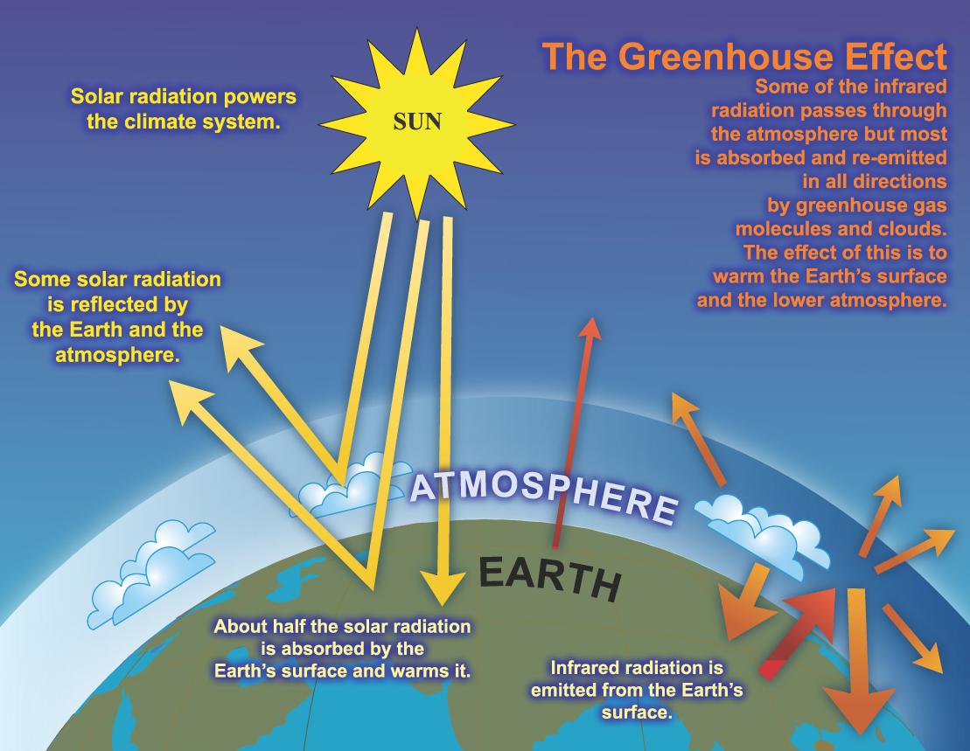
The Greenhouse Effect
Source: niwa.co.nz
Notes:
The physical mechanism that causes greenhouse gases to warm the atmosphere has been understood since the mid 1800s. About 30% of the Sun’s energy is reflected back into space by clouds, dust and haze. The rest is absorbed by the Earth’s surface and warms it. The warmed surface emits energy as infrared radiation, a form of light invisible to humans. Some of this infrared radiation passes through the atmosphere into space. Most if it is absorbed and re-emitted in all directions by greenhouse gases and water vapour, warming the Earth’s surface and lower atmosphere to warm. Greenhouse gases and the natural greenhouse effect make the Earth livable; without them the Earth would be about -18°C on average.

Slide 12
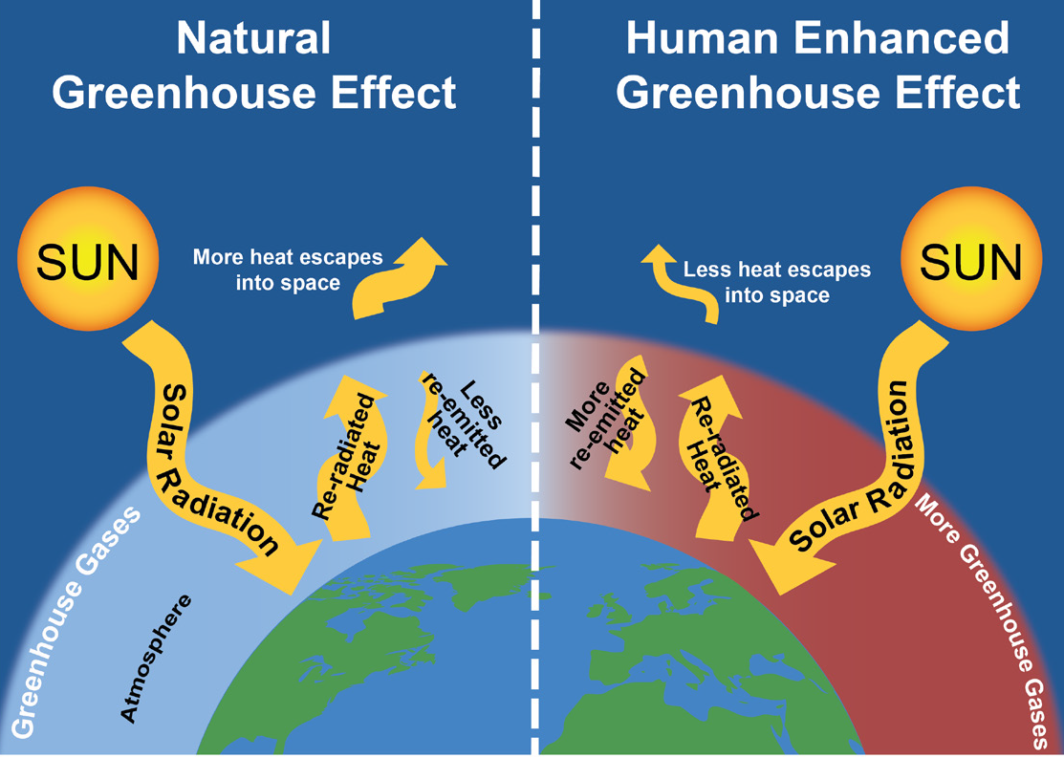
An Enhanced Greenhouse Effect
Source: Center for Sustainable Systems, University of Michigan
Notes:
The natural greenhouse effect is the mechanism that keeps the Earth’s surface livable. However, excess concentrations of GHGs in the atmosphere means that more infrared radiation is being absorbed, more heat is being trapped than under balanced conditions, causing global warming. This is called the human-enhanced greenhouse effect.

Slide 13
Rising temperatures and GHGs in the atmosphere lead to many other changes
Source: US National Climate Assessment 2018
Notes:
Although a 0.85°C rise in global average air temperatures might seem like a small change, on a global scale this is enough to create significant impacts on global climate patterns. According to the laws of physics, a warming atmosphere would bring with it changes in other physical and biological systems. And they are indeed happening. The diagram on this slide shows changes in a range of climate indicators that are being observed, beyond a rise in air temperatures.
**Warmer ocean: The Earth is gaining heat and much of it is going into the ocean. Between 1971 and 2010, ocean surfaces (upper 75m) on a global scale have warmed by 0.11 [0.09 to 0.13] °C per decade.
**More acidic ocean: Since the onset of the industrial era, oceanic uptake of CO2 has changed ocean chemistry. The pH of ocean surface water has decreased by 0.1 (high confidence) or 26% increase in acidity, measured as hydrogen ion concentration.
**Sea level rise: Between 1901 and 2010, global average sea levels rose by 0.19 [0.17 to 0.21] m (or 1.7mm per year on average). The expansion of water as it warms, and the melting of glaciers, ice caps and the polar ice sheets are all contributing to the rise.
**Increased humidity and changes in rainfall patterns: It is very likely that global near-surface and middle atmosphere air specific humidity has increased since the 1970s. Warming results in changes in evaporation and precipitation. Precipitation trends are harder to measure than temperature trends. Indeed, regional data analysis show the variable trends across regions, with average annual precipitation increasing in some areas and decreasing in others.
Human-caused climate change is intensifying the global water cycle. Warming of the Earth’s surface and atmosphere results in changes in evaporation and precipitation, and in atmospheric circulation patterns that influence where rain falls. In general, warmer temperatures lead to greater potential evaporation of surface water, thereby increasing the potential for surface drying and increasing the amount of moisture in the air. As warmer air can hold more moisture, more intense precipitation events are expected.
There are two sides of climate change: long-term gradual changes in average conditions, like temperature and rainfall, and the increase in frequency and / or intensity of extremes. Scientists agree that changes in the mean (say temperature), as observed over the past decades, have consequences for the intensity and frequency of extremes, such as extreme heat, drought and intense storms.
**Shifting abundance and distribution of species: Observations from around the world show that many natural systems are being affected by regional climate changes, especially by rising temperatures. Plants and animals are adapted to their habitat’s climate conditions; life histories and predator-prey interactions are finely tuned to seasonal weather. Changing climate conditions is throwing these relationships out of balance.

Slide 14
Rising temperatures and GHGs in the atmosphere lead to many other changes
Physical indicator | Trend | Timeframe
Ocean temperature | +0.11°C / decade | 1971-2010
Ocean chemistry | +26% in acidity due to uptake of atmospheric carbon | Since 1750
Air humidity | Increase | Since 1970s
Average annual precipitation | Regionally variable | Since 1970s
Arctic and Antarctic sea-ice extent | Net loss | Since 1978
Mountain glaciers | Widespread retreat | 1900
Antarctic and Greenland ice sheets | Loss in mass | 1992-2011
Sea level | +1.7mm / year | 1901-2010
Source: IPCC, Stocker et al. (2013)
Notes:
Notes:
[This slide is another way of representing some of the observed changes depicted in the previous slide.]

Slide 15
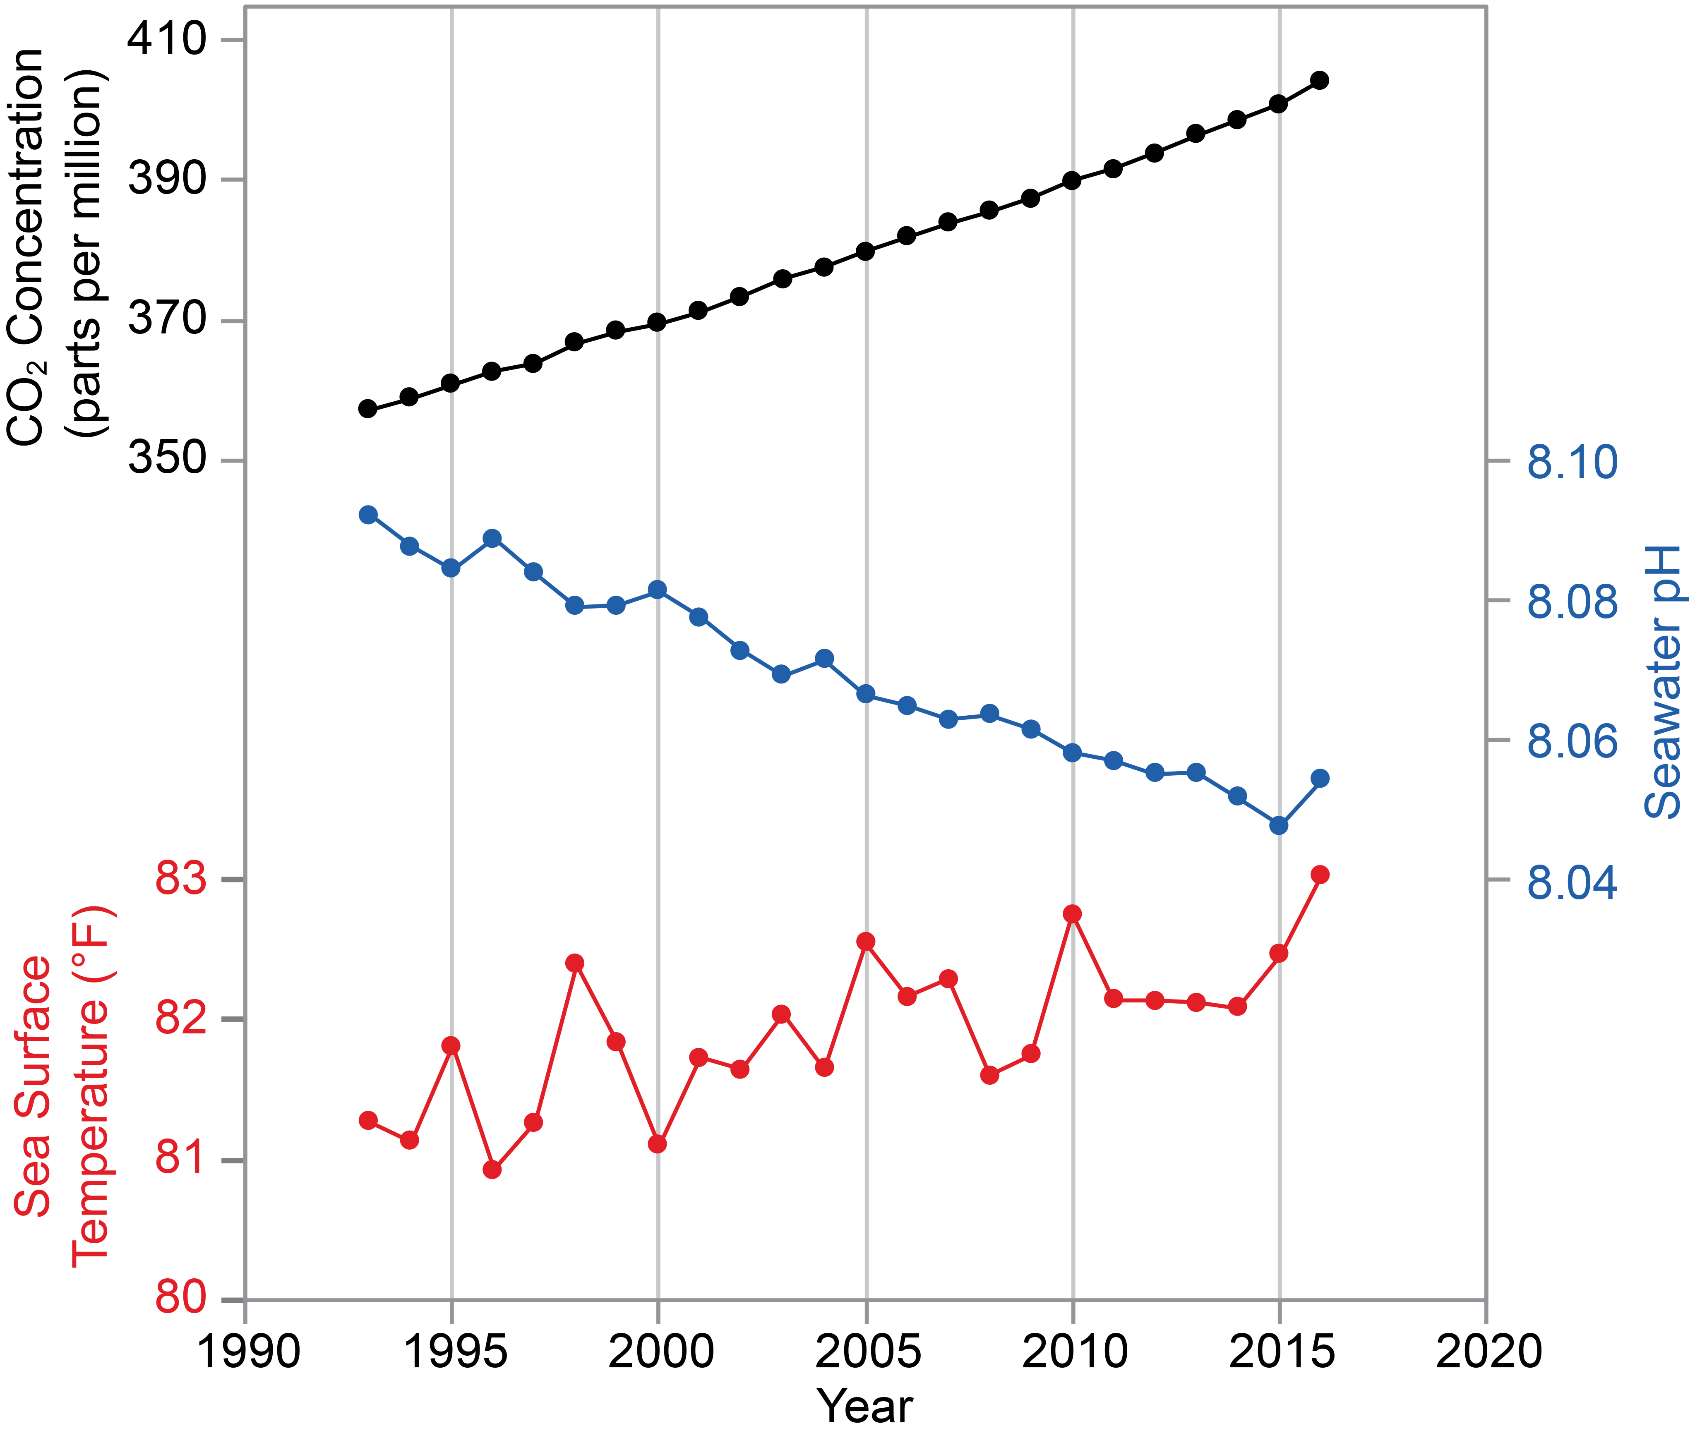
Carbon dioxide from human activities are changing the Caribbean sea
Source: US National Climate Assessment 2018
Notes:
Noteworthy for the fisheries sector is how human-caused climate change is affecting the Caribbean Sea, making it warmer and more acidic.
This figure represents shows annual data from 1993 to 2016 of atmospheric carbon dioxide (CO2; black line) , sea surface temperature (red line), and seawater pH (blue line) for the Caribbean region. Atmospheric CO2 concentrations are changing surface pH and temperature of the Caribbean sea. Oceans have the capacity to absorb heat from the air (leading to ocean warming). They also absorb some of the CO2 in the atmosphere through chemical reactions, leading to more acidic conditions (i.e., lower pH) in oceans. Continued ocean warming and acidification is a key concern for the fisheries sector given the negative consequences for marine life and coastal communities in the Caribbean islands that depend on these resources.

Slide 16
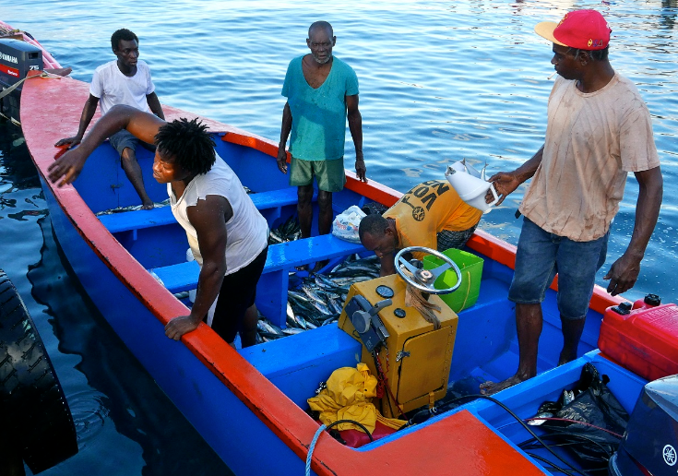
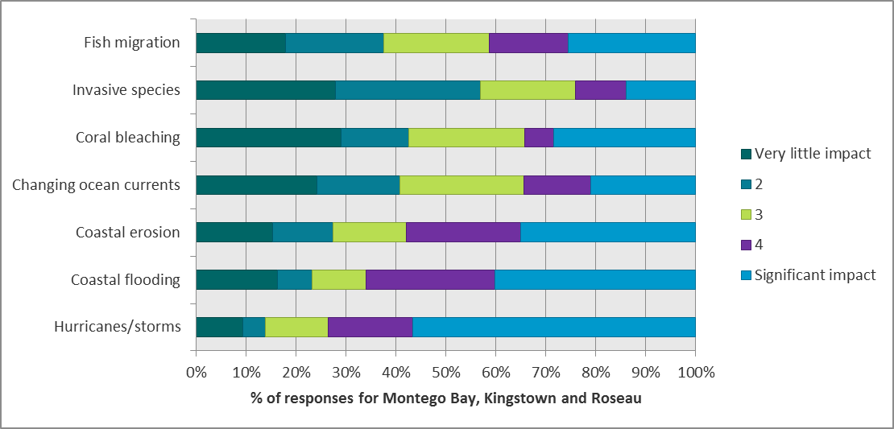
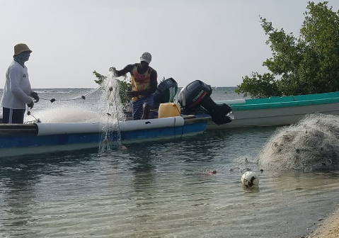
Local observations support the science
Kingstown
Roseau
Montego Bay
Notes:
Communities with attachment to place and strong dependence on land, water, plants and animals for their livelihoods and well-being are also observing changes in climate indicators and their effects. This slide shows perspectives of 157 fishers in Montego Bay, Kingstown and Roseau in response to the question “on a scale of 1 to 5, how much would you say the following climate hazards have negatively affected your community / fishing area?”

Slide 17
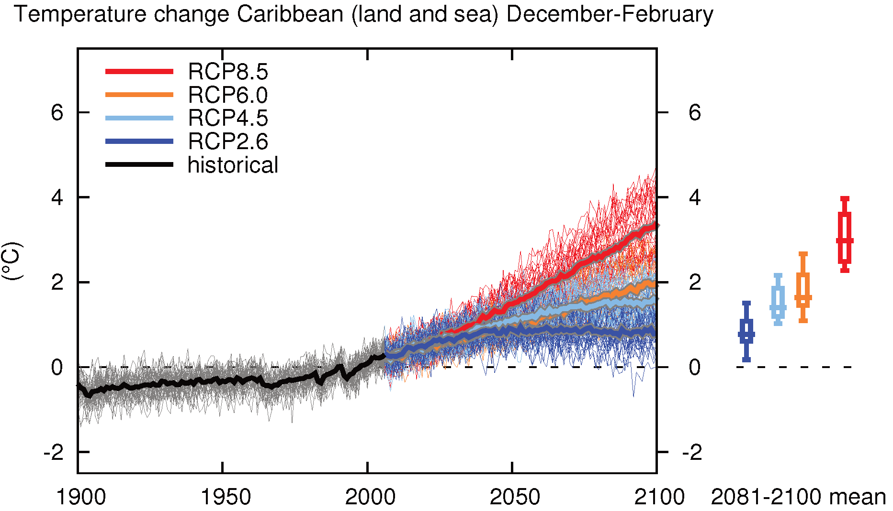
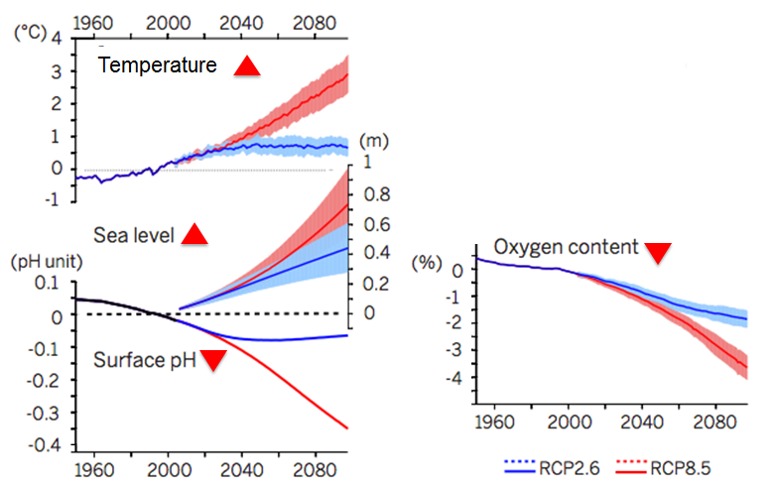
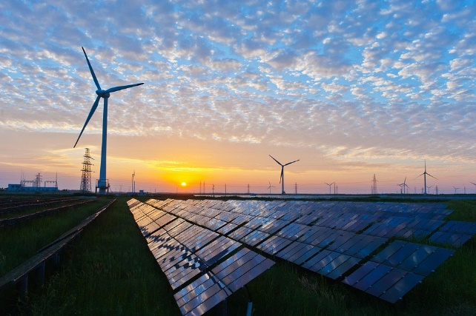
What is the future outlook?
Minor reductions (RCP8.5)
Paris commitments (RCP4.5)
Paris goal (RCP2.6)
Sources: IPCC 2018 (WGI); Gattuso et al. 2015 Science.
Notes:
The climate science community uses a suite of models to inform decision makers on future climate. Among the most widely used are GCMs (Global Climate Models), which are simplified but rigorous mathematical descriptions of important physical and chemical processes governing climate, including the role of the atmosphere, land, oceans, and biological processes. To make projections of future climate, scientists need assumptions about GHG emissions trajectories from human activity, based on known drivers of GHG emissions (population size, economic activity, lifestyle, energy use, land use patterns, technology and climate policy). In its recent science assessment the IPCC used Representative Concentration Pathways (RCPs), which describe four different 21st century pathways of GHG emissions and atmospheric concentrations, air pollutant emissions and land use. The RCPs include a scenario with deep cuts in GHG emissions (RCP2.6), two intermediate scenarios (RCP4.5 and RCP6.0) and one scenario with very high GHG emissions (RCP8.5). The figure at the top right of this slide show the results of dozens of modelling runs using different GCMs operated by research institutes around the world, for the four RCPs. It shows projected temperature changes in the Caribbean to the end of the century. The other three figures show projections for sea surface temperatures, sea level, surface pH and oxygen content in the Caribbean Sea to the end of the century for low emissions and high emissions scenario. Projections indicate continued rise in ocean warming, sea level rise, decreased pH and decreased oxygen content.
Given current GHG concentrations in the atmosphere and ongoing emissions of greenhouse gases, it is likely that by the end of this century, the increase in global temperature will exceed 1.5°C compared to 1850 to 1900 for all but one scenario (RCP2.6). Most aspects of climate change will persist for many centuries even if emissions are stopped today. The world’s oceans will continue to warm, ice melt will continue and sea levels will rise.

Slide 18
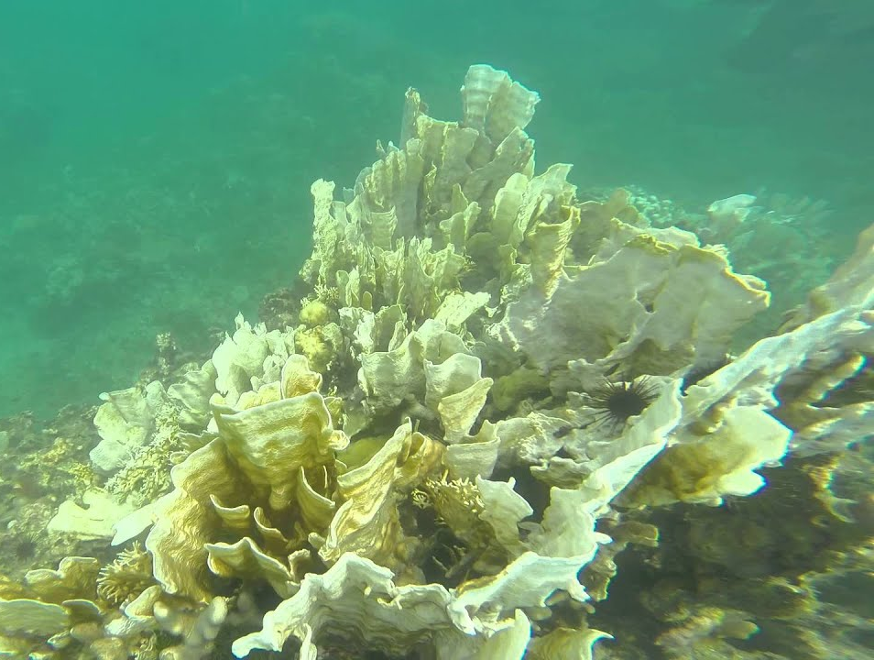
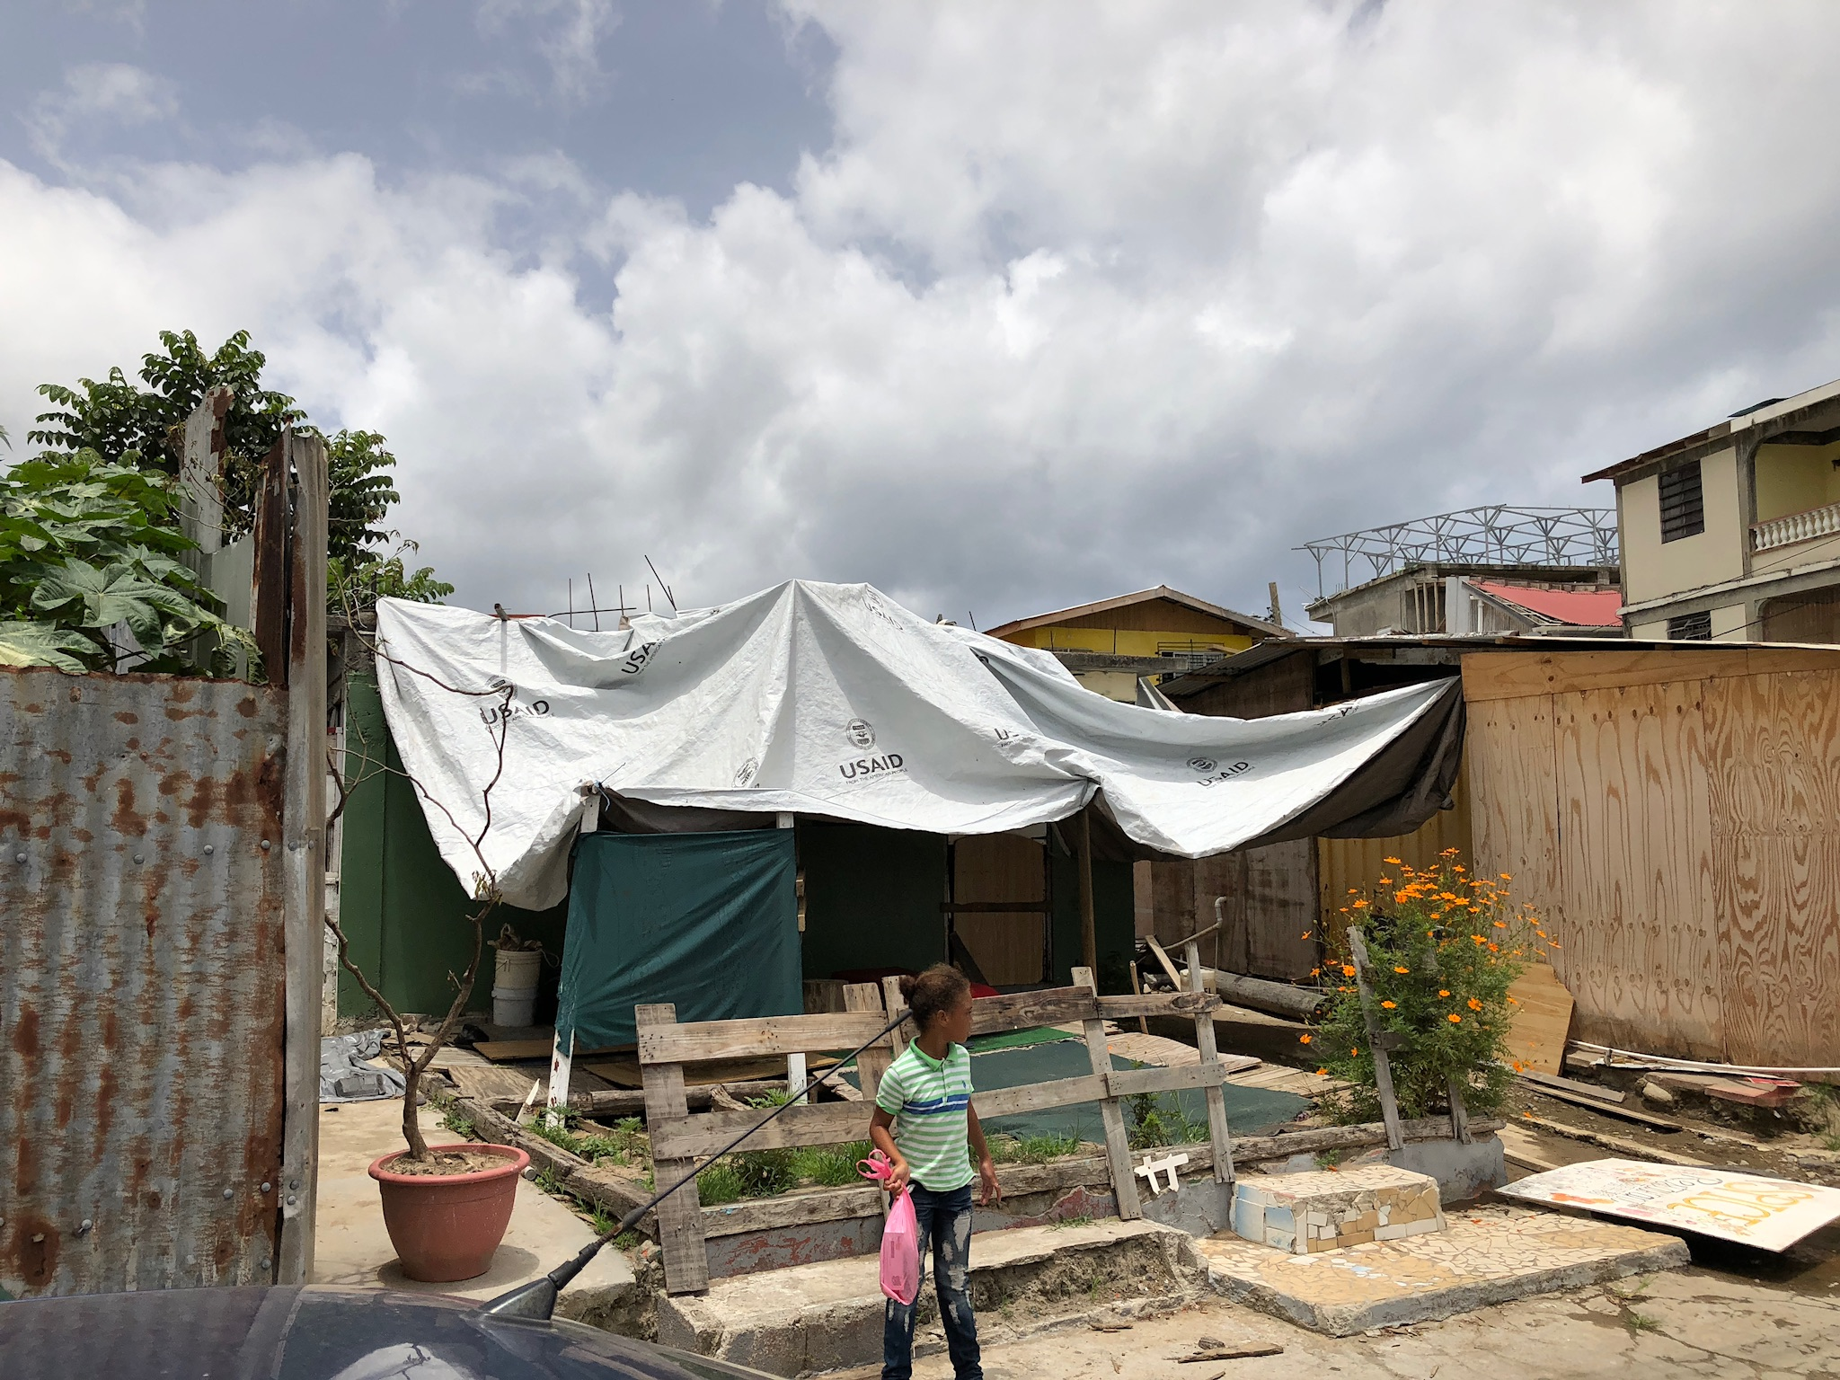
The concern is with the consequences
Degradation of coral and marine habitat
Shifts in abundance and distribution of marine species
Decline in productivity of natural-resource based livelihoods
Greater food insecurity
Water stress
Poor health (heat, disasters, diseases like malaria, nutrition)
Damage to infrastructure and other assets
Decreased tourism appeal
Migration
Photo credit: ReefCheck Foundation.
Notes:
Studying how climate indicators have changed and could change in the future under different emissions scenarios is essential, but policymakers, communities and businesses are most interested in understanding the ecological and socio-economic consequences of these shifts in climate. This is a list of some of the consequences of climate change that governments and communities in the Caribbean may be worried about. Can you list others?

Slide 19
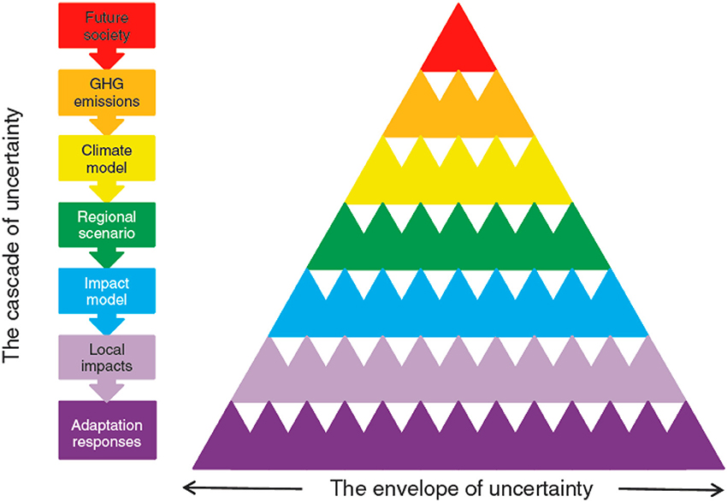
Why don’t we know exactly what will happen on the ground?
Sources: Wilby and Dessai, 2010.
Notes:
There are key sources of uncertainty in projecting the local impacts of climate change.
Staring from the top of the pyramid. We know that GHG emissions and increased carbon dioxide in the atmosphere cause climate change, but how much carbon will future society pump into the atmosphere, by when?
We know that more heat being trapped in the atmosphere, so the globe is warming up. But how sensitive is the global climate system? What are the tipping points and when might they occur?
We have global climate models which are good at global averages but they are not that good at extremes or at regional, national or sub-national levels
What other factors are at play locally that influence our understanding of local impacts of climate change? Urban heat islands? What about adaptive capacity? How does that influence how climate change impacts are felt and distributed?
An appreciation of these is important in planning and taking action. We need to become comfortable with uncertainty – just because we can say what will happen and by when does not mean this isn’t happening.

Slide 20
What do we do?
Mindshifts for climate action:
Changes are not only in the future (5 to 50 years). Climate change impacts are happening now
We need to think ahead NOW/TODAY for tomorrow
We can’t rely on the past to predict the future
Taking future climate into account in decisions and plans is necessary and possible
Notes:
The science is clear. The climate is changing and is affecting people and ecosystems around the world. So what do we do about it? An overall realization is that society’s relationship with the climate needs to shift, and with it our mental models about how we should behave. First, climate change is not some distant phenomenon or a future issue. Climate change impacts are happening now, including in the Caribbean. Second, although extreme events get a lot of attention because of their sometime destructive force, it’s also important to start preparing now for gradual and longer-term impacts. Third, we have grown accustomed to building our houses and infrastructure, deciding what to grow, and structuring our economies recognizing that climate varied within a known range - this is called stationarity. The reality is that the climate is continously changing and we are seeing conditions beyond historic experience. Therefore, we can’t use the past to predict the future. Finally, despite the uncertainty in projecting future climate and related impacts, we need to take these future considerations into account in decision making and planning. Examples in the region and around the world are emerging to show that this is possible.
====
Notes:
[To strengthen messaging related to the fourth point you could identify a specific example from your country or the region of a policy, plan or project that benefited from the use of climate information, e.g., climate proofed infrastructure.]

Slide 21
Two types of climate action
Mitigation
Strategies and measures to limit climate change by reducing emissions of greenhouse gases or enhancing carbon sinks.
Adaptation
Strategies and measures to manage the consequences of climate change.
Notes:
There are two responses to climate change: mitigation and adaptation. Effective climate action requires a portfolio of both types of responses.

Slide 22
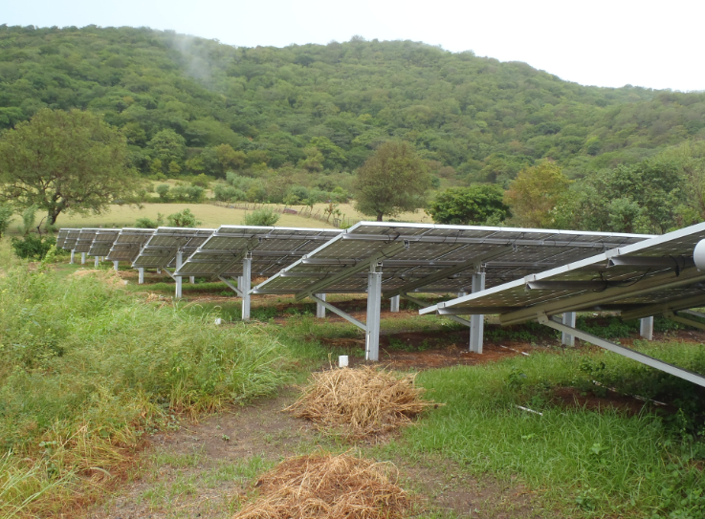
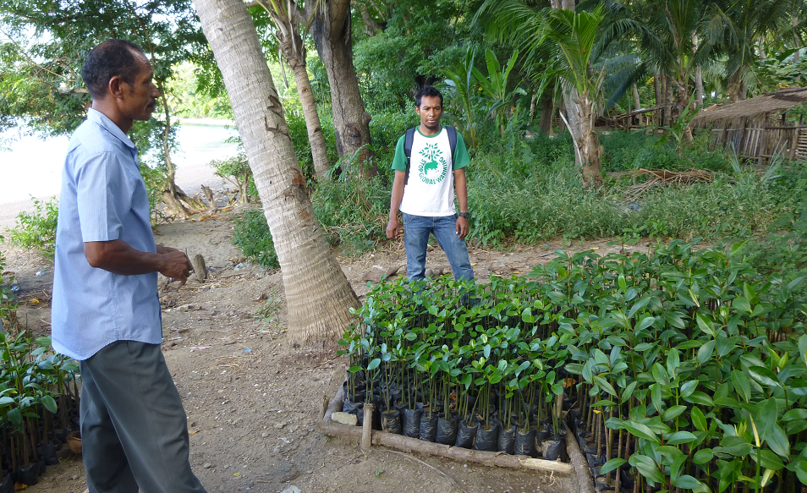
Mitigation
Avoid emissions – energy efficiency, alternative fuels and modes of transport, reduce deforestation
Remove emissions – tree planting, soil and land management, capture of CO₂ in geological formations
Photo credit: National Environment & Planning Agency, Jamaica
Notes:
Mitigation involves measures to avoid emissions of greenhouse gases or remove carbon dioxide from the atmosphere (also known as enhancing carbon sinks). This slide has a few examples of each kind of measure.

Slide 23
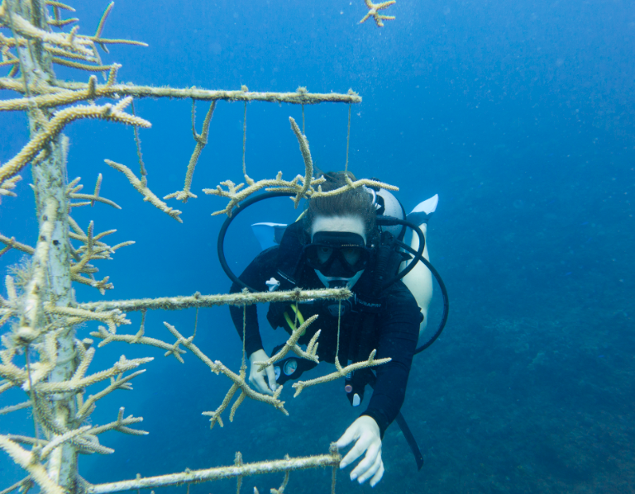
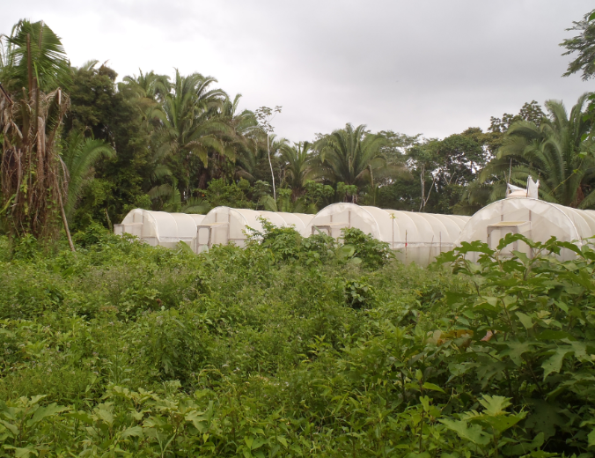
Adaptation
Adjustments in human and/or natural systems in response to actual or expected changes in climate to reduce adverse impacts or take advantage of opportunities
Notes:
Adaptation comprises shifts in behaviour or functioning in response to or in anticipation of changes in climate conditions. Natural systems, such as forests and fish populations, are adapting to climate change but may not be able to keep pace with the speed of climate change [the photo to the left is coral gardening]. In human systems, such as communities or economic sectors, climate change adaptation is necessary in about all aspects of life as we know it. [The photo to the right shows adaptation in farming systems, introducing covered cropping to reduce crops’ exposure to extreme heat and pests.]

